Slide 1

The Latest Buzz with G&C Accounting
Thursday, March 25th, 2021
2:00-3:30PM

Slide 2

Serena Simpson
G&C Systems Analyst Lead

Slide 3
Agenda
Topic | Presenter(s)
Welcome | Joshua Rosenberg
Research Trends | Joshua Rosenberg
General Updates | Joshua Rosenberg
Salary Cap | Joshua Rosenberg
F&A rate announcement | Jonathon Jeffries
Terminating Employee ASR | Jonathon Jeffries
GT RPT Cost Share Fund in Progress Report Discussion | Glenn Campopiano
Award and Grant Overview | Gabrielle Slappey
Workday Grants Reporting – SABER Overview | Serena Simpson
Workday Basics – Award, Award Line, Grant | Serena Simpson
PI Quick View | Serena Simpson
Workday Grants Reporting – Tips and Tricks, Demo | Serena Simpson
Helpful Reports | Serena Simpson

Slide 4
Josh Rosenberg, CPA
Senior Director of Grants & Contracts Accounting

Slide 5
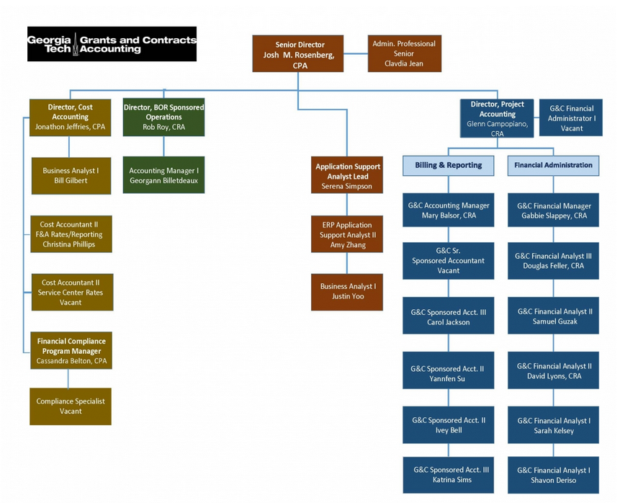
Grants and Contracts Accounting – Who We Are

Slide 6
Research Trends
Resident Instruction (through February):
  Proposals: up $102.50 million (10.8%) to $1.06 billion.
  Awards: up $17.71 million (6.8%) to $278.27 million.
GTRI (through February):
  Awards: up $113.23 million (27.2%) to $529.91 million.

Slide 7
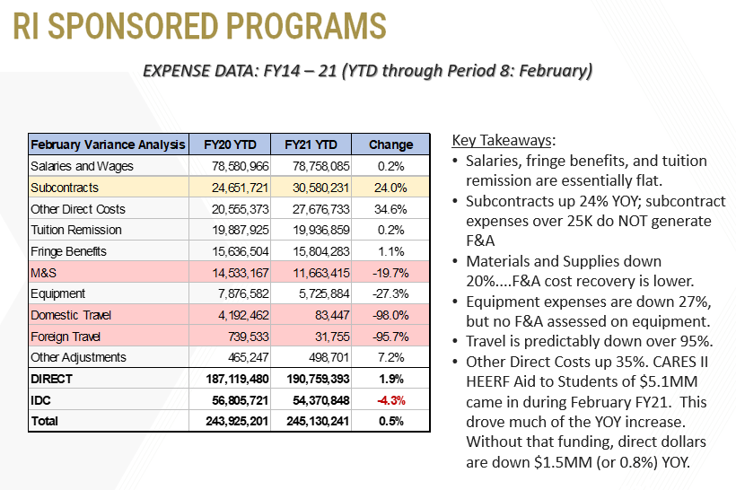
Research Trends

Slide 8
General G&C Updates
Invoices
  G&C is averaging $29.2 million in invoices during the first eight months of FY21 and has billed over $233.7 million during that time (versus $202.6 million through eight months last year)
Financial Reports
  669 total through 8 months.
Single Audit (FY20): Issued. Two findings:
  1. Application of NIH Salary Cap
  2. Subrecipient Monitoring
Policy Updates: Cost Transfers and many others
Next Buzz….Year-end Close

Slide 9
Salary Cap
Policies
IBS
Report
Cap Calculation
Cost Share Grants

Slide 10
Jonathon Jeffries, CPA
Director of Cost Accounting

Slide 11
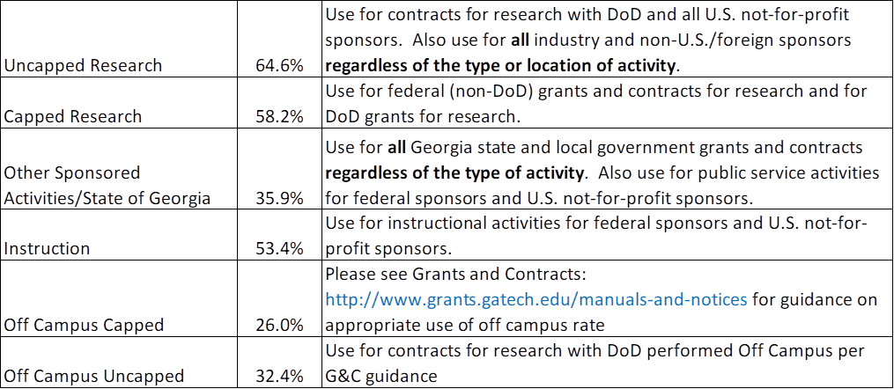
FY22/F23 F&A Rates
An update on FY22 fringe and tuition rates will be communicated once approved later in the fiscal year.

Slide 12
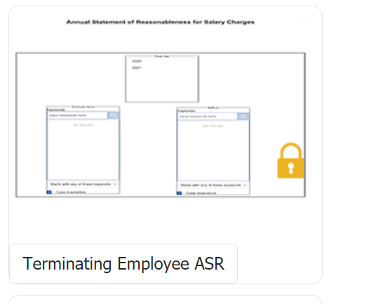
Terminating Employee ASR
Available on lite.gatech.edu under HCM tab

Slide 13
Terminating Employee ASR
Security similar to Ad-Hoc Salary Reports
Criteria is employee name or ID (one report at a time)
Returns actuals only (No Encumbrances)
No Validation of Termination Date in HCM
HCM does have a query for Terminating Employees

Slide 14
Terminating Employee ASR - Process
Establish a Term Date in OneUSG Connect
Run the Terminating ASR after the employee’s last payroll posts in OneUSG Connect
Employee and ASR Financial Manager must sign
Return to the easr.ask Help Desk
No First Hand Knowledge Accepted
Any Changes to Distribution will Void ASR

Slide 15
Glenn Campopiano, CRA
Project Accounting
Director of Project Accounting
Project Accounting Topics

Slide 16
Monitoring Cost Share
Review cost share budget in CS grant line for accuracy.
Budget your cost share funds via OneBudget.
Load or post cost share expenses timely.
Certify In-Kind cost share and send to G&C for posting. Sample letter found here: http://www.grants.gatech.edu/standard-forms

Slide 17
Monitoring Cost Share
Cost share burn rate should be similar to sponsored burn rate.
Best practice to review monthly – quarterly at minimum.
90 days from end date of award ensure you are on track to meet cost share.

Slide 18
Monitoring Cost Share
Cost share Grant lines can be viewed in SABER just like sponsored grant lines.
You can request multiple Cost Share grant lines if it helps you account for Cost Share more efficiently.
Sub-awardees having cost share should submit cost share with each invoice. Best practice to withhold payment until cost share provided.

Slide 19
Monitoring Cost Share
New WD report – GT RPT Cost Share Fund in Progress Report.
Will return a high level report on sponsored & cost share progress.
Run similar to Saber, by cost center, by PI, by Sponsor, etc.
Returns lines by awards with cost share.
Last column indicates cost share percent met.

Slide 20
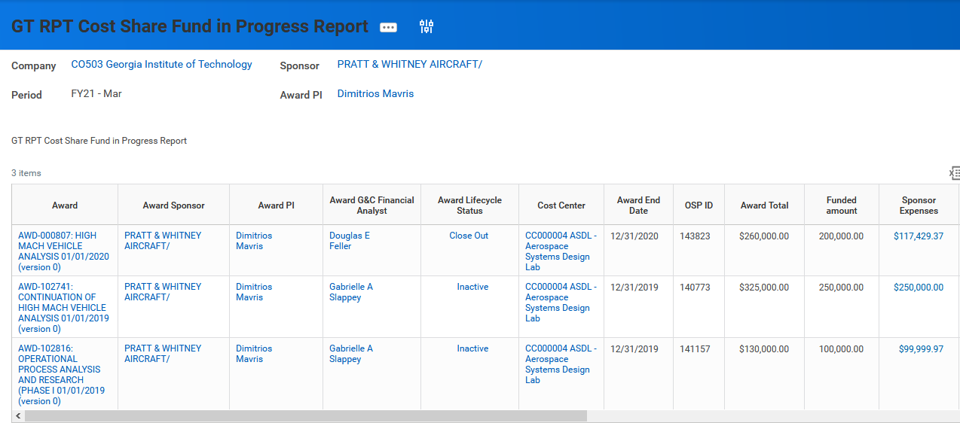
Monitoring Cost Share

Slide 21
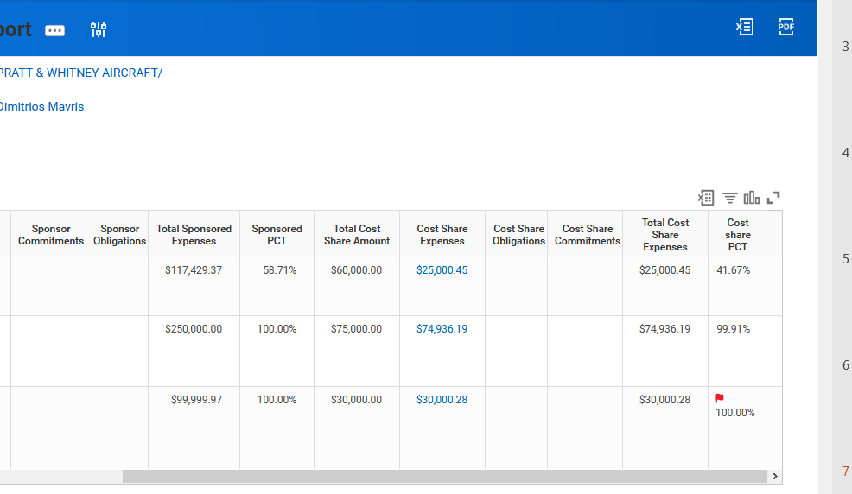
Monitoring Cost Share

Slide 22
Gabrielle Slappey, CRA
Project Accounting
G&C Financial Manager

Slide 23
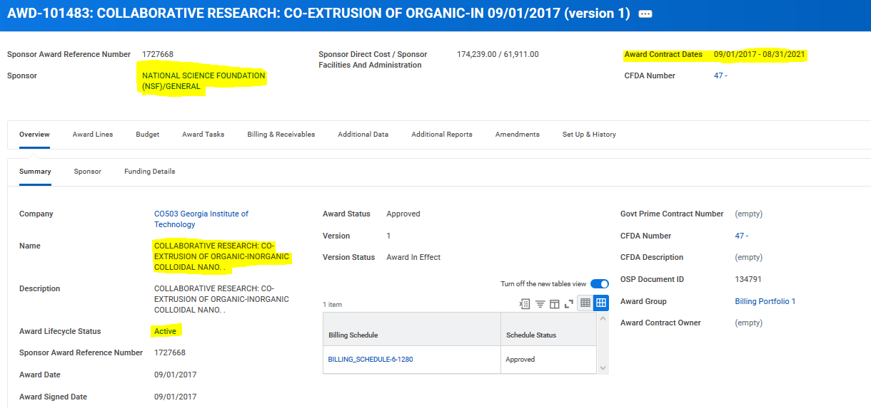
AWARD – Overview/Summary

Slide 24
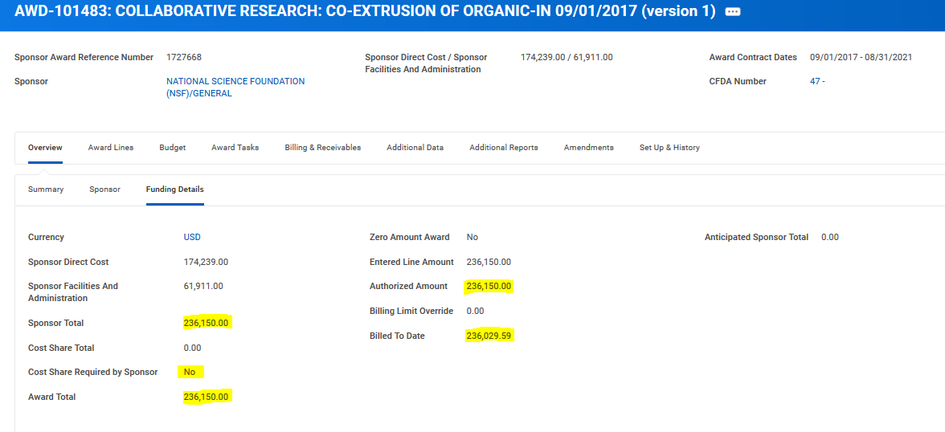
AWARD – Overview/Funding Details
Notes:
Overview/Funding Details Page – Shows the Current Funded Amount corresponding with CIS; shown as the Sponsor Total
There is the Anticipated total; that corresponds to the Contract Value in CIS
This award does not have cost share but you can see that there is a category that indicates if cost share is required; Award Total is the summation of Sponsor Total and Cost Share Total
Finally, there is the billed to date total

Slide 25
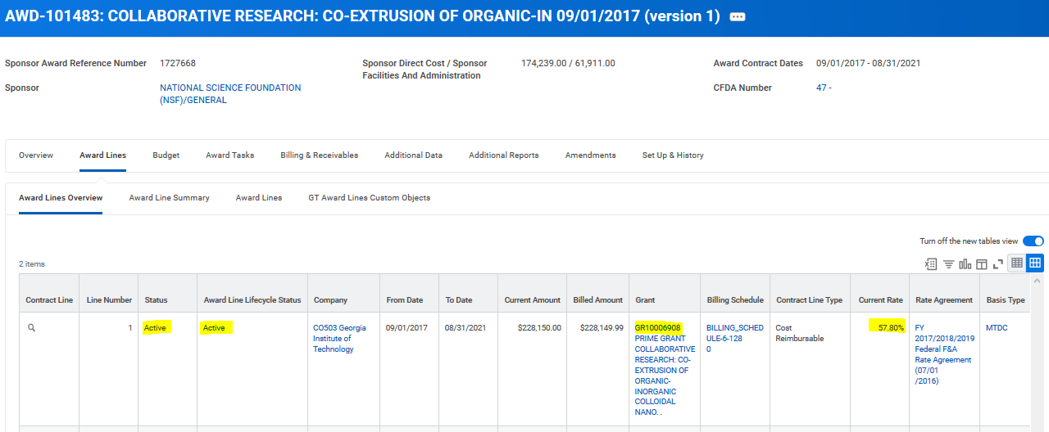
AWARD – Award Lines Overview
Notes:
Shows the grants associated with the award; their status and the F&A rate;

Slide 26
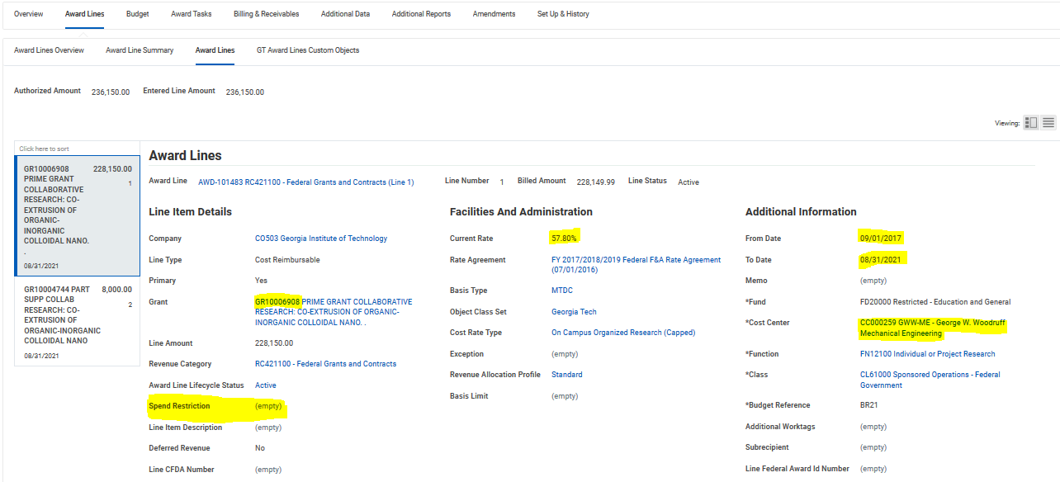
AWARD – Award Lines
Notes:
Has the same information as the Award Lines Overview Tab but it also includes the associated Worktags. Most important being the Cost Center; It also shows the spend restrictions on the award; Toggle between the grants

Slide 27
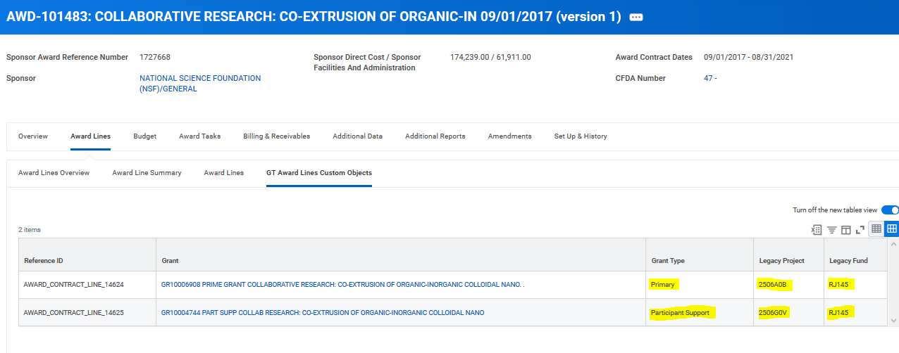
AWARD – GT Award Lines Custom Objects Class
Notes:
Legacy Project and Fund information

Slide 28
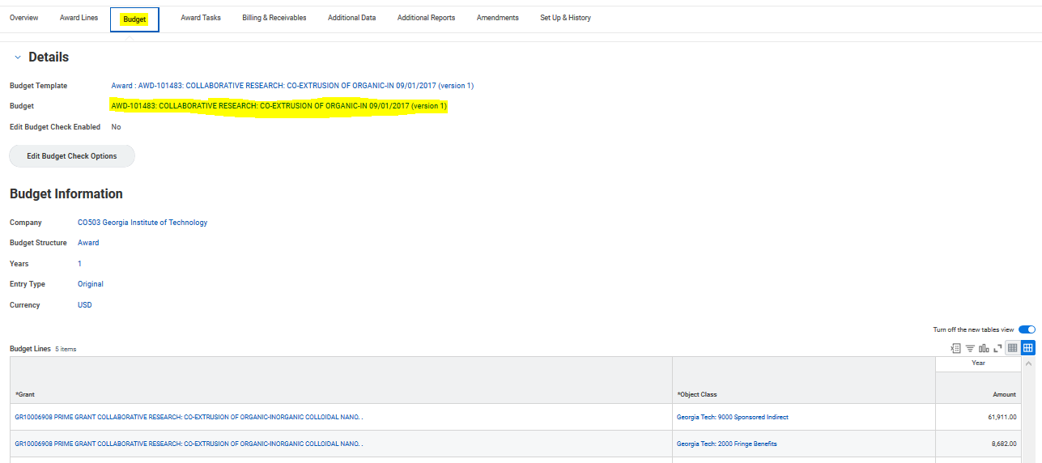
AWARD - Budget
Notes:
All grants with a line item budget are in the budget; if the grant does not have a budget (or expenses/obligations/commitments) it will not show up on SABER;
The total at the bottom of the screen should match CIS funded value and the funding details tab; caveat with Cost Share
Click on the Budget Hyperlink to see admendments

Slide 29
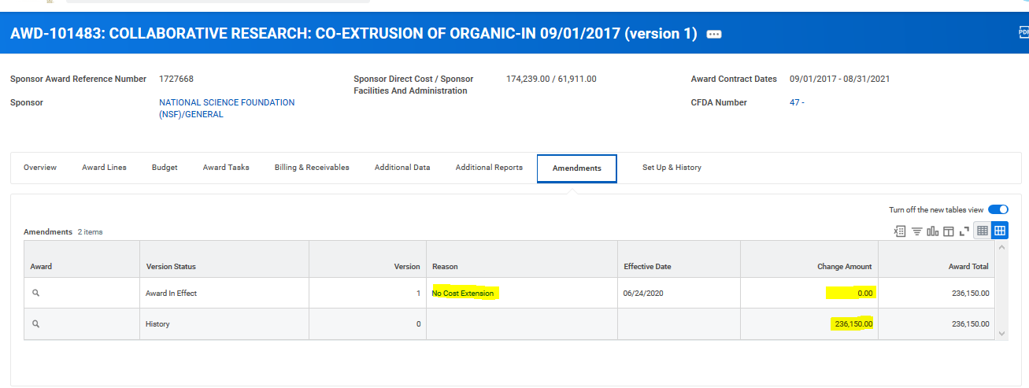
Budget - Amendments
Notes:
AWD-101483 didn’t have amendments so I chose new award; You can see the Amendment Type; description, and the total debits/credits

Slide 30
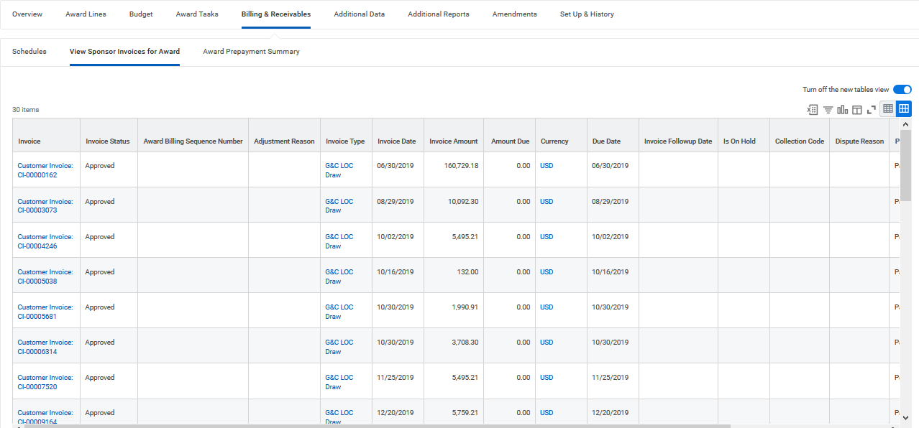
AWARD –Billing and Receivables
Notes:
All the customer invoices associated with the award; this award is Billed via letter of credit but some awards have CI Adjustment credits; reason will be G&C Sponsor Invoice Reverseal; just for GTRC accounting and G&C; ex. AWD-100844

Slide 31
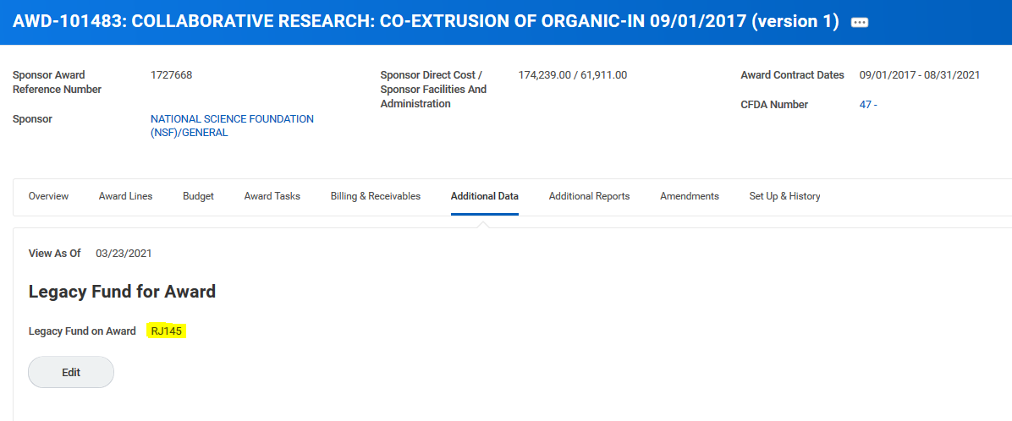
AWARD – Additional Data
Notes:
Find the Legacy Fund information

Slide 32
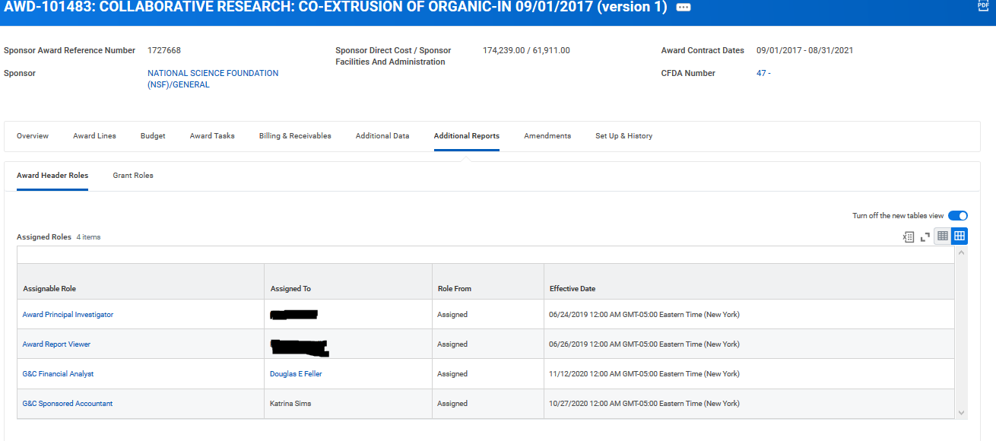
AWARD – Additional Reports
Notes:
Additional Reports – Find the Accountant – Questions concerning Billing and Reports
Find the Analyst – All other G&C related questions

Slide 33
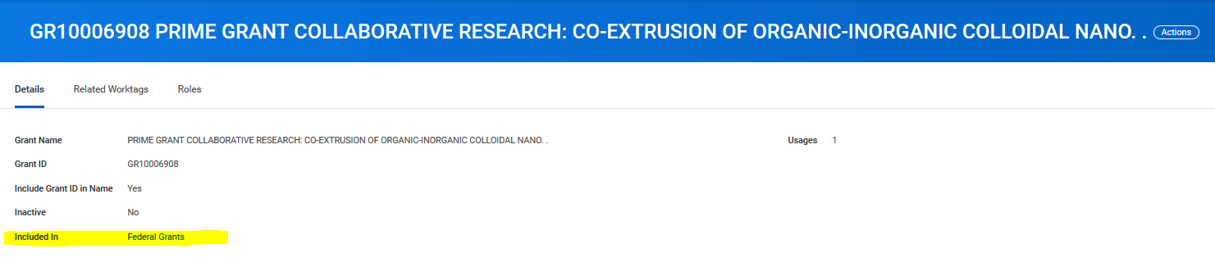
GRANT - Details
Notes:
In the grant details you can see what Grant Hierarchy it is under; i.e Federal, Private, State

Slide 34
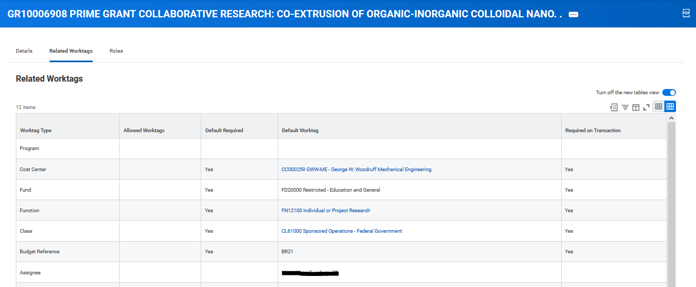
GRANT – Related Worktags
Notes:
It is important to have the cost center correct; if the cost center is incorrect G&C will need to inactive the grant and create a new grant with the correct cost center. This goes for any worktag but the cost center is the most frequent request.

Slide 35
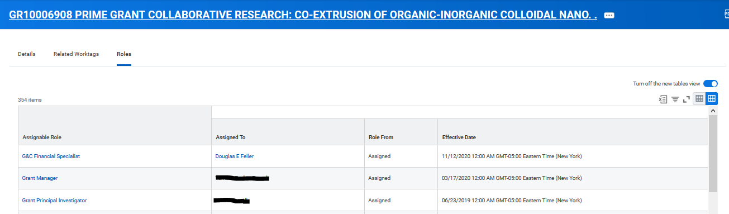
GRANTS - Roles
Notes:
Find the G&C specialist; 99% is matches the Award Analyst under Additional reports; Grant Manager and Grant PI – you can use the request frame work to change this information.

Slide 36
Workday Grants Reporting
Serena Simpson
Grants and Contracts Accounting, Systems
Systems Analyst Lead

Slide 37
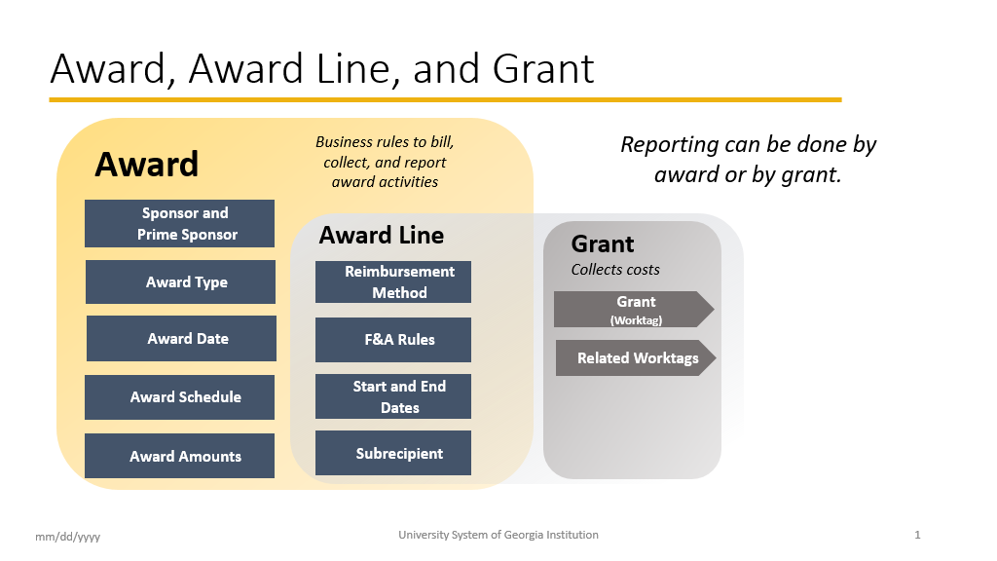

Slide 38

SPONSORED AWARD BUDGET EXPENSE REPORT (SABER)
Type of Reports:
SABER
SABER BY OBJECT CLASS
SABER BY AWARD (NEW)

Slide 39

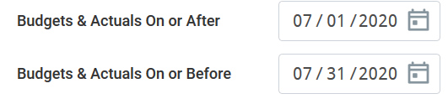
TIPS AND TRICKS
  Question: How do I view actuals for a specific period of time?
  Answer: Use the Budgets & Actuals On or After and Budgets & Actuals On or Before criteria

Slide 40

TIPS AND TRICKS
Question: How do I view just the Sponsored portion of my Award, not the cost share (vice versa)?
Answer: Use the Grant Hierarchy field to filter.

Slide 41
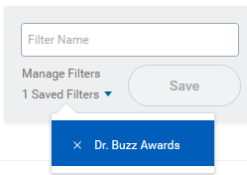

TIPS AND TRICKS
Question: How do I save a filter if I want to view the same criteria on a regular basis?
Answer: Enter Criteria, Create filter name, and Save filter
Question: How do I modify filters?
Answer: You can select Manage Filters and then edit your filter.
Question: Can I create multiple filters?
Answer: Yes, you must create unique filter name. All filters will display in the drop down.

Slide 42
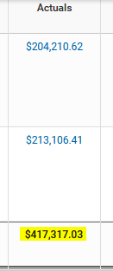
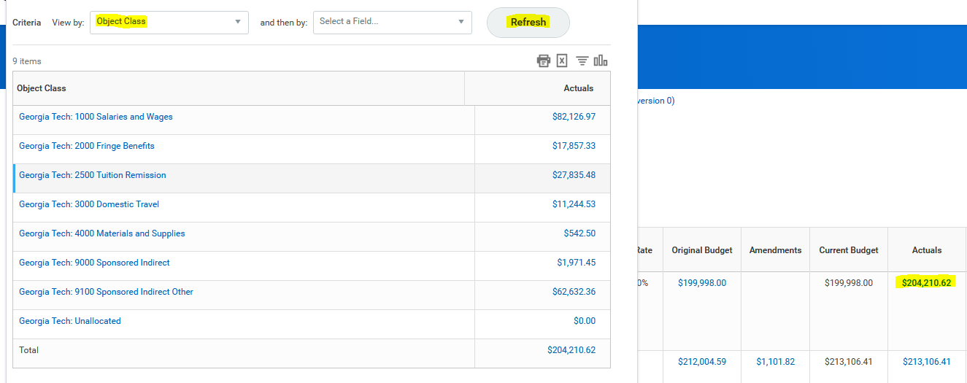
TIPS AND TRICKS
Question: How do I view actual costs by Object Class?
Answer: Drill down on total for Award and/or Grant and view by Object Class and refresh

Slide 43

HELPFUL REPORTS AND WORKLETS
  WORKLET:
  Grants Reporting (New)
  PI QUICK VIEW (New)
  WORKDAY REPORTS:
  FIND AWARDS
  G&C PARTICIPANT SUPPORT TRANSACTION -GTCR
  SABER
  SABER BY OBJECT CLASS
  SABER BY AWARD (New)
  AWARD AUDIT SUMMARY – GTCR
  GT AWARD EXCEPTION REPORT (New)
  EXTRACT AWARDS
  EXTRACT GRANTS
  GT AWARD LINES EXTRACT- GTCR
  GT RPT COST SHARE FUND IN PROGRESS REPORT
  LITE AND EXTERNAL REPORTS:
  G&C AD HOC SALARY (LITE)
  AD-HOC SALARY DETAILS
  COMMITMENT ACCOUNTING – PERSON HOURS
  GRA BY PI
  LEGACY PEB
  COMING SOON:
  SABER 2.0v
  https://transformation.gatech.edu/financials-transformation/workday-reports

Slide 44



Slide 45

How can I get help?
Where can
I find help?

Slide 46
Service Now
Security
  Someone left the department and needs to be replaced (ex: Grant Manager)
  Need a new Grant Manager
  Need to add an Assignee
Reporting
  Request a change in an existing report
  Suggest a new report
  Reporting is not working properly
  services.gatech.edu

Slide 47
KNOWLEDGE ARTICLES
Search for Knowledge Articles
There are some thirty Knowledge Articles related to Grants and Cost Sharing
services.gatech.edu

Slide 48

The Latest Buzz with G&C Accounting
GRANTS.GATECH.EDU

Slide 49

GRANTS.GATECH.EDU

