Slide 1

The Latest Buzz with G&C Accounting
Thursday, February 25th, 2021
2:00-3:30PM

Slide 2

Serena Simpson
G&C Systems Analyst Lead

Slide 3
Agenda
Topic | Presenter(s)
Welcome | Joshua Rosenberg
Effort Reporting & NIH | Joshua Rosenberg & Jonathon Jeffries
Compliance | Cassandra Belton
Workday Grants Reporting – SABER Overview | Serena Simpson
Workday Basics – Award, Award Line, Grant | Serena Simpson
PI Quick View | Serena Simpson
Workday Grants Reporting – Tips and Tricks, Demo | Serena Simpson
Helpful Reports | Serena Simpson
Obligations | Doug Feller
Tips | Doug Feller
Request Framework | Gabrielle Slappey
Invoicing | Glenn Campopiano
Subaward | Glenn Campopiano
Training | Robert Roy

Slide 4
Josh Rosenberg, CPA
Senior Director of Grants & Contracts Accounting

Slide 5
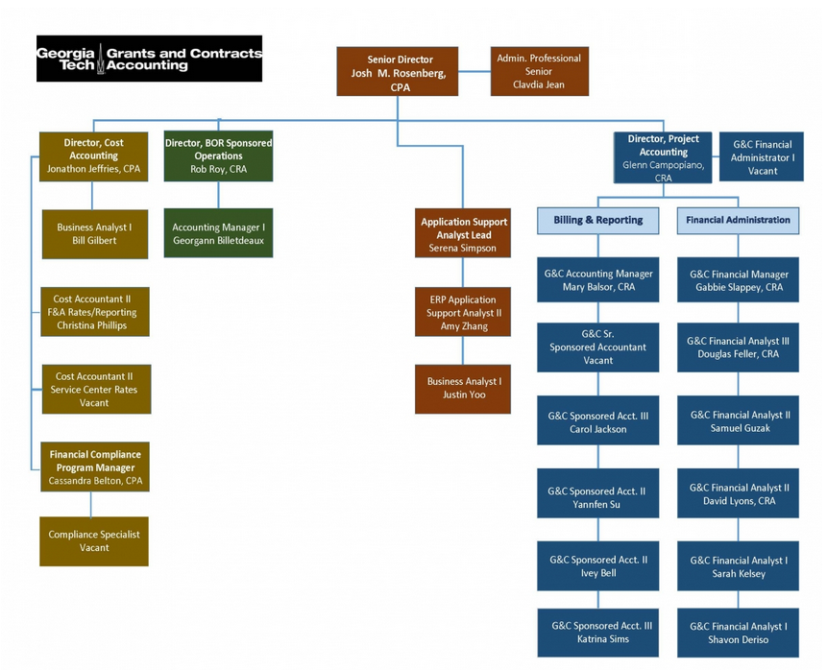
Grants and Contracts Accounting – Who We Are

Slide 6

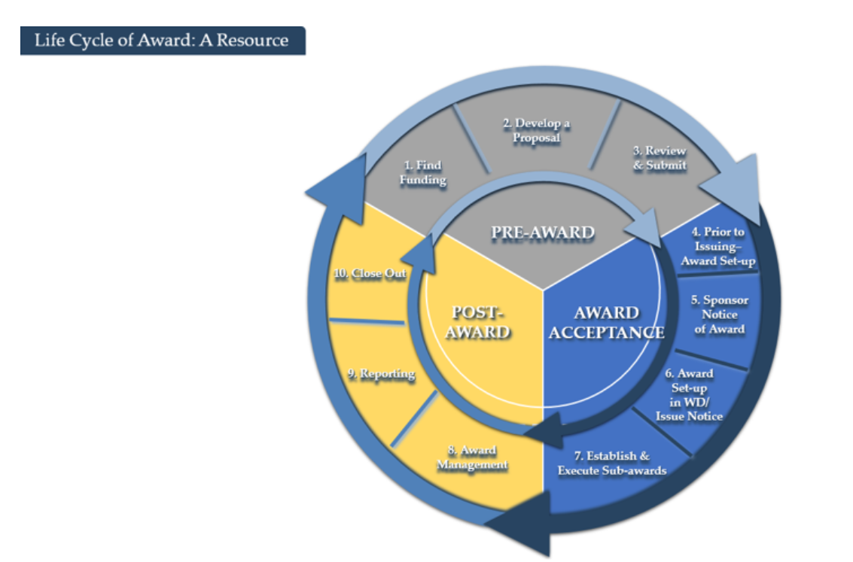
Grants and Contracts Accounting Website
Grants.gatech.edu

Slide 7

Josh Rosenberg,CPA
Sr. Director, Grants and Contracts
Effort Reporting and the NIH Salary Cap
Jonathon Jeffries,CPA Director, Cost Accounting

Slide 8
  DEPARTMENT OF INTERNAL AUDIT
  Effort Reporting

Slide 9
  In the Fall of FY21, Internal Audit performed a comprehensive review of GT effort reporting practices. They identified seven (7) areas of concern:
  NIH Salary Cap Limitations
  IBS Guidance
  Effort Reporting Training
  Terminated Employees and ASRs
  WAF Retention
  Cost Transfers
  Undesignated Driver Worktags

Slide 10
  NIH Salary Cap Limitations
  Individuals paid over the annual salary cap and sponsors who apply the cap.
  Cost share grant is the most effective way to show to auditors that over the cap salary is captured.
  Other grants from the sponsor under the cap.
  Must be managed regularly.

Slide 11
  Institutional Base Salary (IBS) Guidance
  Definition of IBS
  Posting on website

Slide 12
  Effort Reporting Training
  Required for anyone who has salary charged to extramural sponsored awards or Workday Grants.
  The challenge of students
  Will be enhanced in the coming year

Slide 13
  Terminated Employees and ASRs
  Especially problematic for students
  The question becomes: who can certify?

Slide 14
  Workload Assignment Form (WAF) Retention
  Current requirement
  Potential future requirements
  Website: how to interpret the WAF

Slide 15
  Cost Transfers
  Policy consistency
  The importance of solid justifications

Slide 16
  Undesignated Driver Worktags
  Expectations for salary charges and removal.
  Timeline and process.

Slide 17
New NIH Salary Cap
Effective January 3, 2021
  $199,300 per year for full-time appointment
  $16,608.33 per month
  Previously $197,300 or $16,441.67 per month
  Must be applied based on level of effort
  Applies to all subawards and subcontracts
  Grantee can re-budget funds to accommodate new cap if adequate funds available and does not negatively impact the scope of the award

Slide 18
New NIH Salary Cap Calculation
Effective January 3, 2021
  $199,300 per year for full-time appointment
  $16,608.33 per month
  Example – Monthly Rate $25,000 month
  1 Summer Month @100% Effort
    Cost Share 8,391.67 (25,000 – 16,608.33)
  1 Summer Month @ 50% Effort
    Cost Share 4,195.83 (12,500 – 8,304.17)

Slide 19
Tools to Manage NIH Salary Cap
NIH Cap Report in Development
  Report will show monthly over the cap amount
  Exceptions will need to be cleared
NIH Calculator in development to help for planning
Request linked NIH Cost Share Grant if needed
  Submit a request via Workday or reach out to assigned Analyst
Send me questions or suggestions, here to help!

Slide 20
NSF Salary Cap – Best Practices
NSF limits salary compensation for senior project personnel to no more than two months of their regular salary in any one year
  Senior Personnel refers to all individuals responsible for the scientific or technical direction of the project
  NSF allows re-budgeting authority without approval as long as it has no impact to scope
  If identified at Proposal stage, request approval
  2) If using re-budget authority, document in project file

Slide 21
ASRs for Terminating Employees
Report should be available on LITE soon
  Only shows Actuals, no encumbrances
  Security based on Ad-hoc Salary Details Report
  Employees must be termed in OneUSG Connect
  Ensure Final salary distribution is correct, as any change voids the signed ASR
  Requires terminating employee signature, First-Hand Knowledge signature not accepted
  Return to easr.ask once signed

Slide 22
Cassandra Belton, CPA
Cost Accounting
Financial Compliance Program Manager

Slide 23
Timing of Journal Entry for Tuition Remission on Cost Share
Delays in tuition remission reporting during the April 2020 OneUSG transition resulted in timing questions.
Tuition Remission on “standard” cost share with eligible graduate student salaries are posted by Compliance monthly, one month in arrears.
  e.g. January’s eligible tuition remission transactions are posted in February
  Timing is consistent with historical reporting
Non standard cost share arrangements should be monitored in coordination with G&C Analyst for possible individual posting.
Notes:
Caveat with over 90 days includes late setup by G&C and/or OSP; we cannot move prior year expense from State account; Cost transfers without a Grant Worktag should go to the controller’s office.

Slide 24
Participant Support Audit Recommendation
NSF recommendations from May 2020 site visit…
recommends the activation of accounts that are currently available under the participant support grant line (in Workday) [SC751113 & SC75112 DO NOT USE] to be dedicated to costs such as stipend, subsistence, travel, and miscellaneous.
End users…should receive training to use these specific accounts in order to separate participant support costs from all others in the general ledger in accordance with the NSF Proposal Policies and Procedures Guide (PAPPG) Chapter II.C.2.g(v)
recommends policy and procedures be updated to incorporate the requirements of 2 CFR 200.75, 2 CFR 200.456 as well as the NSF PAPPG Chapter X.A.3b
recommend GTRC review all award charges to participant support to ensure only true participants have been charged to those account codes.

Slide 25
Participant Support Audit Response
Management Action…
GIT investigated use of Workday account codes for participant support
  The codes are incompatible with our billing and travel reporting configurations as primary indicators of participant support costs.
  Alternatively, a Workday report to simplify participant support reporting and monitoring was explored.
  The G&C Participant Support Transaction Detail report was developed.
Campus outreach to promote use of the report will be conducted (Hint: This is said outreach.)
Policies and procedures to be updated with references to regulatory requirements
  2 CFR 200.75 - direct costs for items such as stipends or subsistence allowances, travel allowances, and registration fees paid to or on behalf of participants or trainees (but not employees) in connection with conferences, or training projects.
  2 CFR 200.456 - allowable with the prior approval of the Federal awarding agency
  NSF PAPPG Chapter X.A.3 - The Research Terms and Conditions (RTC), Appendix A, (NSF column) provides a consolidated listing of prior approvals that are required to be obtained from NSF. Unless otherwise specified in the grant notice or the applicable grant general terms and conditions, no additional prior approvals beyond those specified in RTC Appendix A are required.
Compliance and campus will periodically review the G&C Participant Support Transaction Detail report and participant payment spend categories to ensure participant support costs are properly reported.

Slide 26
G&C Participant Support Transaction Detail – GTCR
A New
Report
The G&C Participant Support Transaction Detail- GTCR report is designed to facilitate monitoring and reporting of participant support expenditures in compliance with 2CFR200 and sponsor program guides.
Users may run the report by desired award and period to produce a drillable report summarized by spend category.
Report fields include: Award, Grant, Grant Type, Sponsor, Spend Category, Period, Fiscal Year and Total.

Slide 27
Workday Grants Reporting
Serena Simpson
Grants and Contracts Accounting, Systems
Systems Analyst Lead

Slide 28
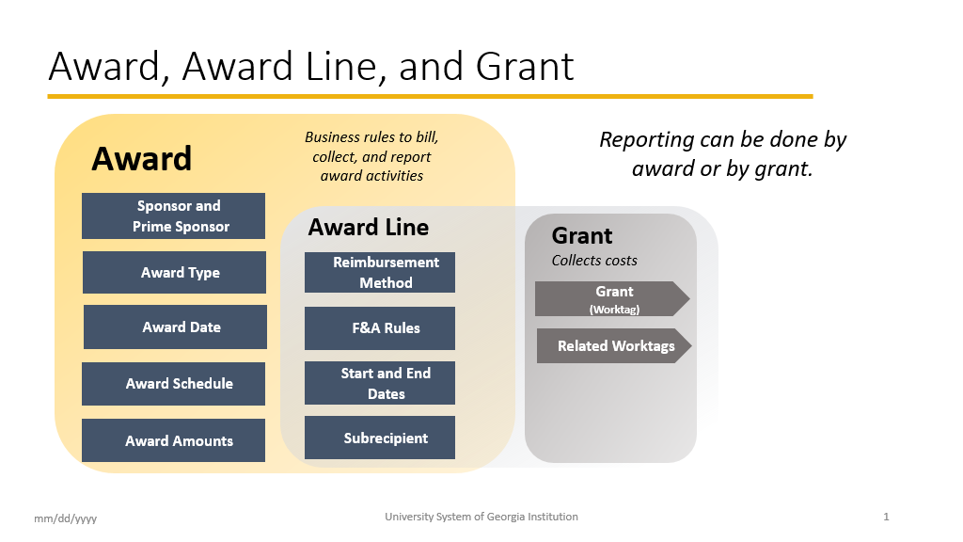

Slide 29

SPONSORED AWARD BUDGET EXPENSE REPORT (SABER)
Type of Reports:
SABER
SABER BY OBJECT CLASS
SABER BY AWARD (NEW)

Slide 30

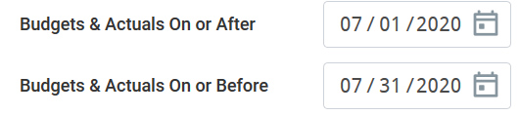
TIPS AND TRICKS
  Question: How do I view actuals for a specific period of time?
  Answer: Use the Budgets & Actuals On or After and Budgets & Actuals On or Before criteria

Slide 31

TIPS AND TRICKS
Question: How do I view just the Sponsored portion of my Award, not the cost share (vice versa)?
Answer: Use the Grant Hierarchy field to filter.

Slide 32
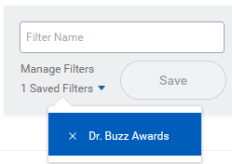

TIPS AND TRICKS
Question: How do I save a filter if I want to view the same criteria on a regular basis?
Answer: Enter Criteria, Create filter name, and Save filter
Question: How do I modify filters?
Answer: You can select Manage Filters and then edit your filter.
Question: Can I create multiple filters?
Answer: Yes, you must create unique filter name. All filters will display in the drop down.

Slide 33
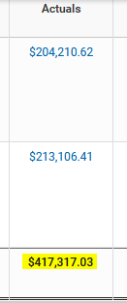
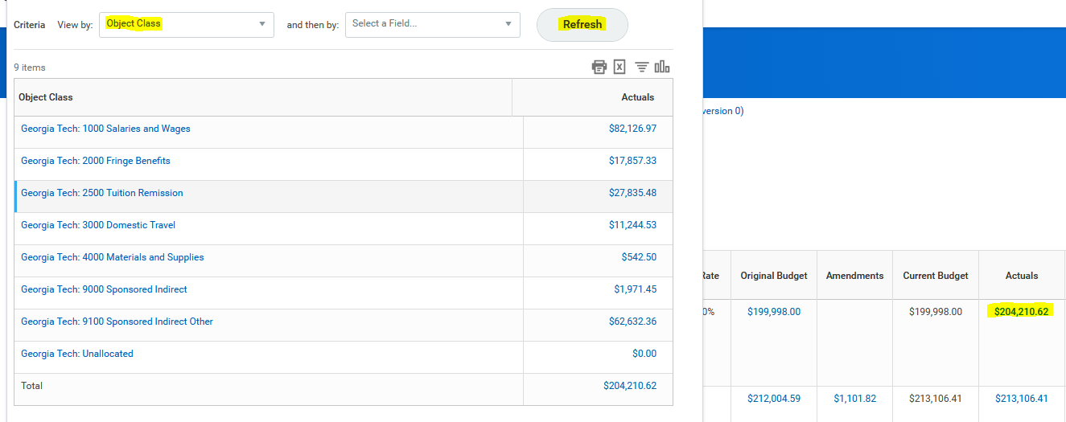
TIPS AND TRICKS
Question: How do I view actual costs by Object Class?
Answer: Drill down on total for Award and/or Grant and view by Object Class and refresh

Slide 34
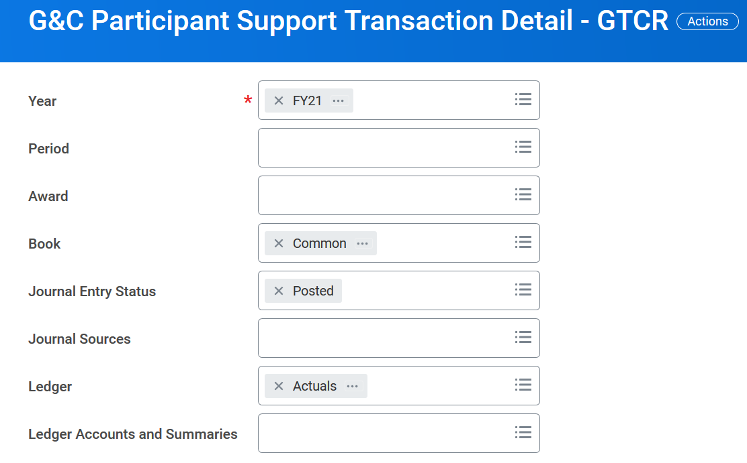
G&C Participant Support Transaction Detail - GTCR

Slide 35
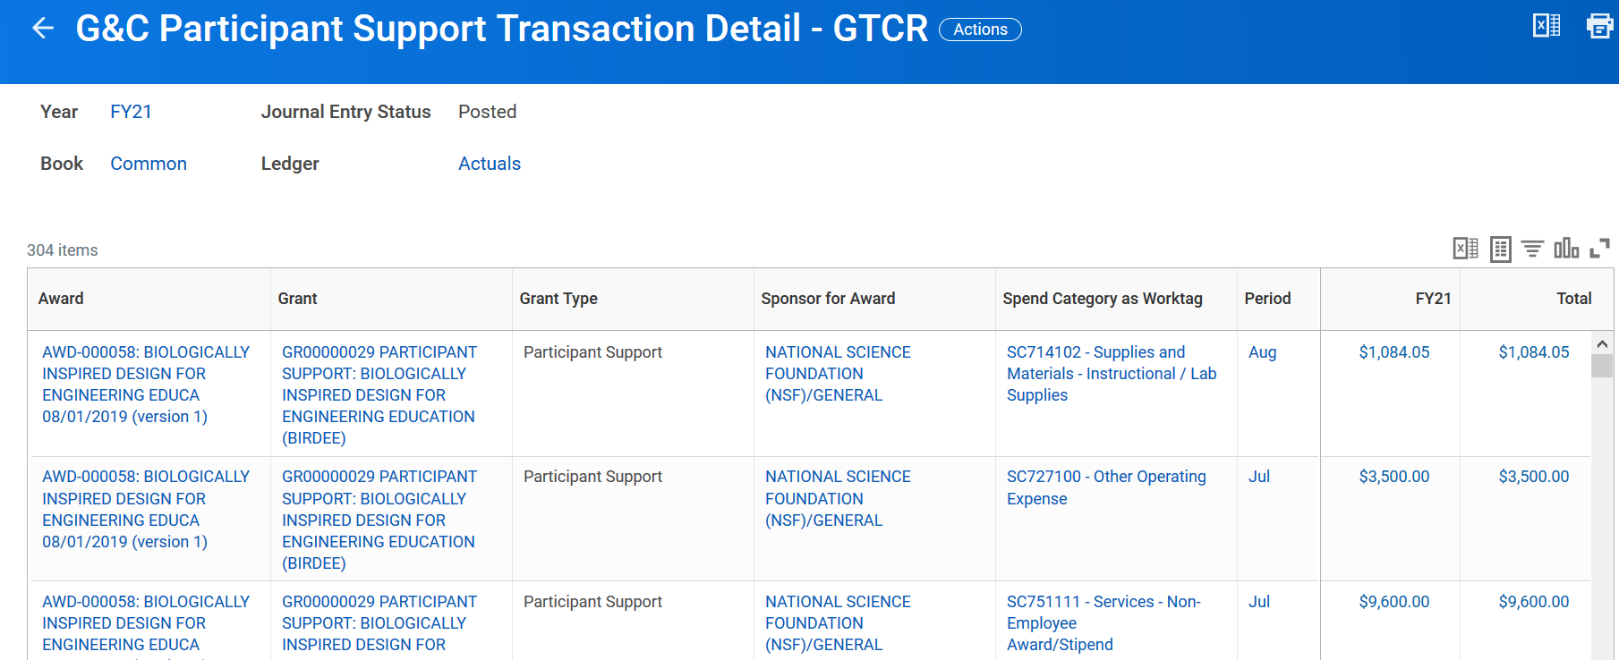
G&C Participant Support Transaction Detail - GTCR

Slide 36
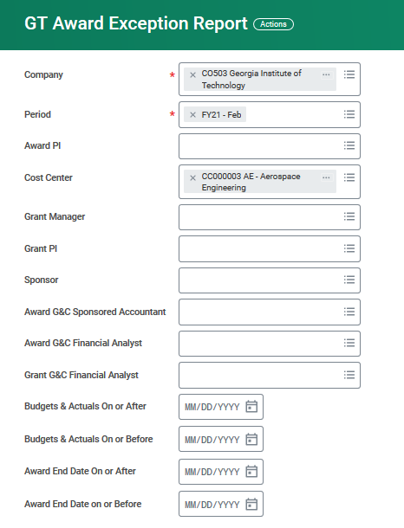
GT Award Exception Report

Slide 37
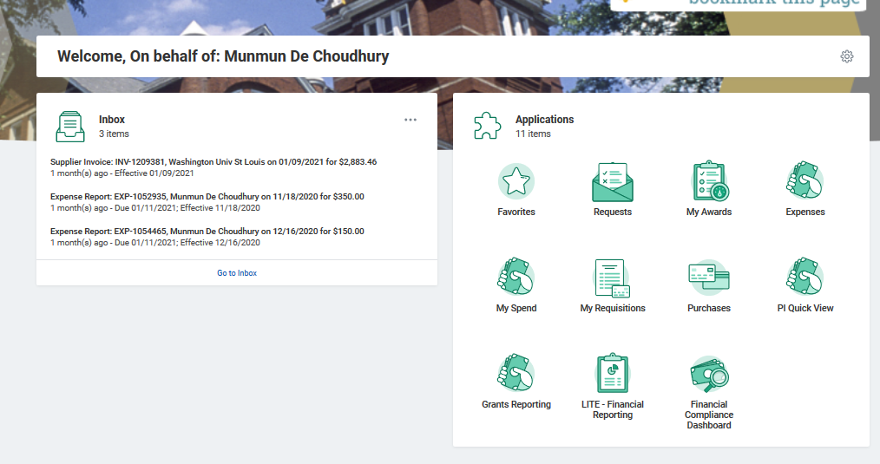
PI Quick View

Slide 38
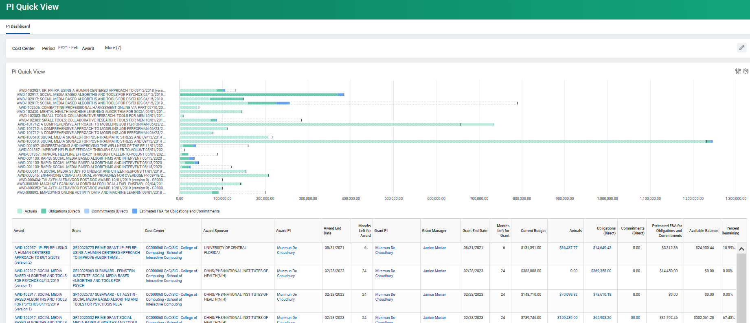
PI Quick View

Slide 39

HELPFUL REPORTS
  WORKDAY REPORTS:
  SABER
  SABER BY OBJECT CLASS
  SABER BY AWARD (New)
  EXTRACT AWARDS
  GT EXTRACT AWARD LINES - GTCR
  EXTRACT GRANTS
  G&C AD HOC SALARY (LITE)
  WORKLET:
  Grants Reporting (New)
  PI QUICK VIEW (New)
  COMING SOON:
  EXCEPTION REPORT
  SABER 2.0v

Slide 40



Slide 41

How can I get help?
Where can
I find help?

Slide 42
Service Now
Security
  Someone left the department and needs to be replaced (ex: Grant Manager)
  Need a new Grant Manager
  Need to add an Assignee
Reporting
  Request a change in an existing report
  Suggest a new report
  Reporting is not working properly
  services.gatech.edu

Slide 43
KNOWLEDGE ARTICLES
Search for Knowledge Articles
There are some thirty Knowledge Articles related to Grants and Cost Sharing
services.gatech.edu

Slide 44
Doug Feller, CRA
Project Accounting
G&C Financial Analyst III

Slide 45
Inactivation of Awards
Common Bottle Neck for Closing out Awards
- Outstanding balance under Obligations and Commitments on Awards that have ended
- G&C cannot close out awards with obligation and commitment balances
- G&C reaches out to Grant Manger to have the obligations/commitments closed

Slide 46
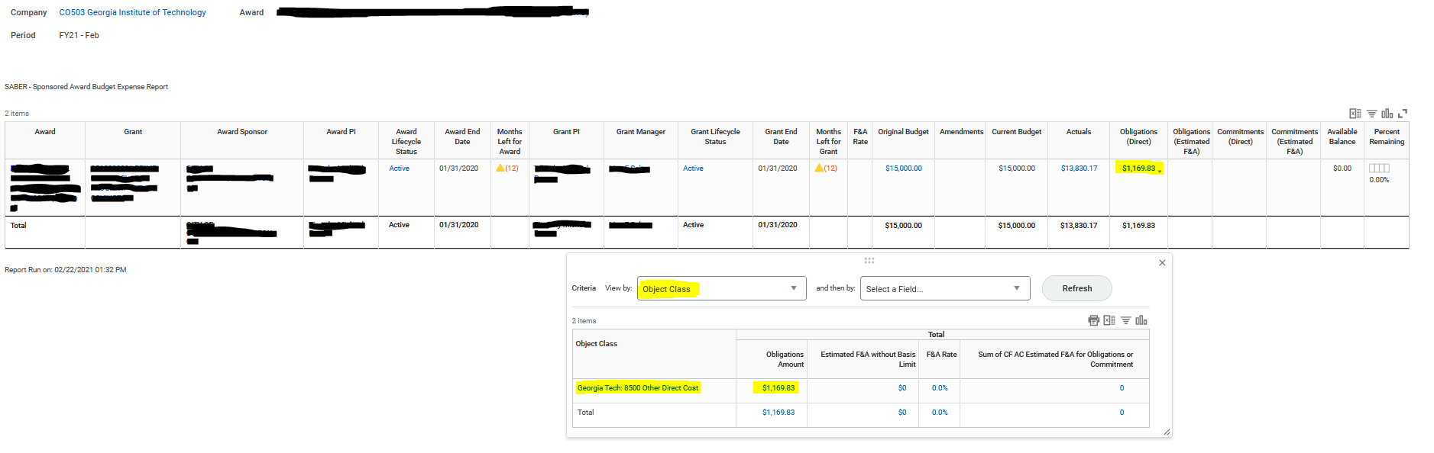

Slide 47
Outstanding Commitments/Obligations | Office
Spend Authorization (Travel) | Travel
Purchase Order (Non-Subaward) | Procurement
Purchase Order (Subaward) | Office of Sponsored Programs
SPD Expenses | Commitment Accounting

Slide 48
Service Now
POs – “CLOSE OPEN PURCHASE ORDER”
TRAVEL – “CLOSE SPEND AUTHORIZATION”
SUBAWARDS – “SABER NEGATIVE F&A ON OBLIGATIONS”
- CONTACT G&C
- MOSTLY SEEN ON SUBAWARDS
- CASE BY CASE ISSUE

Slide 49
Gabrielle Slappey, CRA
Project Accounting
G&C Financial Manager

Slide 50
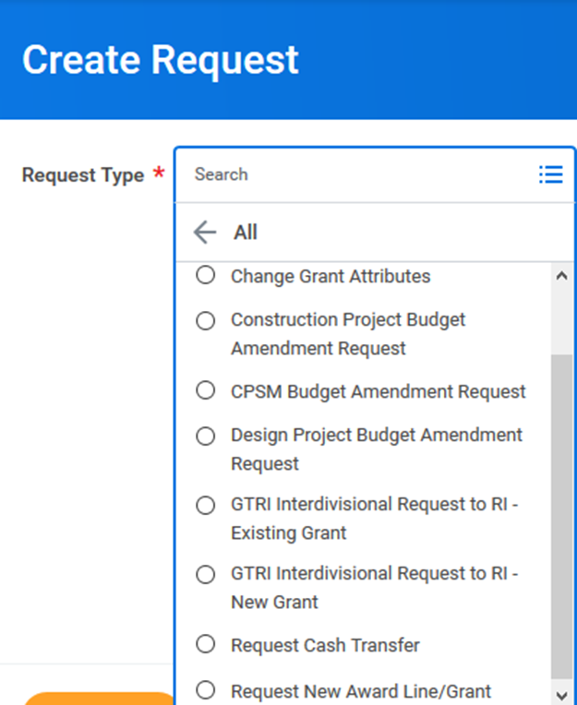
Request Framework – Create New Request
Using Create Request allows
  Grant attribute changes - grant name, grant status, grant manager
  New award line/grant request
  GTRI Interdivisional grant request
  Request cash transfers typically related to memberships
Maintains a trail of requests in WD
Grant Managers
  For Grant Managers that are leaving the institute, please be sure to complete a Service Now ticket before departure
  Mass changes use Service Now
  One offs (or a handful), use Create Request

Slide 51
Request Framework – New Award Line/Grant
Add detailed description of the request
  “This is a Subaward request for the University of Georgia.”
  General Comments is also useful for this
Choose the correct Purpose
  Subawards – External (i.e. University of Georgia)
  Internal Collaboration – Internal (i.e. COPI)
Important to specify the correct Cost Center for new grant line
  New grant will need to be created if incorrect
Use the Award number
  Not the Prime Grant
Notes:
Make sure the request has as much information as possible; cuts down the emails needed to figure out the request; be aware the subawards is for external entities; make sure you add the correct cost center, G&C will have to create a new award if it needs to be changed; use the award number not the prime grant, we look the information up in CIS.
General comments is a good place to specify the new PI name, subawardee, spend restrictions for the grant, different F&A from Prime, etc

Slide 52
Glenn Campopiano, CRA
Project Accounting
Director of Project Accounting
Project Accounting Topics

Slide 53
  G&C AWARD INVOICING
  Process for Invoicing Sponsored Projects

Slide 54
  COST REIMBURSABLE AWARDS
  Most awards are billed monthly for expenses posted in the prior month.
  Some awards have a scheduled billing where expenses are invoiced quarterly, semi-annually or annually.
  Some awards have a fixed invoicing schedule: a fixed amount either billed monthly, quarterly or to some other schedule.
  In order for G&C to invoice on most awards, expenses must be posted in Workday for the system to generate an invoice.
  No expenses = no invoice
  Invoices can be found in WD under Billing & Receivables – View Sponsor Invoices for Award on the Award landing page in WD.

Slide 55
  FIXED PRICE AWARDS
  Fixed Price awards can be prepaid upfront so no invoicing is required.
  Other payment plans can be agreed to in the terms and conditions of the contract.
  Common terms include a portion due upon signing and scheduled invoices over the life of the award.
  Some sponsors make scheduled payments so no invoicing is required.
  Residual funds unspent at end of award, if considered immaterial, are retained. Those funds are stripped of overhead and returned to the unit/PI to utilize.

Slide 56
  SUB-AWARD INVOICING AND PAYMENTS
  (SPONSOR → Prime Institution → GT as Sub)
  If GT is a sub-awardee, invoicing follows the terms and conditions of the contract and is very similar to most awards.
  (SPONSOR → GT as Prime Institution → Sub to another institution)
  Paying sub award invoices is handled by the Office of Sponsored Programs. G&C is not involved in sub-award payments
  Sub-awardees are to submit invoices to ospinvoices@osp.gatech.edu
  OSP begins the payment process.
  Unit/PI approve invoices in Workday process flow.
  GT A/P pays the invoice. Expense posted to grant line.

Slide 57
  MEETING COST SHARE
  Cost share expenses should post on a regular basis, ideally in step with the spending of the sponsored funding.
  Cost share is usually state funds, so be mindful of the fiscal year dollar requirements.
  Allocate Faculty salaries timely on the cost share grant line.
  Fund your cost share grant lines through OneBudget.
  Ensure sub-awardees with CS requirements provide CS with each invoice. Good practice to withhold payment until CS received.
  Un-met cost share results in return of sponsor funds so that cost share requirement aligns with dollars received from sponsor. Unit responsible for moved off charges due to un-met cost share.

Slide 58
Rob Roy, CRA
Director of BOR Sponsored Operations

Slide 59


Slide 60
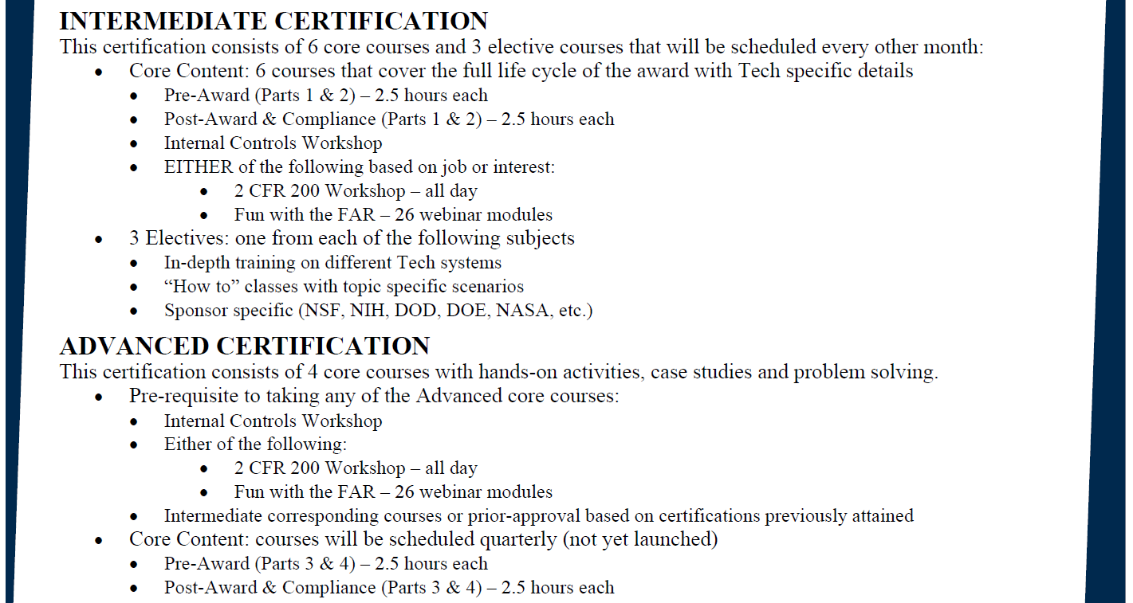

Slide 61
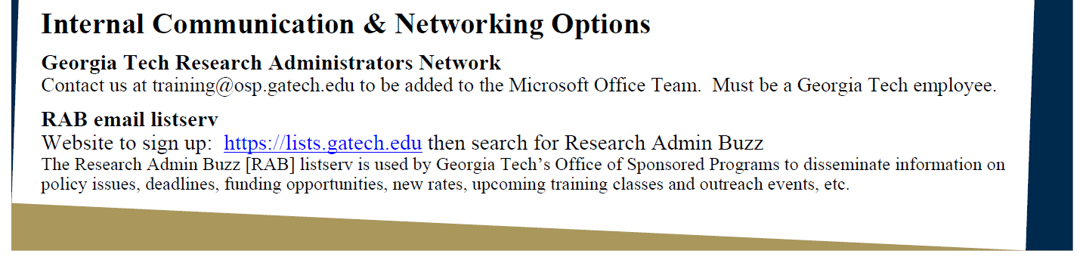


Slide 62
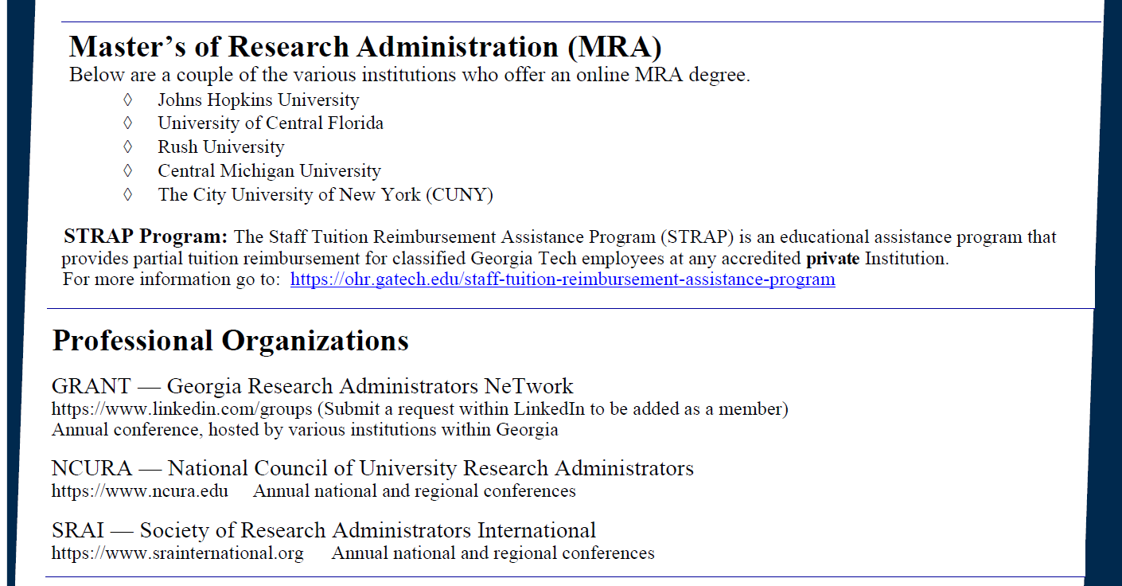

Slide 63
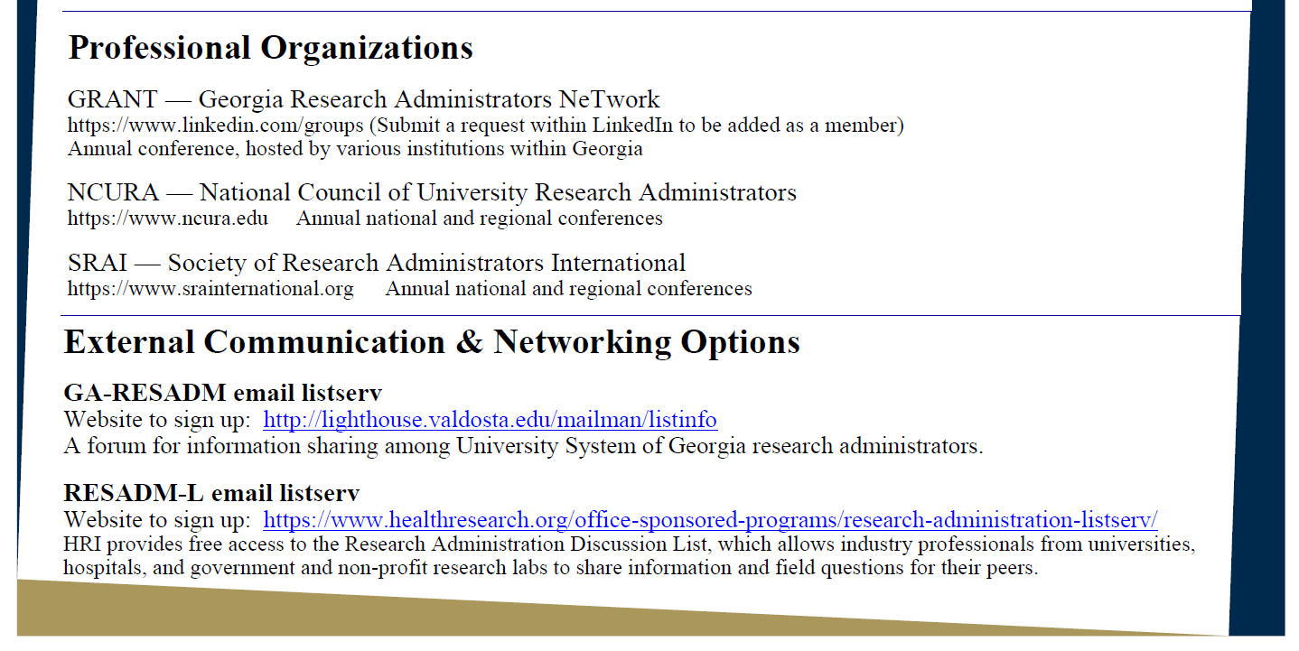

Slide 64
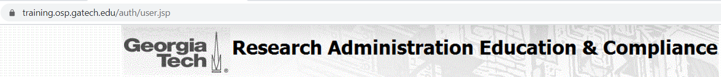
Upcoming Research Administration Post-Award Focused Trainings
Class | Date
2 CFR 200 – Workshop | Mar. 4 (Th)
GT Basic Certification – Workshop | Mar. 11 (Th)
Post-Award & Compliance (Part 2) | Apr. 6 (Tu)
Post-Award & Compliance (Part 1) | Apr. 8 (Th)
GT Basic Certification – Workshop | Apr. 13 (Tu)
Internal Controls – Workshop | Apr. 21 (W)

Slide 65

The Latest Buzz with G&C Accounting
GRANTS.GATECH.EDU

Slide 66

GRANTS.GATECH.EDU

