Slide 1

The Latest Buzz with G&C Accounting
Thursday, July 28, 2021
1:00 - 2:30PM

Slide 2
Agenda
Topic | Presenter(s)
Welcome and Lots of Research Updates | Josh Rosenberg
Commitment Accounting Update | Terryl Barnes
Project Accounting Update | Glenn Campopiano
Compliance and Audit Update | Cassandra Belton
Updates: Effort Reporting, Fringe Rates, Costing | Jonathon Jeffries
Workday Updates and Reporting Updates | Amy Zhang
Training Update | Rob Roy

Slide 3

Josh Rosenberg
Sr. Director, Grants and Contracts
Post Award Research Updates

Slide 4
Research Trends
Resident Instruction (through June):
  Proposals: up $140.4 million (9.7%) to $1.6 billion.
  Awards: up $13.2 million (3.3%) to $415.7 million.
  Expenditures:
    Direct: up $7.5 million (2.6%) to $294.2 million.
    Indirect: up $1.4 million (1.7%) to $86.2 million.
GTRI (through June):
  Awards: up $119.1 million (17.9%) to $782.5 million.
  TOTAL FY21 GEORGIA TECH AWARDS: $1.2 BILLION!!!

Slide 5
Research Trends
RI Expenditures: FY20 v. FY21 YOY

Slide 6
Invoices and Financial Reports
Invoices
  G&C averaged $29.7 million in invoices per month in FY21 and invoiced $355.8 million in total (versus $312.7 million in FY20)
Financial Reports
  907 total during FY21.

Slide 7
Other G&C Updates
Sponsor and Faculty Views – Research Administration
State Audit
Single Audit
Policy Updates

Slide 8
Terryl Barnes
Commitment Accounting Manager, Institute Budget Planning and Administration
Commitment Accounting
Updates

Slide 9
Commitment Accounting
2021 Summer Pay Data Entry Deadlines
At 5:00 p.m. on the deadline date, a process will run that will gray out the data entry fields for that month. Once this process is complete, the Summer Pay data entry field will be disabled for the associated month. Any additional summer pay earnings for that month will need to be manually entered by the payroll department.
If you have questions or concerns, please contact oneusgsupport@usg.edu.
Summer Pay Month ​ | Deadline for Summer Pay Page Data Entry​
July 2021​ | 07/20/2021​
August 2021​ | 08/23/2021​

Slide 10
Commitment Accounting
Known Issue:
Pay Group | Pay Group Title | Issue | Status
03F | Academic Year Faculty | Regular salary is being encumbered in July which overstates the employee’s estimated pay for FY2022. Employees in this pay group should have their regular salary encumbered over 10 months equally (August - May). | Reviewing academic pay accrual process and impact to GT encumbrance process for July. Code change to GT encumbrance process may be required. TBD.
Workaround: Currently, there is no workaround for either of the known issues. The OneUSG Connect Support team is investigating the issue and we will communicate an update once it is resolved.

Slide 11
Commitment Accounting
Review FY2022 Position Funding
Funding loaded based off of annual budget developed in April 2021.
  Correct FY2022 funding if necessary with a change position funding transaction to avoid submitting an EDR.
Grants that have ended will cause funding to post to suspense, undesignated, or cost overrun worktags.
Extend grant end date or transfer funding to valid funding source
Establish cost share to avoid over 90 day requests

Slide 12
Commitment Accounting
Beginning July 1, 2021; up to three (3) weeks of paid Parental Leave will be available to state employees as part of House Bill 146. Eligible employees who have their leave requests approved will have their funding for parental leave payments allocated to 03DE00019145 IBPA/Fringe Parental Leave.
The associated earnings codes will be:
Please do not change the funding or submit an EDR to transfer parental leave payments from the 03DE00019145 IBPA/Fringe Parental Leave worktag. No further action is required. For additional information regarding parental leave please visit the following link.
Group | Associated Earnings Code
Non-Exempt for hourly employees | PRH - Parental Leave
Exempt for monthly employees | PRM - Parental Leave

Slide 13
Commitment Accounting
Office Hours will now be held once a week every Thursday from 1:00 – 4:00 p.m. via Microsoft Teams until August 26th 2021.
Office Hours can be found on the under the Training Calendar and News & Events.
If you have any questions about the Commitment Accounting Office Hours, please contact erp.training@gatech.edu

Slide 14
Glenn Campopiano, CRA
Project Accounting
Director of Project Accounting
Project Accounting Topics

Slide 15
How to find G&C Accountant and Analyst on an Award
Type award number in Workday search bar
Go to Additional Reports Tab
Under Award Header Roles you will find the PI name, the G&C analyst and the G&C accountant assigned to this award.

Slide 16
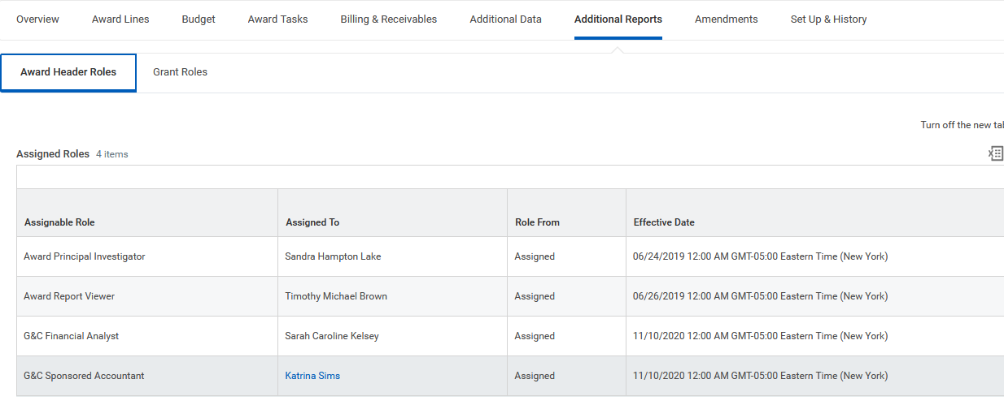

Slide 17
How to Find my Grant Manager
Click on Grant Roles tab and you will see the G&C Financial Analyst, the Grant Manager, and Grant PI.

Slide 18
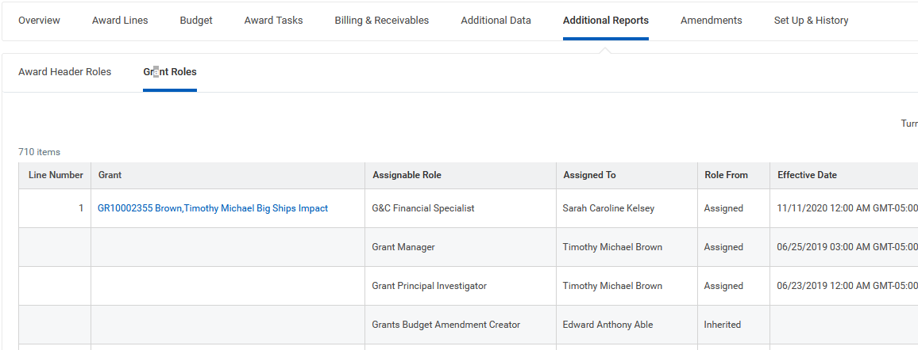

Slide 19
When to Call OSP and G&C
Grants and Contracts
  Grant set up, modifications, close out and related actions in the financial system (Financial Analysts)
  Invoicing and financial reporting (Grant Accountants)
  Grant (GR) lines (prime award and subaward)
  Financial Reports
  Budget revision on existing awards are Unit via Service Now ticket – G&C makes the changes.
Office of Sponsored Projects
  Award (AWD) setup (what you see in CIS)
  Post-award sponsor approvals:
    No-Cost Extensions
    Equipment (not in approved budget)
    Subaward (not in approved budget)
    Foreign Travel (even if in approved budget, for some sponsors)
    PI and Scope Changes
  Subaward processing (via Subaward Team)
  Budget increases (continuation awards or funding supplements/modifications)
  Budget revisions that exceed sponsor threshold on existing award
  Closeout reports (via Closeout Team)

Slide 20
Cassandra Belton, MBA,CPA
Cost Accounting
Financial Compliance Program Manager

Slide 21
Behind the Audit Sample Curtain
Why was my transaction(s) selected for audit?
The purpose of an audit is to validate information and lend integrity to data. Clean audits provide assurance to our sponsors that we are trusted stewards of funds granted.
It’s inefficient for auditors to examine 100% of transactions, so sampling is used. Sampling is a tool used to study a smaller group to produce an accurate estimation of the larger population. Three common sample approaches follow.
Notes:
Caveat with over 90 days includes late setup by G&C and/or OSP; we cannot move prior year expense from State account; Cost transfers without a Grant Worktag should go to the controller’s office.

Slide 22
Three Common Sampling Strategies
Strategy | Pros | Cons
1. Random Sample | Statistically based, so results can be projected to larger population | Typically requires large samples to achieve high confidence levels
2. Judgmental Sample | Smaller samples required so less time consuming | Requires expert knowledge Not statistically based
3. Risk-Based Sample | Systematically reduce review of low-risk transactions | Sampling process and sample tracking can be complex
Notes:
Caveat with over 90 days includes late setup by G&C and/or OSP; we cannot move prior year expense from State account; Cost transfers without a Grant Worktag should go to the controller’s office.

Slide 23
Behind the Audit Sample Curtain
Why are my transactions ALWAYS selected for audit?
Answer:
It’s just your “luck.” (Random Sample)
You have a history of “unique” transactions and/or circumstances. (Judgmental Sample)
You have a high risk profile - large dollar and/or volume; late cost transfers; high turnover; low report usage; etc. (Risk-Based Sample)
Notes:
Caveat with over 90 days includes late setup by G&C and/or OSP; we cannot move prior year expense from State account; Cost transfers without a Grant Worktag should go to the controller’s office.

Slide 24
Jonathon Jeffries, CPA
Director of Cost Accounting

Slide 25
Effort Reporting – ASRs (Annual Statement of Reasonableness
Currently available for online certification
  UFMs will need to certify after employee
Federal Work Study students did not receive FY21 ASRs unless they worked multiple jobs during FY
ASRs deadline is August 31st
  We will distribute manual ASRs electronically for manual signature
Financial Managers can run manual ASRs for prior year correction

Slide 26
SCARV - Service Center Annual Rate Validation
Rate Setting Principles
  Actual cost is the most the rate is allowed to recover
  Rates must be based on actual use of the service
  Rates must be adjusted when there is a surplus
  Rates do not discriminate between federally and non-federally supported activities including internal activities (free/reduced price use)
  Rates must be reviewed and approved on a
  regular basis

Slide 27
SCARV – Service Center Annual Rate Validation
SCARV Reminders
  Revenue should balance by price * units sold
  All expenses should be reported on SCARV both DSS and Department Support of Center
  Only approved rates may be charged by center
  Changes to Employees, Effort Allocations, Equipment, and Space need to be reported on SCARV
  Equipment needs Workday related Tag Number

Slide 28
NOW HIRING – Cost Accountant II
Cost Studies and Analysis
  Fringe (Resident Instruction and GTRI)
  Facility and Administrative Rates
  Space Studies
  GTRI Exchange of Services (Admin Study)
  F&A Revenue Projections
  Schedule of Federal Expenditures (SEFA)
Compliance
  Audit Support DCAA (Defense Contract Audit Agency)
  State Accounting Office
  Bond Compliance/Treasury

Slide 29
Workday Grants Reporting Update
Amy Zhang
ERP App Support Analyst II
Grants and Contracts Accounting

Slide 30
WORKDAY REPORTS
  SABER ( Enhancements have been made to the SABER report in May)
  SABER BY OBJECT CLASS (Enhancements are in testing phase)
  We are currently working with consultant on updating Saber by Object Class report to improve the performance.
  SABER BY AWARD (Enhancements are still in development)

Slide 31
OTHER REPORT
We are working with ERP team on SABER like reporting capacities in EDW. It is currently in starting phase.
*The intent is not at all to replace the SABER but to complement the SABER and extend the SABER's utility into the realm of EDW
1. To provide available balance as a data set in EDW to consumers like SUMS and other ancillary systems
2. To accurately calculate Estimated F&A
3. To accurately report on Award/Grant Exceptions
4. To be able to potentially drill down into personal cost details
5. To be able to explore additional reporting formats that Workday does not offer
6. To be able to relate Available balance data with other data sets like invoicing, etc.
7. To be able to query, report on grant balances on an ad hoc basis

Slide 32
Rob Roy, CRA
Director of BOR Sponsored Operations

Slide 33
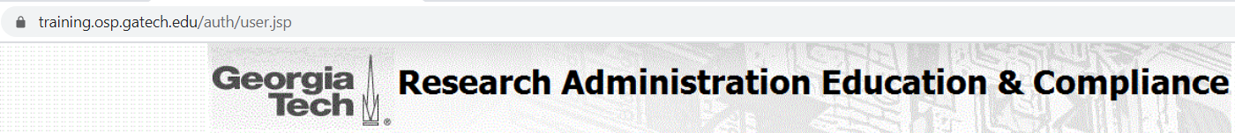
Training
Events
https://training.osp.gatech.edu – Sign in with GT credentials and register!
Hybrid = In-person OR Via WebEx option
Wednesday, August 4th
GT Basic Certification Workshop, (Hybrid) 9:30am – 3:00pm
Wednesday, August 11th
Finding Funding and Submission Process, (virtual)
7:00pm - 8:00pm
Tuesday, August 24th
eRouting Proposal Module, (Hybrid) 10:00am – 11:30am
Wednesday, August 25th
Cayuse Proposal System, (Hybrid) 10:00am – 11:30am
New Faculty Orientation, (Hybrid) 1:30pm – 3:00pm
Friday, August 27th – Friday, November 5th (10 weeks)
CRA Study Session, (Hybrid)
Fridays, 12:30pm - 2:00pm
Thursday, September 9th
Finding Funding and Submission Process, (virtual)
7:00pm - 8:00pm
Friday, September 10th
NSF Proposal Prep & Review Tips, (Hybrid)
9:30am - 11:30am
Tuesday, September 14th
Subawards: Request, Monitoring and Risk, (Hybrid) 1:00pm - 3:30pm
Wednesday, September 15th
GT Basic Certification Workshop, (Hybrid) 9:30am – 3:00pm
Tuesday, September 21st
Post-Award & Compliance Part 1, (Hybrid)
1:00pm – 3:30pm
Wednesday, September 22nd
Post-Award & Compliance Part 2, (Hybrid)
9:30am – 12:00pm
Thursday, September 23rd
Annual Celebration of Research Administration Appreciation Day, (Hybrid) 9:00am - 11:00am
Tuesday, September 28th
eRouting Proposal Module,
(Hybrid) 10:00am – 11:30am
Pre-Award Part 1, (Hybrid)
12:30pm – 3:00pm
Thursday, September 30th
Pre-Award Part 2, (Hybrid)
9:30am – 12:00pm
Cayuse Proposal System,
(Hybrid) 2:00pm – 3:30pm
Wednesday, October 6th
GT Basic Certification Workshop, (Hybrid) 9:30am – 3:00pm
Thursday, October 7th
Service Centers and Best Practices, (Hybrid) 10:00am - 11:30am
Tuesday, October 12th
Finding Funding and Submission Process, (virtual)
7:00pm - 8:00pm
Wednesday, October 13th
Research Admin Buzz Meeting,
(virtual) 11:00am - 1:00pm
Wednesday, October 27th
2 CFR 200 Workshop, (Hybrid) 9:00am - 4:00pm
Thursday, October 28th
eRouting Proposal Module, (Hybrid) 10:00am – 11:30am
Cayuse Proposal System,
(Hybrid) 2:00pm – 3:30pm
Wednesday, November 2nd
GT Basic Certification Workshop, (Hybrid) 9:30am – 3:00pm
Wednesday, November 3rd
Internal Controls Workshop,
(Hybrid) 9:30am - 3:00pm
Friday, November 5th
NIH Proposal Preparation & Review Tips, (Hybrid)
9:00am – 10:30am
NIH F Series--Fellowship Programs, (Hybrid)
10:45am – 11:45am
Tuesday, November 9th
Post-Award & Compliance Part 3, [Advanced]
1:00pm - 3:00pm
November 10th, Wednesday
Post-Award & Compliance
Part 1, (Hybrid)
9:30am – 12:00pm
Finding Funding and Submission Process, (virtual)
7:00pm - 8:00pm
November 11th, Thursday
Post-Award & Compliance
Part 2, (Hybrid)
9:00am – 11:30am
November 16th, Tuesday
Pre-Award Part 1, (Hybrid)
12:30pm – 3:00pm
November 17th, Wednesday
Pre-Award Part 2, (Hybrid)
9:30am – 12:00pm

Slide 34

The Latest Buzz with G&C Accounting
GRANTS.GATECH.EDU

Slide 35

GRANTS.GATECH.EDU

