Slide 1

The Latest Buzz with G&C Accounting
Thursday, Jun. 24, 2021
1:00 - 2:00PM

Slide 2
Agenda
Topic | Presenter(s)
Welcome, Research Stats, Positions, Billing/Reporting Updates | Josh Rosenberg
Financial Administration Updates | Gabbie Slappey
Compliance and Audit Update | Cassandra Belton
Updates: Effort Reporting, Fringe Rates, Costing | Jonathon Jeffries
Workday Updates and Reporting Updates | Amy Zhang
Training Update | Josh Rosenberg

Slide 3

Josh Rosenberg
Sr. Director, Grants and Contracts
Research Stats, Priorities, and Billing

Slide 4
Research Trends
Resident Instruction (through May):
  Proposals: up $275.0 million (22.7%) to $1.5 billion.
  Awards: up $28.4 million (8.0%) to $383.4 million.
  Expenditures:
    Direct: up $4.4 million (1.7%) to $258.5 million.
    Indirect: FLAT - $76.1 million.
GTRI (through May):
  Awards: up $115.8 million (19.0%) to $724.7 million.

Slide 5
Research Trends
RI Expenditures: FY20 v. FY21 YOY

Slide 6
General G&C Updates
Invoices
  G&C is averaging $28.4 million in invoices during the first eleven months of FY21 and has invoiced $312 million during that time (versus $291 million through ten months last year)
Financial Reports
  845 total through 11 months.

Slide 7
Billing/Reporting
Cost share: continue to monitor to make sure you are meeting your FY21 cost share commitments.
If awards are nearing the end date, make sure your subs are invoicing…..invoices should be received and processed for payment.
For awards ending Jun. 30, make sure any remaining EDRs are in.
Top Priorities – reporting needs for campus.
Commitment Accounting: Key Dates
  June 28 (M): Liquidate encumbrances; post biweekly accrual
  June 30 (W): Last day for EDR Redistributions
  July 12 (M): Commitment Accounting open for FY22

Slide 8
Gabrielle Slappey
G&C Financial Manager
Financial Administration Updates

Slide 9
Updates/Reminders
Gifts Management
  GTRC Gifts (not GTF) – GTRCxxxxxxxx
    Budget increases from GTRC
    GTRC billing
    GTRC gift number set up
Sub Invoicing/Payments
  G&C will decline requests to put awards in Central Admin status for subaward invoices that are past term
Anticipated downtime of award setup between 07/01/21-07/03/21 to allow for Budget Reference Load year end task
Year End Deadlines
  June 18th- Prior year paper cost transfers
  June 22nd-Over 90 days
  June 30th – Workday requests

Slide 10

Questions?

Slide 11
Cassandra Belton, MBA,CPA
Cost Accounting
Financial Compliance Program Manager

Slide 12
G&C Compliance Team is Hiring
Critical hire just approved! New job post coming soon…
Financial Reporting & Compliance System Specialist (A8)
Assist/lead periodic internal reviews of transactions posted to sponsored projects. (Research Administration)
Prepare requested audit documentation. (Audit)
Perform data validation through query tool. (Data)
Assist in system improvements, design, testing, implementation, and training. (Training)
Notes:
Caveat with over 90 days includes late setup by G&C and/or OSP; we cannot move prior year expense from State account; Cost transfers without a Grant Worktag should go to the controller’s office.

Slide 13
Jonathon Jeffries, CPA
Director of Cost Accounting

Slide 14
Year End Effort Compliance - NIH
An email was sent out for employees requiring an adjustment (EDR) based on May close and adjustments should have been made are by department
Please reach out if you have an employee that may be in violation and requires an analysis due to Summer Pay
Identified EDRs must be moved to a Linked NIH Cost Share
Analysis for FY22 will be done quarterly

Slide 15
Fringe and GSTRP Rates
 | FY21 | FY22
Full Benefits Rate | 32.3% | 32.6%
Limited Benefits Rate | 23.4% | 23.5%
Partial Benefits Rate | 1.5% | 1.4%
Grad Health | 6.1% | 5.4%
GSTRP (Monthly) | 1,557 | 1,557
* FY22 Rates are Provisional

Slide 16
Effort Reporting – ASRs (Annual Statement of Reasonableness
Available for online certification by July 19th
Federal Work Study students will not receive FY22 ASRs ☺
ASRs deadline is August 31st
  We will distribute manual ASRs electronically for manual signature
Send any changes to Financial Managers for ASR approval to help desk email

Slide 17
NOW HIRING – Cost Accountant II
Cost Studies and Analysis
  Fringe (Resident Instruction and GTRI)
  Facility and Administrative Rates
  Space Studies
  GTRI Exchange of Services (Admin Study)
  F&A Revenue Projections
  Schedule of Federal Expenditures (SEFA)
Compliance
  Audit Support DCAA (Defense Contract Audit Agency)
  State Accounting Office
  Bond Compliance/Treasury

Slide 18
Workday Grants Reporting
Amy Zhang
ERP App Support Analyst II
Grants and Contracts Accounting

Slide 19
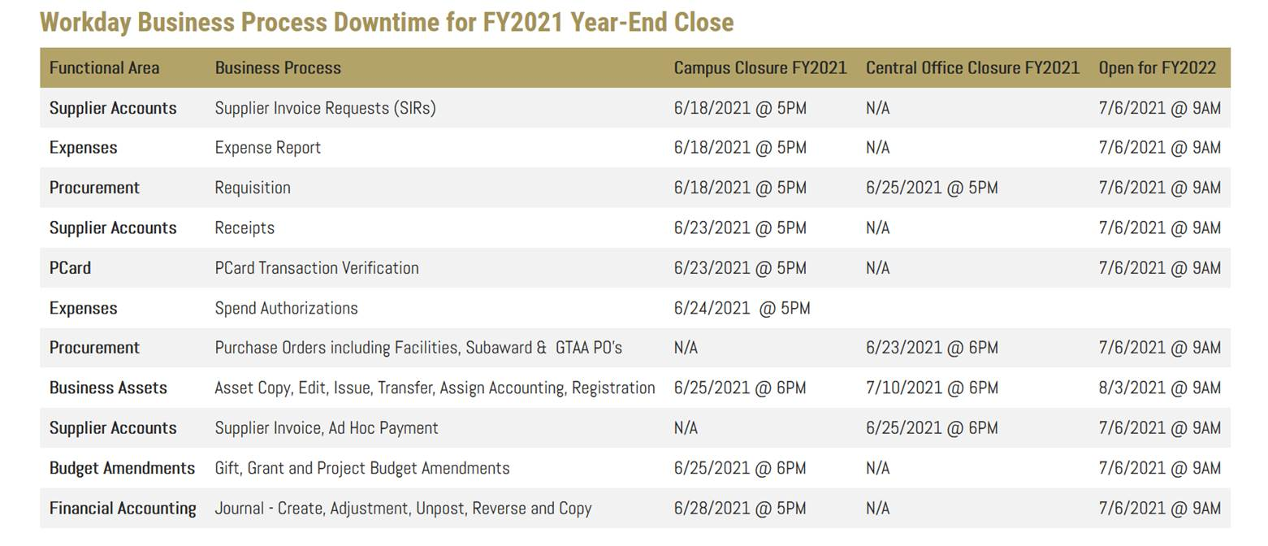
FY2021 Year-End Close
Please find below the Workday Business Process Downtime Schedule for Year-End Close. This schedule is located on the Controller’s Office website (www.controller.gatech.edu/monthyear-end) and will also be published to or linked from Workday (Announcements).

Slide 20
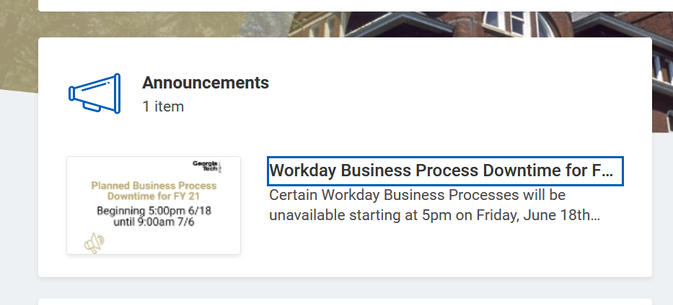
FY2021 Year-End Close
Please find below the Workday Business Process Downtime Schedule for Year-End Close. This schedule is located on the Controller’s Office website (www.controller.gatech.edu/monthyear-end) and will also be published to or linked from Workday (Announcements).

Slide 21
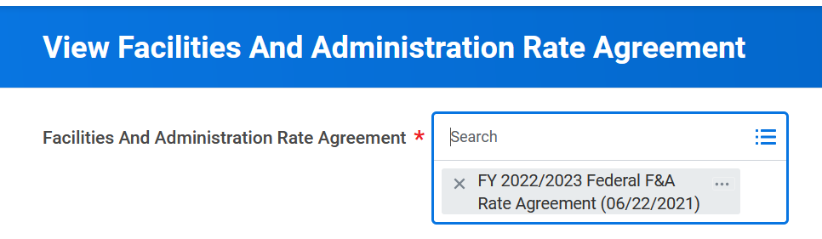
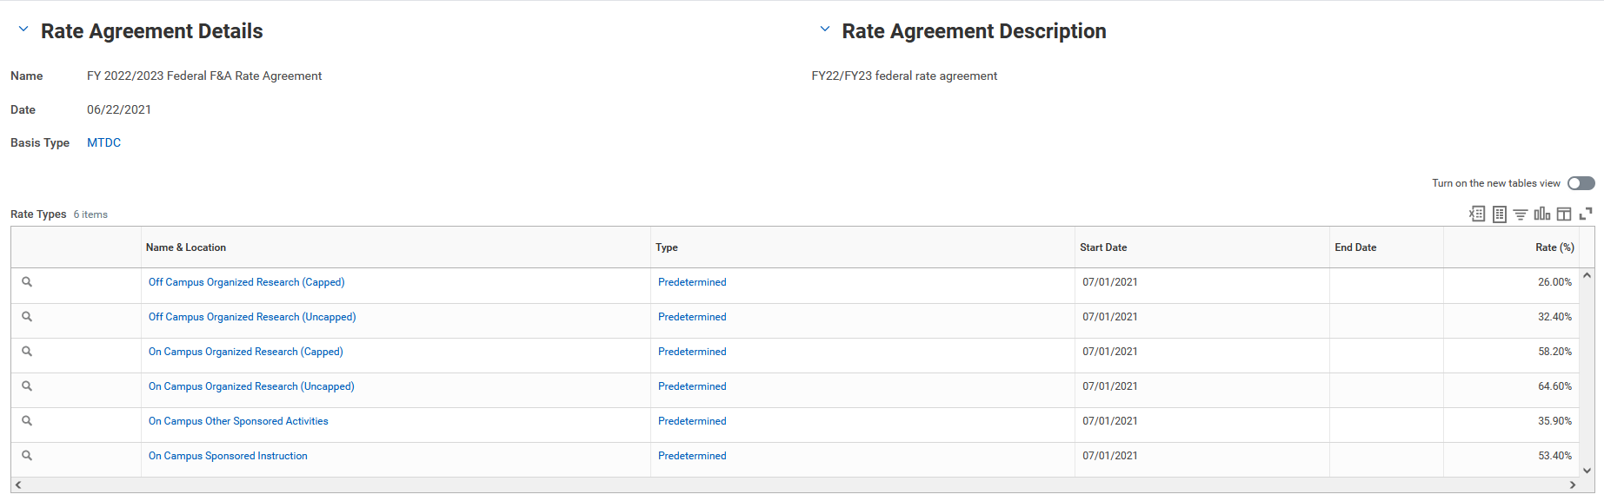
FY2021 Year-End Close

Slide 22
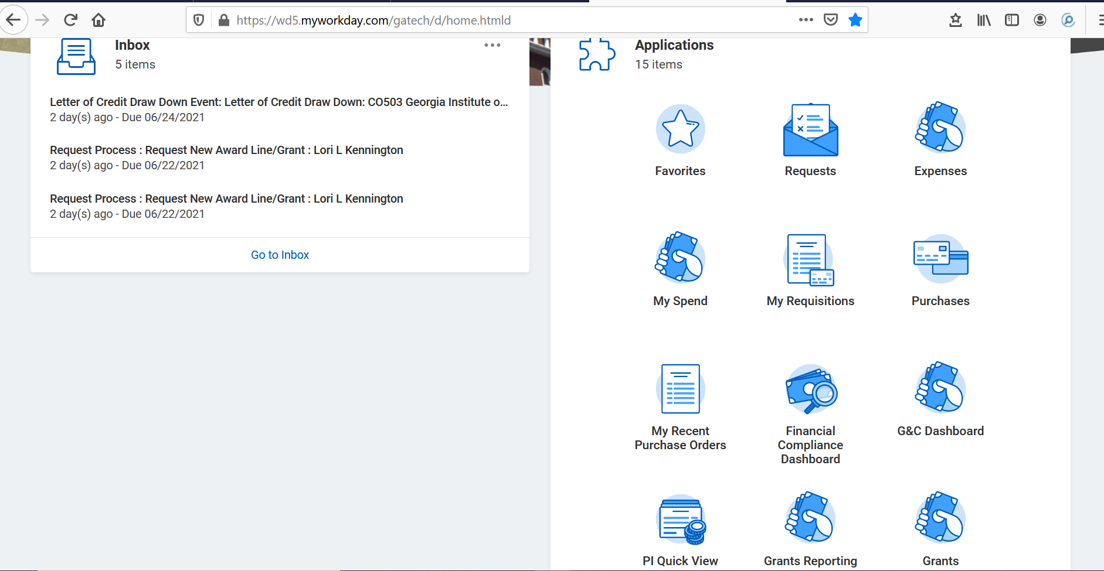
HELPFUL REPORTS AND WORKLETS
  WORKLET:
  Grants Reporting
  PI QUICK VIEW

Slide 23
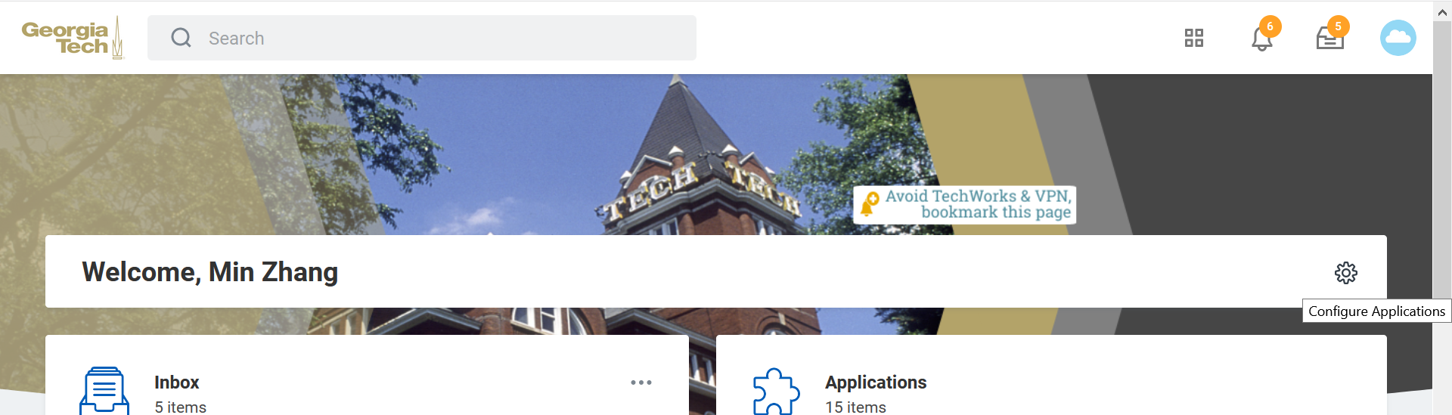
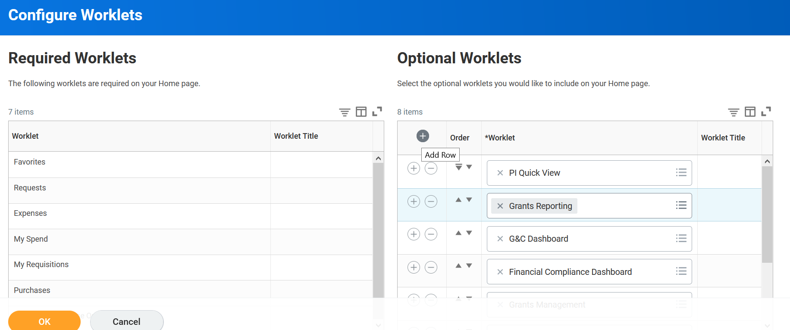
HELPFUL REPORTS AND WORKLETS

Slide 24
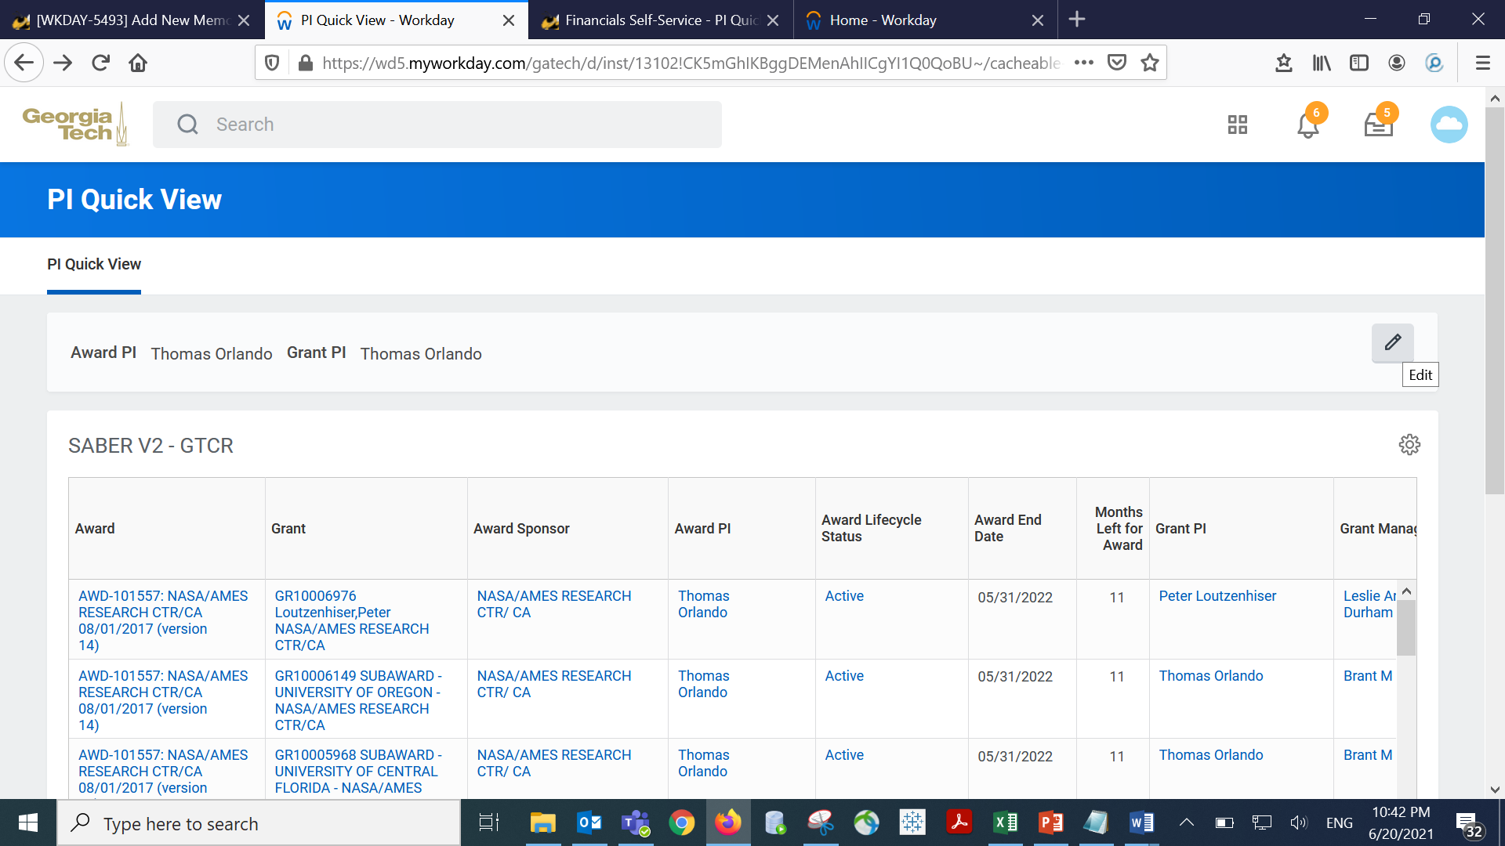
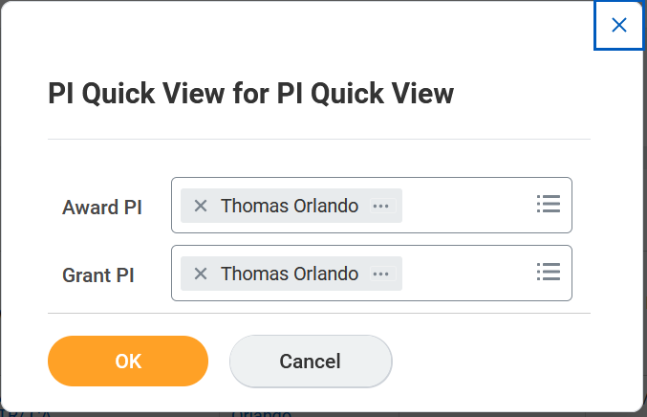
HELPFUL REPORTS AND WORKLETS

Slide 25
HELPFUL REPORTS AND WORKLETS
  WORKDAY REPORTS:
  SABER
  SABER BY OBJECT CLASS
  SABER BY AWARD
  FIND AWARDS
  G&C PARTICIPANT SUPPORT TRANSACTION - GTCR
  AWARD AUDIT SUMMARY – GTCR
  EXTRACT AWARDS
  EXTRACT GRANTS
  GT AWARD LINES EXTRACT- GTCR
  GT RPT COST SHARE FUND IN PROGRESS REPORT

Slide 26
Josh Rosenberg
Sr. Director, Grants and Contracts
Training Update

Slide 27
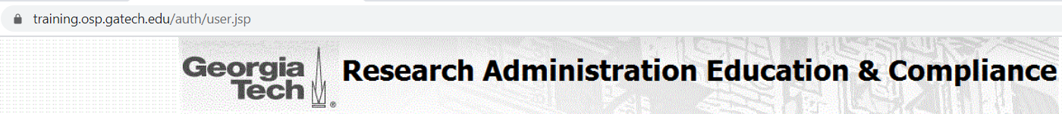
Upcoming Research Administration Trainings
https://training.osp.gatech.edu/ - sign in with GT credentials and register
Research Admin Buzz Quarterly Meetings:
  July 20th and October 13th from 11:00am – 1:00pm
CRA Study Group (10 week session) Friday's between 12:30pm – 2:00pm
  Next series August 27th (skips Sept 3rd) through November 5th
Grad Student and Postdoc Intro to Proposal Preparation, Submission & Post-Award Processes
  July 21, 2021 1:00 – 4:00
The fall training schedule will be coming soon

Slide 28

The Latest Buzz with G&C Accounting
GRANTS.GATECH.EDU

Slide 29

GRANTS.GATECH.EDU

