Slide 1

The Latest Buzz with G&C Accounting
Wednesday, May 19, 2021
1:00 - 2:30PM

Slide 2
Agenda
Topic | Presenter(s)
Welcome and Research Stats | Josh Rosenberg
Compliance and Audit Update | Cassandra Belton
Controller’s Office Update | Carol Gibson
Accounts Payable – Match Exceptions | Abbie Coker/Julie Beattie
Spotlight: Financial Administration Team | Gabbie Slappey
Updates: Effort Reporting, Fringe Rates, GTRI Admin. Study | Jonathon Jeffries
Project Accounting Updates | Glenn Campopiano
Workday: Latest News | Don Cochran
Reporting Updates | Amy Zhang
Training Update | Rob Roy

Slide 3

Josh Rosenberg
Sr. Director, Grants and Contracts
Grants and Contracts
General Updates

Slide 4
Research Trends
Resident Instruction (through April):
  Proposals: up $224.2 million (20.1%) to $1.3 billion.
  Awards: up $18.0 million (5.5%) to $346.3 million.
  Expenditures:
    Direct: up $4.4 million (1.9%) to $233.4 million.
    Indirect: down $1.3 million (1.9%) to $67.9 million.
GTRI (through April):
  Awards: up $122.1 million (22.6%) to $662.7 million.

Slide 5
Research Trends
RI Expenditures: FY20 v. FY21 YOY

Slide 6
General G&C Updates
Invoices
  G&C is averaging $28.4 million in invoices during the first ten months of FY21 and has $284 million during that time (versus $264 million through ten months last year)
Financial Reports
  833 total through 10 months.

Slide 7
Cassandra Belton, MBA,CPA
Cost Accounting
Financial Compliance Program Manager

Slide 8
Audit Corner: Rebudgeting Risk
High risk:
Between existing and new budget category
Between existing and restricted category
e.g. participant support; foreign travel, equipment
Medium risk:
Between existing categories, but unapproved type e.g. GRA salary→ Tech Temp salary
Lower risk:
Between existing categories and existing type
e.g. travel → material & supplies
ALL changes involve risk! Written sponsor approval is best practice.
Notes:
Caveat with over 90 days includes late setup by G&C and/or OSP; we cannot move prior year expense from State account; Cost transfers without a Grant Worktag should go to the controller’s office.

Slide 9
Carol Gibson, CPA
Institute Controller and Chief Accounting Officer
Controller’s Office

Slide 10
FY21 Key Year-End Reminders
Obligations must reconcile to the ledger at 6/30
Commitments must be zero at 6/30
Review Financial Reports (EBBR/SABER/etc.) for:
  Payment made against PO, PO Obligation did not liquidate
  PO issued, Requisition Commitment did not liquidate
  Expense Report paid, Spend Authority Commitment not zero
Review Open Obligation Campus - CR for All PO’s
  CY and PY PO’s open at 6/30 each year must be valid
    If good/services received, PO should be closed
Campus Reporting Dashboard in Workday
Managing Institute Finances Guide in ServiceNow
  YE Town Hall Meeting Slide #94
Notes:
Managing Institute Finances Guide is a continuation of the Fiscal Year-End Closeout User Guide
• MIF Guide contains four main sections:
• Financial Reports User Guide
• Common Financial Concepts
• Reporting Overview
• Tips on Financial Topics including supplier invoicing, procurement, travel and expenses, etc

Slide 11

FY21 High Level Closeout Schedule
KEY YEAR-END TASKS | DEADLINE | COMMENTS
PCard Purchases | June 17 | Must hit the bank by this date
Requisitions Created and Approved | June 18 | Small Dollar; Earlier dates - Large Dollar
Payments for Invoices and Travel | June 24 | Deadline for submission is June 11th
Biweekly Payroll Accrual | June 24 | Does not include students and temps
Salary & Fringe Transactions | June 28 | Monthly Payroll
Journal Transactions | June 28 | Acctg Jrnls, Acctg Adj, Operational Jrnls
Cash Receipts | June 29 | Bursar’s Office
Salary & Fringe Redistributions | June 30 | Via Express Direct Retro in OneConnect
Final Close Processes – Operating Ledger | July 6 to 11 | GTPE, GTRI, Grants, Budgets, Controller
Final Close Processes – Capital Ledger | July 23 | Controller’s Office
***Deadlines published in Closeout Documents

Slide 12

FY21 Financial Reporting Schedule
KEY REPORTS & EXTRACTIONS | DUE DATE | RESPONSIBLE
Budgetary Compliance Report (BCR) | August 16 | Controller’s Office
Annual Financial Report (AFR) | August 16 | Controller’s Office
Schedule of Expenditures of Federal Awards (SEFA) | August 16 | Grants & Contracts
Transparency in Government Act (TIGA) – Salaries and Travel | August 14 | Accounts Payable and Payroll
Annual Expenditure Report (AER) | September 1 | Budget Office
GT AFR with Component Units | September 20 | Controller’s Office
Annual Return of Surplus Funds | October 1 | Controller’s Office
Transparency in Government Act (TIGA) – Payments/Obligations/PCard | October 15 | Procurement & Business Services
Annual Immigration Reform Data | December 31 | Procurement & Business Services
Georgia Tech Audited AFR Issued | Late Dec 2021 | GA Dept of Audits and Accounts
University System of Georgia Audited AFR Issued | Mid Jan 2022 | GA Dept of Audits and Accounts
State of Georgia Audited CAFR Issued | 1st Qtr 2022 | GA Dept of Audits and Accounts
***Due dates based on prior year timelines

Slide 13
Clearing Invoices In Match Exception
May 19, 2021
Abbie Coker
Director, Accounts Payable and Travel
Julie Beattie
Senior Accounts Payable Analyst

Slide 14
Where are we with the match exceptions?
Match Exception Reasons | Count of Invoices
Change Orders | 79
Receipts Needed | 444
Both | 9
Total | 532
Please take immediate action in so invoices can be processed!
Enter receipts
Complete a change order

Slide 15
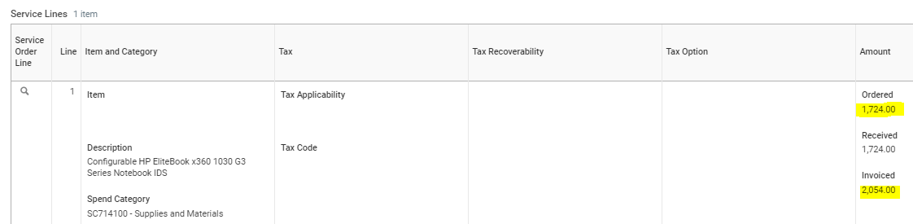
What causes Match Exceptions: Change Orders Required
When the Tolerance is exceeds
Invoice is < $5,000:
  $250 over-invoiced
Invoice is >= $5,000:
  5% or $500 over-invoiced
  In this example, you can see that line 1 needs a change order to increase the PO amount by $330.

Slide 16
What causes Match Exceptions: Receipts or Approval
Receipts required for:
For a Goods Line PO > $3,000
The department needs to enter receipts in order for the voucher to match to payable/paid
Cost Center Approval required for:
Any Service Line PO > $3,000
The department needs to approve in order for the voucher to match to payable/paid

Slide 17
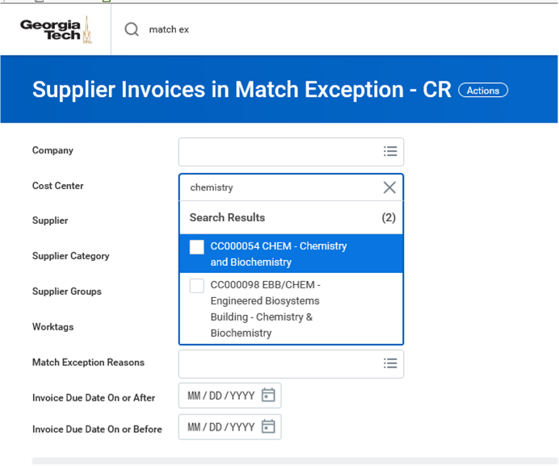


How can you help clear out invoices in match exception?
Review all invoices in match exception report.
Run “Supplier Invoices in Match Exception – CR” report in Workday weekly.
Take necessary action in order for invoice to be processed
  Create change order to increase funds
  Enter receipts
Invoice status would reflect “Matched” once match exception has been cleared.

Slide 18
Where are we with outstanding invoices in department WebNow queues:
Missing PO | Count of Invoices
Invoice with no PO# in WebNow | 429
Invoice with no PO# in Department Queues | 87
Total | 516
Please take immediate action in WebNow so invoices can be processed!

Slide 19

Questions

Slide 20
Gabrielle Slappey
Financial Manager, Grants and Contracts
Grants and Contracts
Spotlight: Financial Administration Team

Slide 21
Meet the Team
Doug Feller, CRA, G&C Analyst III
  At Tech for 3 years
  ME, Aerospace, ASDL
David Lyons, CRA, G&C Analyst II
  At Tech for 4 years
  NEETRAC, BME, Chemistry
Samuel Guzak, G&C Analyst II
  At Tech for 3 years
  ECE, CEE

Slide 22
Meet the Team
Shavon Deriso, G&C Analyst I
  At Tech for 4 years
  ISYE, EAS
Sarah Kelsey, G&C Analyst I
  At Tech 8 months
  EI2, IEN

Slide 23
Overview
Some Key Responsibilities
  Sponsored Award Management
  Award/Grant Number Set-up
  Post Award Budgets
  Fixed Price Award Residual Balance Transfers
  Workday Inbox Requests

Slide 24
Overview
Some Key Responsibilities (cont’d)
  Service Now Requests
  Cost Transfers/Journal Entries
  Award Closeout
  Assist w/audit requests when necessary

Slide 25
Reminders
Billing and financial reporting is handled by the assigned accountants
New award line/grant requests should route through Workday via Create Request (not Service Now)
Awards flow through from CIS first into Workday
  Award status changes to ‘OSP Import New,’ ‘OSP Import Mod’ or ‘OSP Import Advance’ once received through system integration
  That status reflects that it is in the analyst’s queue

Slide 26
Reminders
Watch for Actions that can Delay the Closing Process
  Past-Term Charges
  Unallowable Charges
  Charges in Excess of Budget
  Lack of Adequate Cost Sharing
  Lack of Project Deliverables
  Subrecipient Final Invoicing

Slide 27
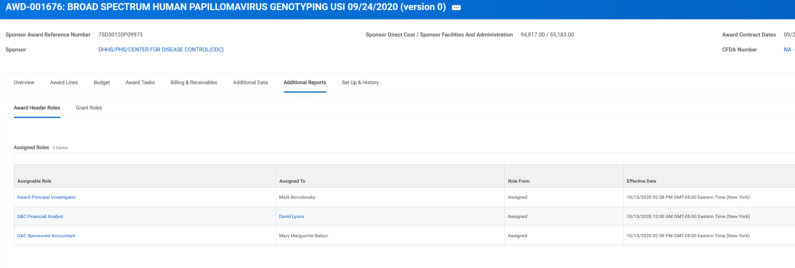
Reminders
Find Award Analyst or Accountant

Slide 28
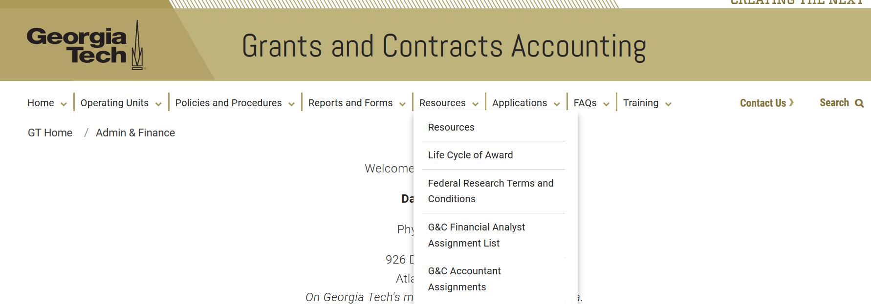
Reminders
Find Award Analyst or Accountant

Slide 29

Quick Stats
Since going live to Workday, the Financial Administration team has set up over 2300 awards
Processed over 750 journals
Managed/processed over 2000 Workday Inbox requests
Responded to countless Service Now requests

Slide 30
Jonathon Jeffries, CPA
Director of Cost Accounting

Slide 31
Year End Effort Compliance - NIH
NIH Memo distributed in May includes examples
An email was sent out for employees requiring an adjustment (EDR) based on April close
Please reach out if you have an employee that may be in violation and requires an analysis due to Summer Pay
Identified EDRs must be moved to a Linked NIH Cost Share
Submit a request via Workday or reach out to assigned Analyst
Notes:
NIH Memo posted to Website
NIH will be reviewed again based on May close, Mid-May deadline for EDRS otherwise an Accounting Adjustment will be posted to Cost Share within period

Slide 32
Year End Effort Compliance - NSF
NSF limits salary compensation for senior project personnel to no more than two months of their regular salary in any one year
  Senior Personnel refers to all individuals responsible for the scientific or technical direction of the project
  NSF allows re-budgeting authority without approval as long as it has no impact to scope
  If identified at Proposal stage, request approval
  2) If using re-budget authority, document in project file

Slide 33
Terminating Employee ASR - Process
Establish a Term Date in OneUSG Connect
Run the Terminating ASR after the employee’s last payroll posts in OneUSG Connect
Employee and ASR Financial Manager must sign
Return to the easr.ask Help Desk
No First Hand Knowledge Accepted
Any Changes to Distribution will Void ASR

Slide 34
Year End – Service Center Carry Forward
New process in FY2021 due to additional Board of Regents (BOR) and Office of Planning and Budget (OPB) oversight and scrutiny
No DSS Carry Forward Request will be required
Grants and Contracts will review based on Budget Office Report and compare to Rate Study
  50% of Revenue should be generated from sponsored or external to GT users
  Salary should be charged to DSS funds in proportion to rate study and goods/services sold
  CF spend down plan may be requested

Slide 35
Fringe and GSTRP Rate Studies
Proposed Fringe Rates submitted to ONR-DC April 30th
  Full Fringe slight increase proposed - 0.3%
    New Component to include employee benefit for Campus Bus and Trolley Services
    TRS Rate Increase
  Grad Health proposed decrease -0.7%
    Rate trending downward but cost and subsidy increases expected in FY22
  Graduate Student Tuition Remission Program (GSTRP) Submitted to ONR- Atlanta
    No Change

Slide 36
GTRI/RI Exchange of Services/Admin Study
The Exchange of Services/Admin Study is prepared annually to identify the projected cost of administrative and support services to be provided to Georgia Tech Research Institute (GTRI) by units and offices funded by the Georgia Institute of Technology, Resident Instruction budget (Fund 10000) during each fiscal year.
The Exchange of Services/Admin Study is completed each Spring for the following fiscal year by looking at the most recently closed fiscal year’s actual costs and allocation of costs.
For example, the FY22 study was completed with the starting point being FY20 actual costs and allocations. A “true up” of FY20 actual costs compared to the original study (over or under recovery) will be added to FY22 totals in order for GTRI to only charge our government sponsors for actual costs.
Notes:
23M paid by GTRI to RI overall

Slide 37
Glenn Campopiano, CRA
Project Accounting
Director of Project Accounting
Project Accounting Topics

Slide 38
Grants and Contracts Accounting
Legacy Grants Management had a 90-day to Expiration report
Very helpful for managing awards as they approached the end date.
No longer available in Workday – but there are substitutes.
One can run SABER by PI or Cost Center and sort by time remaining on award.
OK but returns a good bit of data that needs filtering.
I have an alternative – you still need SABER but it may be easier.

Slide 39
Grants and Contracts Accounting
One can Use Ad Hoc reporting in CIS – WebWise to generate a list quickly.
Choose Ad Hoc: Awards: Summary from menu
Criteria- several ways but I’ll us PDPI
Select PDPI you want to review
Choose End date and enter in beginning and end date.
Create report output
PDPI – End date – Award/fund#- PrimeGrant# - Total Funded Amt

Slide 40
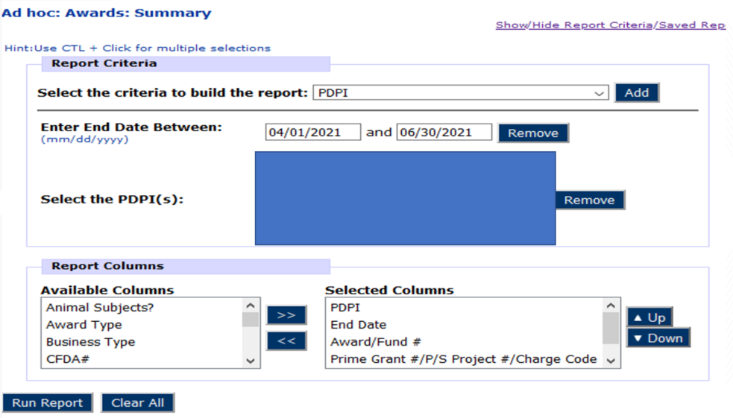
Grants and Contracts Accounting

Slide 41
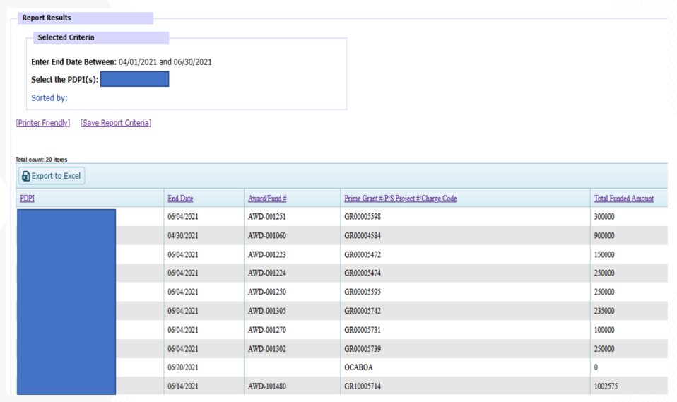
Grants and Contracts Accounting

Slide 42
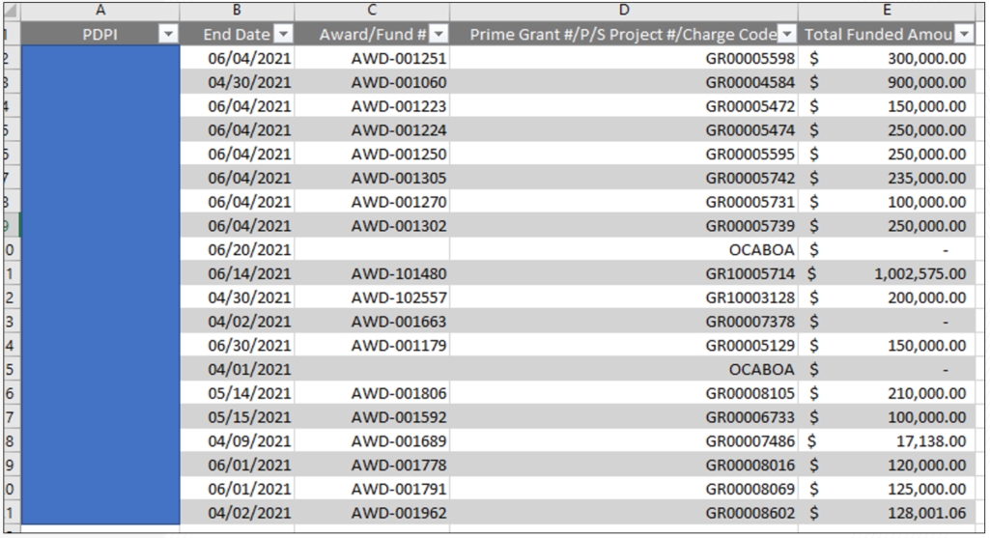
Grants and Contracts Accounting

Slide 43
Grants and Contracts Accounting
2 CFR 200 Definitions of Budget Period and Period of Performance.
In late 2020 a revised definition took effect.
From 2 CFR 200 Definitions (Current as of April 19, 2021) - https://www.ecfr.gov/cgi-bin/retrieveECFR?gp=1&SID=3cbe437ffe224ebb0af8609bd8cc2c42&ty=HTML&h=L&mc=true&r=PART&n=pt2.1.200#se2.1.200_1308
Budget period means the time interval from the start date of a funded portion of an award to the end date of that funded portion during which recipients are authorized to expend the funds awarded, including any funds carried forward or other revisions pursuant to §200.308.
Period of performance means the total estimated time interval between the start of an initial Federal award and the planned end date, which may include one or more funded portions, or budget periods. Identification of the period of performance in the Federal award per §200.211(b)(5) does not commit the awarding agency to fund the award beyond the currently approved budget period.
From Federal Register OMB Final Guidance for Grants and Agreements - https://www.federalregister.gov/documents/2020/08/13/2020-17468/guidance-for-grants-and-agreements
Subpart A—Acronyms and Definitions
Period of Performance, Budget Period, and Renewal
The definition of period of performance and renewal was revised to help clarify that the term period of performance reflects the total estimated time interval between the start of an initial Federal award and the planned end date, and that the period of performance may include one or more budget periods, but the identification of the period of performance does not commit funding beyond the currently approved budget period. The definition of budget period was edited to clarify that recipients are authorized to expend the current funds awarded, including any funds carried forward or other revisions pursuant to 2 CFR 200.308. Further, recipients may only incur costs during the first year budget period until subsequent budget periods are funded based on the availability of appropriations, satisfactory performance, and compliance with the terms and conditions of the award.

Slide 44
Grants and Contracts Accounting
Be aware that spending past a budget period end date without the next increment of funding MAY put you at risk of having those expenses not being allowed if the funding arrives at some future date and the agency does not recognize the spending whilst you had no funding in place.
Spending past the budget period end date with unspent funds should be OK if carryforward is allowed or granted.
G&C is not implementing any changes at this time to enforce this as the interpretation of the changes varies widely. We believe continuing the research on multiyear, incrementally funded awards to avoid stopping and starting the research unnecessarily is the best course of action at this time.

Slide 45
Don Cochran
ERP System Analyst Lead, ERP

Slide 46
Workday : Latest News
Workday Community
- Collaboration
- User Groups
- Brainstorms
- Documentation
ServiceNow

Slide 47
Workday Grants Reporting
Amy Zhang
ERP Application Support Analyst II

Slide 48
SPONSORED AWARD BUDGET EXPENSE REPORT (SABER)
Type of Reports:
SABER (NEW)
SABER BY OBJECT CLASS
SABER BY AWARD

Slide 49
SPONSORED AWARD BUDGET EXPENSE REPORT (SABER) (NEW)
The goal in the re-engineering was limited to improving the SABER report's processing time and improving the accuracy of Estimated F&A values.
The SABER report should run faster for larger datasets created when using the cost center prompt or the Award PI prompt.
Visually the report changes are as follows:
On the Prompt page: We removed the Company and Award Report Viewer prompts as they were unnecessary or added limited value.
On the Results page: We have combined the Estimated F&A for Obligations and Commitments which replaces what was two different values.

Slide 50
SPONSORED AWARD BUDGET EXPENSE REPORT (SABER) (NEW)
The new SABER improves the results for the Estimated F&A. Great efforts were taken to improve the 'Estimated F&A' calculation; however, there are still scenarios where the algorithm displays an incorrect Estimate because Workday does not support 'Estimated F&A' - so it is something we have had to build in complicated conditional logic in order to create the 'Estimated F&A' in our reports. 'Estimated F&A for Obligations and Commitments' is subject to errors in the calculated value presented on Subawards. In the event the error occurs, usually the error is an omission of an estimated value where it should exist. In a few cases, we observed a different calculated estimate. The error only occurs on a small fraction of the Resident Instruction subawards or other grants with a Basis Limit such as I-Corps funding. We will continue to work on improving this calculation and hope to resolve the remaining issue soon.
Please note that differences may be observed on the Estimated F&A on Obligations of the 'SABER' report and the corresponding Estimates on 'SABER for Award', and 'SABER by Object Class'. The SABER is the most reliable report, as it contains the most accurate calculations of the three reports.

Slide 51
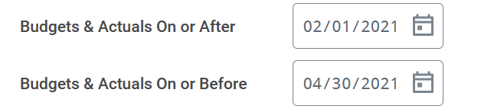
TIPS AND TRICKS
  Question: How do I view actuals for a specific period of time?
  Answer: Use the Budgets & Actuals On or After and Budgets & Actuals On or Before criteria

Slide 52

TIPS AND TRICKS
Question: How do I view just the Sponsored portion of my Award, not the cost share (vice versa)?
Answer: Use the Grant Hierarchy field to filter.

Slide 53
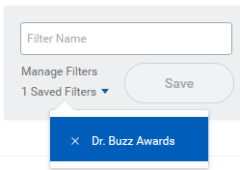
TIPS AND TRICKS
Question: How do I save a filter if I want to view the same criteria on a regular basis?
Answer: Enter Criteria, Create filter name, and Save filter
Question: How do I modify filters?
Answer: You can select Manage Filters and then edit your filter.
Question: Can I create multiple filters?
Answer: Yes, you must create unique filter name. All filters will display in the drop down.

Slide 54
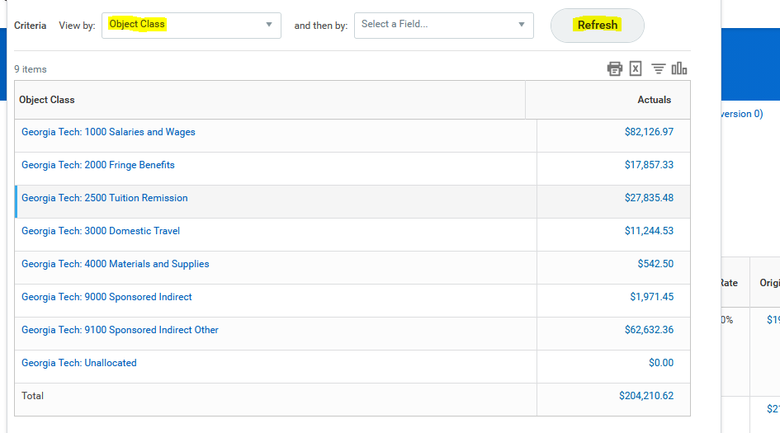
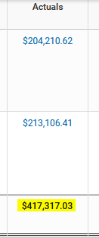
Drill Down for Detail
Drill down on total for Award and/or Grant and view by Object Class and refresh

Slide 55
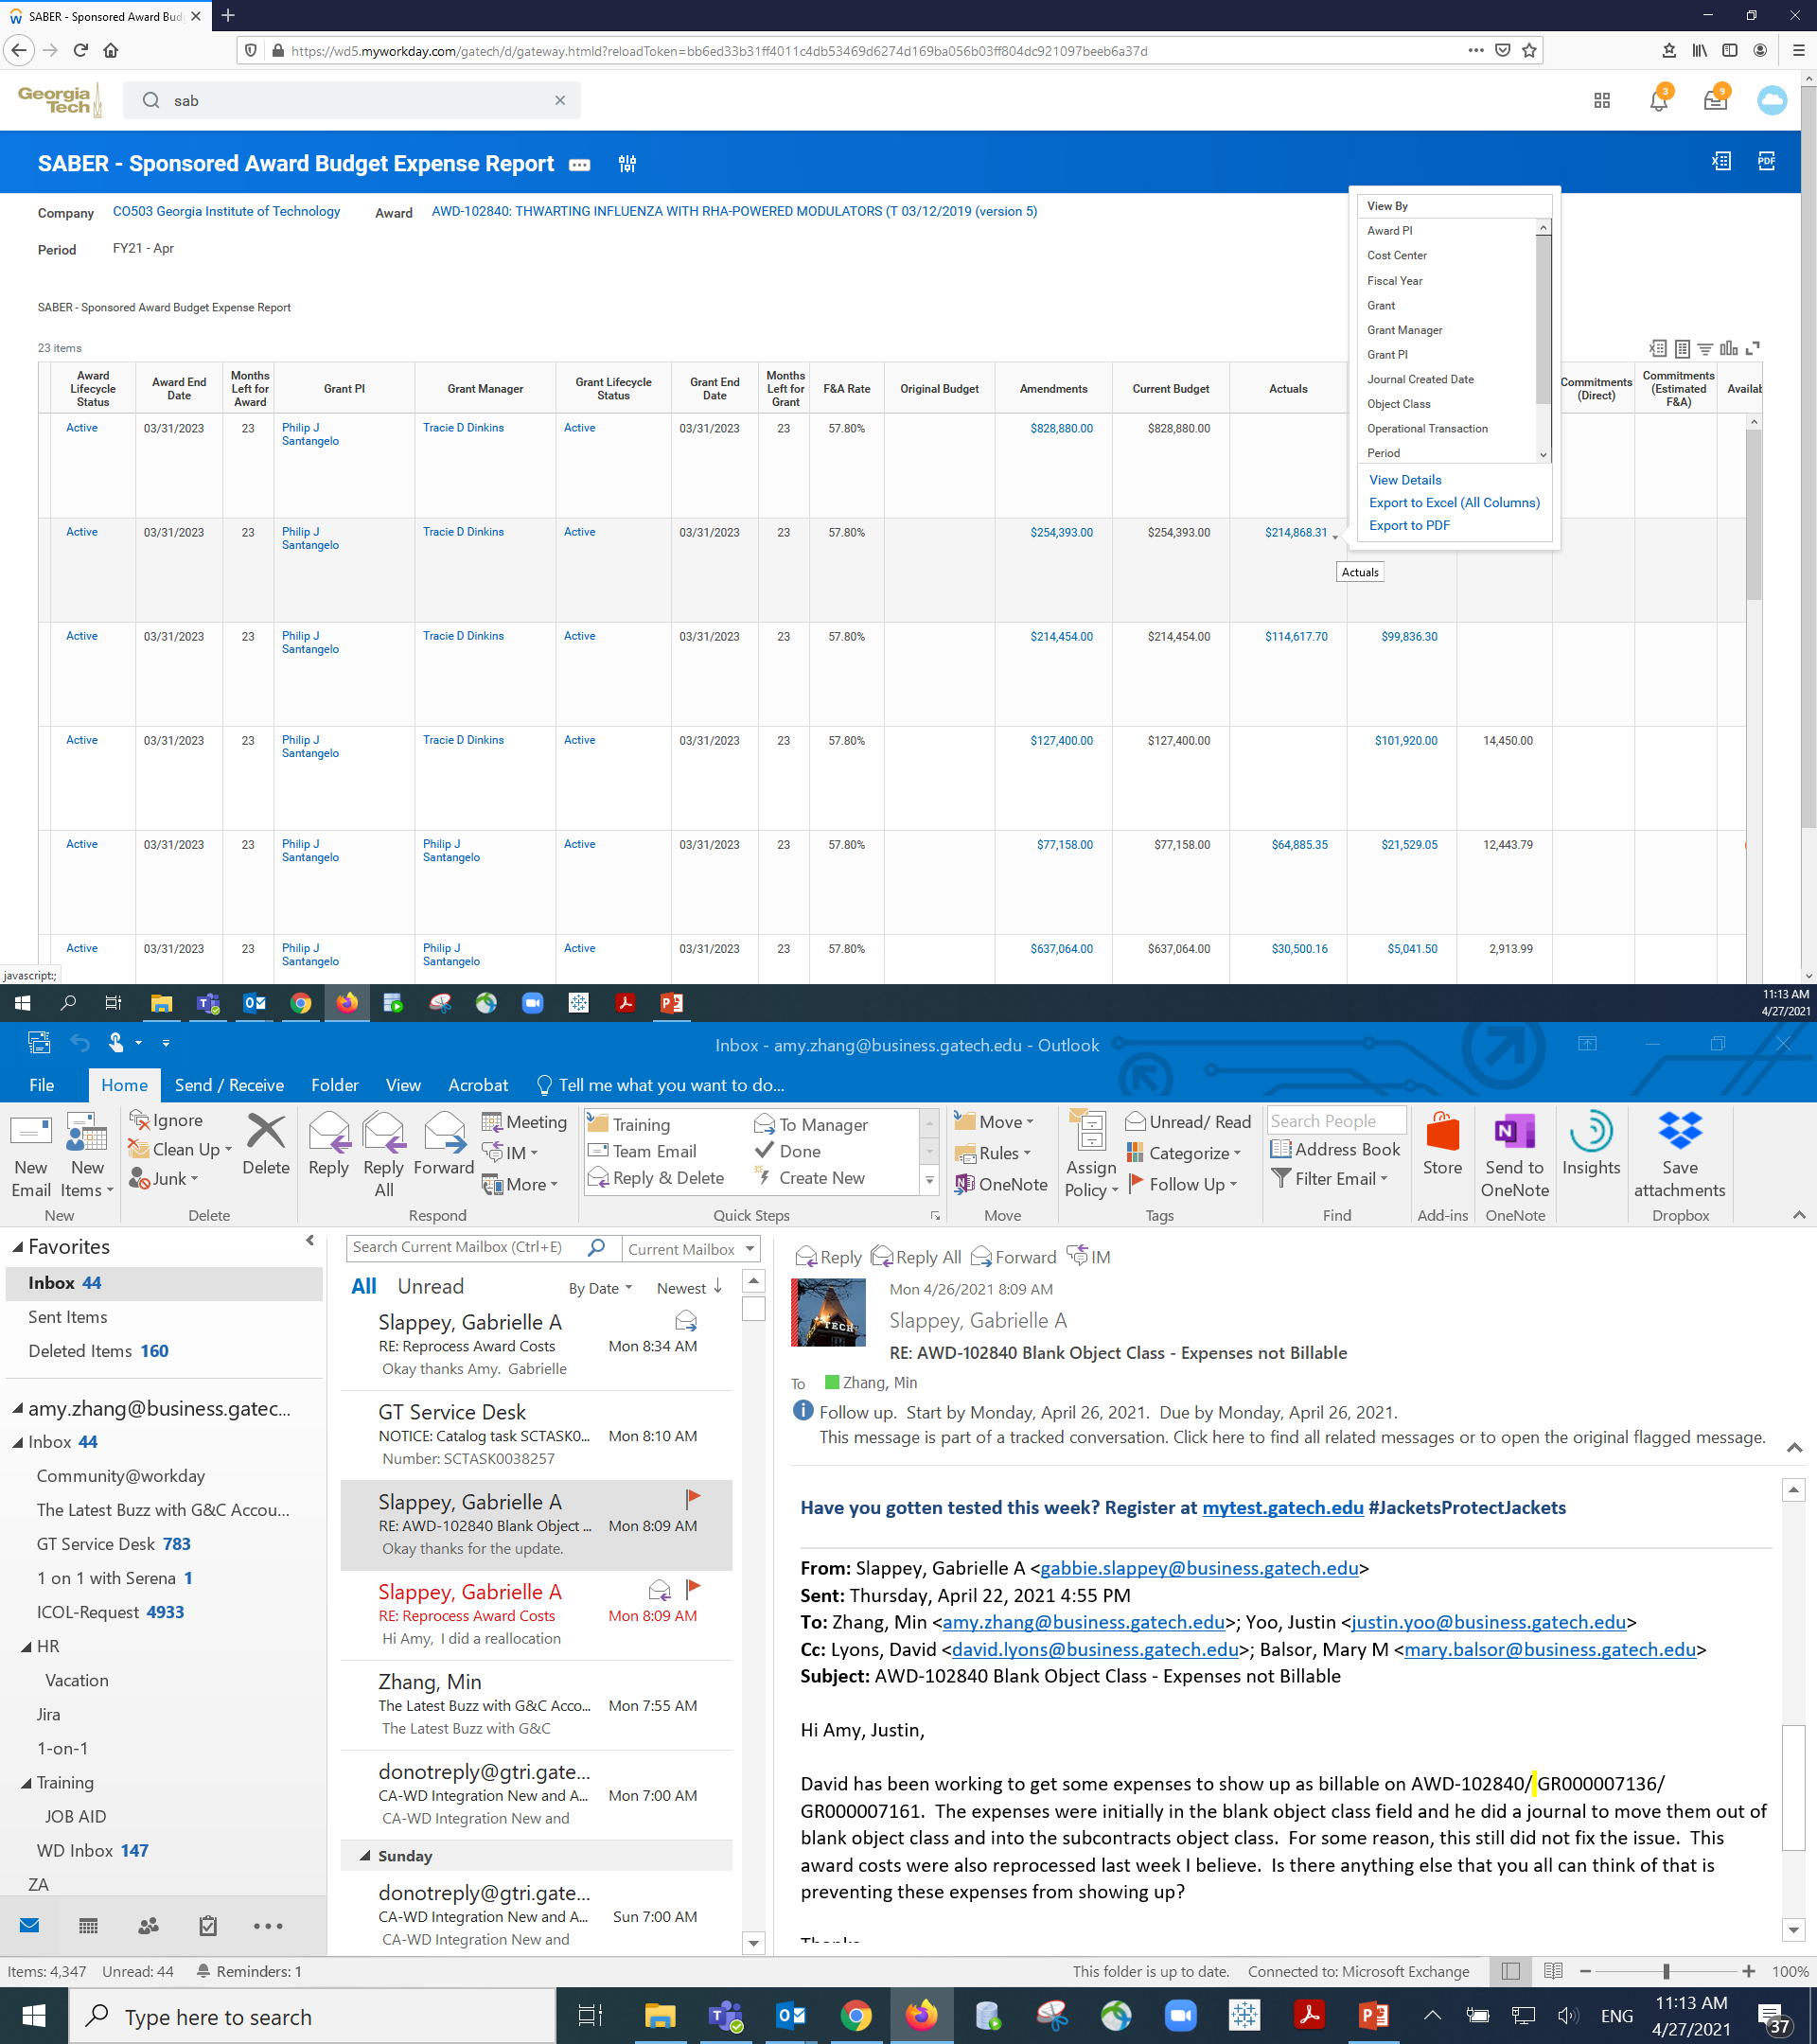
Drill Down for Detail
  Move your cursor next to the number until you see the triangle and left click your mouse. You will see the pop up menu.

Slide 56
Rob Roy, CRA
Director of BOR Sponsored Operations

Slide 57
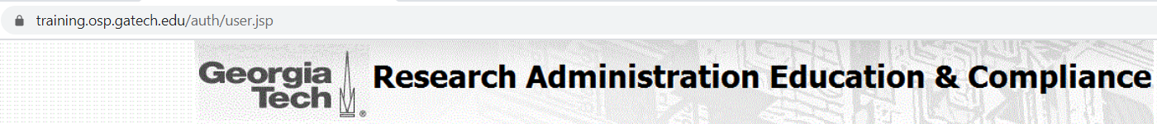
Upcoming Research Administration Trainings
    https://training.osp.gatech.edu/ - sign in with GT credentials and register
May Training Classes:
5/18 (Tuesday) - Post-Award & Compliance Part 2 from 12:30pm - 3:00pm
5/19 (Wednesday)
  GT Basic Certification Workshop from 9:30am - 12:30pm
  Finding Funding and Submission Process from 7:00pm - 8:00pm
5/20 (Thursday) - Post-Award & Compliance Part 1 from 9:30am - 12:00pm
5/21 (Friday) - NSF CAREER Panel Discussion from 10:00am - 12:00pm
5/24 (Monday) – eRouting Proposal Module from 1:00pm – 2:30pm
5/26 (Wednesday) – Cayuse Proposal System from 1:00pm – 2:30pm
OTHER
Research Admin Buzz Quarterly Meetings:
  July 20th and October 13th from 11:00am – 1:00pm
CRA Study Group (10 week session) Friday's between 12:30pm-2pm
  Next series starts August 27th (skips Sept 3rd) and ends November 5th

Slide 58

The Latest Buzz with G&C Accounting
GRANTS.GATECH.EDU

Slide 59

GRANTS.GATECH.EDU

