Slide 1

The Latest Buzz with G&C Accounting
Thursday, April 29th, 2021
1:00-3:00PM

Slide 2

Josh Rosenberg
Senior Director, Grants and Contracts

Slide 3
Agenda
Topic | Presenter(s)
Welcome | Josh Rosenberg
Research Trends | Josh Rosenberg
General Updates | Josh Rosenberg
Deadlines/Issues (Year-End) – Business Services | Frans Barends
Effort Reporting | Jonathon Jeffries
ASR Dates | Jonathon Jeffries
NIH Salary Cap | Jonathon Jeffries
Cost Transfers | Cassandra Belton
Journal Entries | Cassandra Belton
Project Accounting Deadlines | Glenn Campopiano
Cost Transfers/Service Now | Glenn Campopiano
Commitment Accounting, Salary, and EDRs | Kimberly Short/Jason Cole
Reporting | Amy Zhang
Training Classes | Rob Roy

Slide 4

Josh Rosenberg
Sr. Director, Grants and Contracts
Grants and Contracts
General Updates

Slide 5
Research Trends
Resident Instruction (through March):
  Proposals: up $138.9 million (13.3%) to $1.2 billion.
  Awards: up $17.9 million (6.0%) to $314.6 million.
  Expenditures:
    Direct: up $4.9 million (2.3%) to $216.0 million.
    Indirect: down $2.3 million (3.7%) to $61.4 million.
GTRI (through March):
  Awards: up $101.7 million (21.3%) to $580.1 million.
  Expenditures:
    Direct: up $52.6 million (20.9%) to $304.0 million.
    Indirect: up $6.3 million (4.7%) to $138.7 million.

Slide 6
Research Trends
RI Expenditures: FY20 v. FY21 YOY

Slide 7
General G&C Updates
Invoices
  G&C is averaging $28.3 million in invoices during the first nine months of FY21 and has billed over $254.4 million during that time (versus $239.9 million through nine months last year)
Financial Reports
  718 total through 8 months.

Slide 8
Frans Barends
Sr. Director, Business Services

Slide 9
Procurement and PCard Update

Slide 10
Procurement Update
Deadlines are listed in the Closeout memo
  Dates are similar to last year.
Make sure to close obligations (open encumbrances) early!
PO Closures
  (*excludes Construction and OSP PO’s)
  PO’s will be closed per the closeout memo for BR19/20 and 21

Slide 11
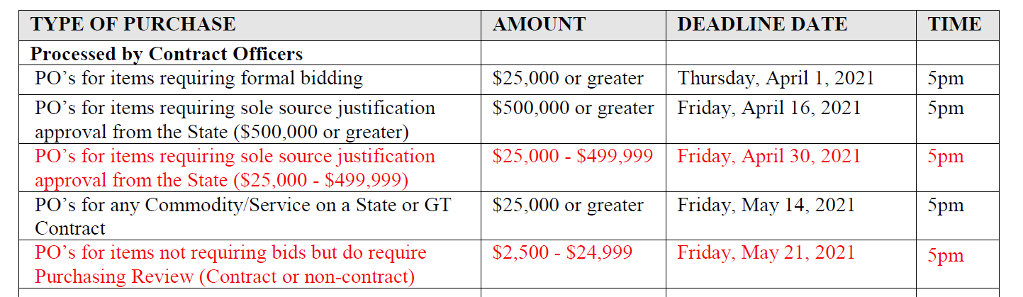
Procurement Update
Key Closeout dates Updates to Close Out Memo
Campus access to Workday Procurement will be removed at 5pm on Friday, June 18th.

Slide 12

Procurement Update
No Bid Limit increased to $24,999
  Order of precedence applies. No Splits or changes.
  Review of Orders close to $24,999

Slide 13
Procurement Update
Procurement Website has been updated
Training
  Training being developed for system and policy after the new fiscal year
  Training will be mandatory for any new RQ reviewers.
  Recommend all RQ reviewers take the training as a refresher.

Slide 14
Procurement Update
See procurement website for more information
Office Hours (Campus)
Monday –
  Campus Team 9-11am
    Departments: HR, Communications, PE
    Commodities: Professional Services, Hotels/Catering
Tuesday
  Scientific Team 9 am – 11 am
  IT Team 2 – 4 pm.
Friday –
  Campus Team 9-11am
    Departments: Facilities, Housing, GTPD, Parking
    Commodities: MRO, Office Machines, Misc

Slide 15
Procurement Update
Office hours (GTRI)
Monday
  GTRI : 1-3pm
    Departments: CIPHER, CMSO, CTO, ELSYS, ESD, ICSD, PMSO, RS, TMD, S2CD
Tuesday
  GTRI: 2-4 pm
    Departments: ACCT, ASL, COMM, OESD, EOSL, ICL, ISD, SISD, SPS
Wednesday
  GTRI: 11am-1pm
    Departments: ACL, ATAS, DDOPS, ECO, FRA, MSD, SEAL SSD, VPDIR, SURPLUS

Slide 16
PCard
Whittney Haynes is new PCard Manager.
Process will be similar to last year
Deadlines for fully verified transactions
Transactions on or before 6/17/2021 must be fully verified by 6/23/2021
All transactions posted between 6/18/2021 - 6/30/2021 must be fully verified by 7/09/2021

Slide 17
Supplier Accounts and Travel

Slide 18
Supplier Registration & Supplier Changes
Deadline to submit new supplier registration through the Supplier Portal is May 14, 2021 at 5pm

Slide 19

Accounts Payable Deadlines
Deadline to submit invoices, Supplier Invoice Requests (SIRs), Adhoc Payments, and Wire Transfers is June 11, 2021 at 5pm
The final payment run for fiscal year 2021 is Thursday, June 24, 2021 at 4pm
Student refund payments from the Bursars Office are to also adhere to this deadline.
Payments for fiscal year 2022 will resume on Tuesday, July 6, 2021.

Slide 20
How can you help meet the deadline?
Send all invoices in the dept to apinvoices@gatech.edu immediately
Do not order goods or services w/o a PO
Do not send duplicate invoices to apinvoices@gatech.edu
  Slows down the process
Review all invoices in your department’s WebNow queue
Clear out match exceptions
  Enter receipts
  Create change orders

Slide 21

Travel & Expenses Deadlines
Travel is still under COVID restrictions. See Travel website.
Deadline to submit expense reports to Expense Partners (Travel Team) to guarantee payment in FY21 is June 11, 2021 at 5pm
Expense reports not paid on June 24th will be denied by the Expense Partners, and will need to be re-entered in FY22. Impacted employees or expense preparers for External Committee Members (ECMs) will be notified.
These expense reports will be paid against FY22 funds

Slide 22
Spend Authorizations
On Friday June 25, 2021 at 8:00am
There will be a mass close of ALL “Approved” spend authorizations
There will be a cancellation of ALL spend authorizations with a status of “Draft” or “In Progress”
Spend Authorizations with a travel end date of April 30 ^{th} and after that do not have an expense report associated, will be reloaded into FY2022 in an approved status .
  Please note that approval of spend authorizations entered in FY2021 for travel that will occur in FY2022 is in essence approving commitment of FY2022 funds
These documents will have a new spend authorization (AUTH-xxxxxxx) number, and the old spend authorization (AUTHxxxxxxx) number will be referenced in the memo field.

Slide 23
Prepaid Expenses
Airfare transactions included on the June 15th AirPlus bill will be paid against FY2021 funds
Airfare with a travel date of July 1st or later will be posted to a pre-paid expense account and transferred as a FY2022 expense after July 6, 2021
Invoices received with expenses for FY2022 will be paid in FY2021 as prepaid. The expenses will be posted to FY2022 funds after July 6, 2021
Invoices with expenses that cross between fiscal years FY2021 and FY2022 will be paid as normal and expensed in FY2021
Invoices for license renewals, maintenance agreements, subscriptions, etc. that cross fiscal years should be expensed in the current FY. Journals will be recorded by the Controller’s Office to recognize these expenses in the correct FY for the AFR.

Slide 24
Travel & Expense Internal Audit Review
Audit issues identified:
Lack of adequate review of travel expenses
Failure to submit Spend Authorizations and Expense Reports in a timely manner
Corrective Measures:
Sufficient documentation and justification required for :
  First class or business class airfare
  Upgraded rental cars
  Luxurious ground transportation e.g., Limousine service
Spend Authorizations must be approved prior to first day of trip
Expense Reports must be submitted with 10 calendar days of a trip and no longer than 45 calendar days

Slide 25

Unused Airfare Tickets
Flight cancellations due to COVID-19
List of unused tickets for each department sent to impacted departments
Majority have an expiration date of December 31, 2022
Delta is waiving name changes. Tickets can be changed to any employee
Southwest unused tickets have been transferred into a voucher

Slide 26
Property Control

Slide 27
Property and Inventory
Annual Inventory in reconciliation. Best numbers in 4 years
Changed process and deadlines
Change equipment. Live data allowing to record all GT item tags scanned. Dept. overlap finding lost and misplaced inventory

Slide 28

Questions

Slide 29
Jonathon Jeffries, CPA
Director of Cost Accounting

Slide 30
Year End Effort Compliance - NIH
NIH Memo to be distributed early May includes examples
Monthly max billable is NIH cap if 100% effort on NIH
NIH Compliance will be on a Fiscal Year basis
Grants will send any variances to both Grant Manager and Department ASR Financial Manager
Identified EDRs must be moved to a Linked NIH Cost Share
Submit a request via Workday or reach out to assigned Analyst

Slide 31
Year End Effort Compliance - NSF
NSF limits salary compensation for senior project personnel to no more than two months of their regular salary in any one year
  Senior Personnel refers to all individuals responsible for the scientific or technical direction of the project
  NSF allows re-budgeting authority without approval as long as it has no impact to scope
  If identified at Proposal stage, request approval
  2) If using re-budget authority, document in project file

Slide 32
Year End – ASR Update
Distribution for FY21 ASRs will be July 19th
  Employees charged to a Workday Grant in FY21 will receive an ASR; Federal Work Study will be Excluded
Deadline is August 31st, Weekly Reminders
Paper ASRs will then be distributed to ASR Managers
ASR team will contact department to verify correct Financial Managers are assigned in system
If you have questions about an employee assigned to you contact asr.ask

Slide 33
Terminating Employee ASR - Process
Establish a Term Date in OneUSG Connect
Run the Terminating ASR after the employee’s last payroll posts in OneUSG Connect
Employee and ASR Financial Manager must sign
Return to the easr.ask Help Desk
No First Hand Knowledge Accepted
Any Changes to Distribution will Void ASR

Slide 34
Year End – Service Center Carry Forward
New process in FY2021 due to additional Board of Regents (BOR) and Office of Planning and Budget (OPB) oversight and scrutiny
No DSS Carry Forward Request will be required
Grants and Contracts will review based on Budget Office Report and comparing to Rate Study
  50% of Revenue should be generated from sponsored or external to GT users
  Salary should be charged to DSS funds in proportion to rate study and goods/services sold
  CF spend down plan may be requested

Slide 35
Cassandra Belton, MBA,CPA
Cost Accounting
Financial Compliance Program Manager

Slide 36
Compliance Tips for Cost Transfers >= 90 Days
Submit requests early and complete
  Over 90 days require 3 to 5 additional approvals
Attach completed cost transfer form to JEs
Document rationale for exception clearly and succinctly
Include acceptable justifications per Policy 3.6
  Award execution delayed beyond 90 days after effective date
  Specific written approval from receiving sponsor
  New award to meet sponsor need only – PI, SOW, & core contract unchanged
Adjustments: Use original budget date or document date as proposed budget date NOT the accounting/adjustment date.
Include Employee ID in External ID Reference if salary involved
Notes:
Caveat with over 90 days includes late setup by G&C and/or OSP; we cannot move prior year expense from State account; Cost transfers without a Grant Worktag should go to the controller’s office.

Slide 37
Glenn Campopiano, CRA
Project Accounting
Director of Project Accounting
Project Accounting Topics

Slide 38
Grants and Contracts Accounting
Type of Request | Deadline
Written Prior Year Cost Transfer Requests for Grants | Friday, June 18th
Written Cost Transfer Requests for Grants < 90 Days | Monday, June 21st
Request Framework Submissions (New Award Line/Grant and Change Grant Attributes) | Wednesday, June 30th
Budget Amendment by Organization Requests for Grants | Tuesday, July 6th
Accounting Journals and Adjustments for Grants | Friday, June 25th
Last day for Office of Sponsored Programs (OSP) integration to Workday Grants for new awards and modifications is Friday, June 25, 2021
ICOL notices should be received by appropriate parties once new awards and mods are completed in Workday.

Slide 39
Grants and Contracts Accounting
For Service Now requests for a prior year salary cost transfer documentation should include a cost transfer form, appropriately signed ASR and any supporting documentation and emails.

Slide 40
Grants and Contracts Accounting
Grants Reports
Sponsored Award Budget Expense Report (SABER)
SABER by Object Class - Similar to the SABER but displays award real-time budgets, commitments, obligations, spend, remaining balance at the object class level. Drill down into transactions originated in Workday including supplier invoices, expense reports, purchase orders, requisitions, and accounting journals.
NOTE: Always prompt by Award (AWD-xxxxxx) to review the scope of the overall budget balance before initiating actions on an individual Grant (GRxxxxxxxx). All contractual matters with Sponsors are at the Award level, regardless of the number of Grants internally assigned.

Slide 41
Kimberly Short
Commitment Acct Analyst Sr, Institute Budget Planning and Administration
Jason Cole
Commitment Acct Analyst Sr, Institute Budget Planning and Administration
Grants and Contracts
General Updates

Slide 42
Commitment Accounting
Review Salaries Posted to Undesigated Worktags
All charges must be cleared by 6/30/2021
Includes credits / negative amounts
Charges remaining after the deadline will be moved to cost overrun
EDR Year-end Approval Deadline
6/30/2021 4:45 pm NO EXCEPTIONS
Coordinate with members in the workflow
Make sure someone is available to approve before adding them into a transaction

Slide 43
Commitment Accounting
Year End Close Dates
June 11, 2021 | Deadline for 90 Day Late Salary cost transfer requests to externally funded sponsored projects (includes cost share)
June 28, 2021 | Liquidate encumbrances post biweekly accrual
June 30, 2021 | Last Day for Campus Online EDR Redistributions
July 12, 2021 | Commitment Accounting Open for FY2022

Slide 44
Commitment Accounting Reports

Slide 45
Types of Reports
Employee Cost Detail
Monthly Project Cost Detail Report
Ad Hoc Salary Detail Lite
Undesignated Sponsored Justification
Notes:
Below are scripts from a recorded webinar session
So now we will jump into reporting. In OneUSG there are 3 deliberate reports that could be run in PDF format or Excel format, those 3 reports are the Invalid Funding Report, Employee Cost Detail Report and the Monthly Project Detail Report.

Slide 46
Monthly Project Detail Report

Slide 47
Monthly Project Detail Report
Gives a cost report by month for selected worktag for the fiscal year, and includes expended and encumbered salary, fringe, and tuition amounts.​
Includes Payroll postings and EDR transactions after final approval.​
Project cost detail reports displays all positions/employees whose salaries are allocated to a combo code/worktag.​
Gross salary updated with EDR transaction, fringe and tuition updated overnight.
Notes:
Below are scripts from a recorded webinar session
The Monthly project detail report: This report gives a cost report for each month, actually for the entire fiscal year, it includes payroll postings, encumbrances, and EDR transactions that have been approved at all levels, so the report displays all positions or employees who's salaries are allocated to a particular combo code or work tag, you know if their salaries are placed on that work tag for the entire fiscal year, you should see the salary there for the entire fiscal year or however many months you have it allocated.

Slide 48
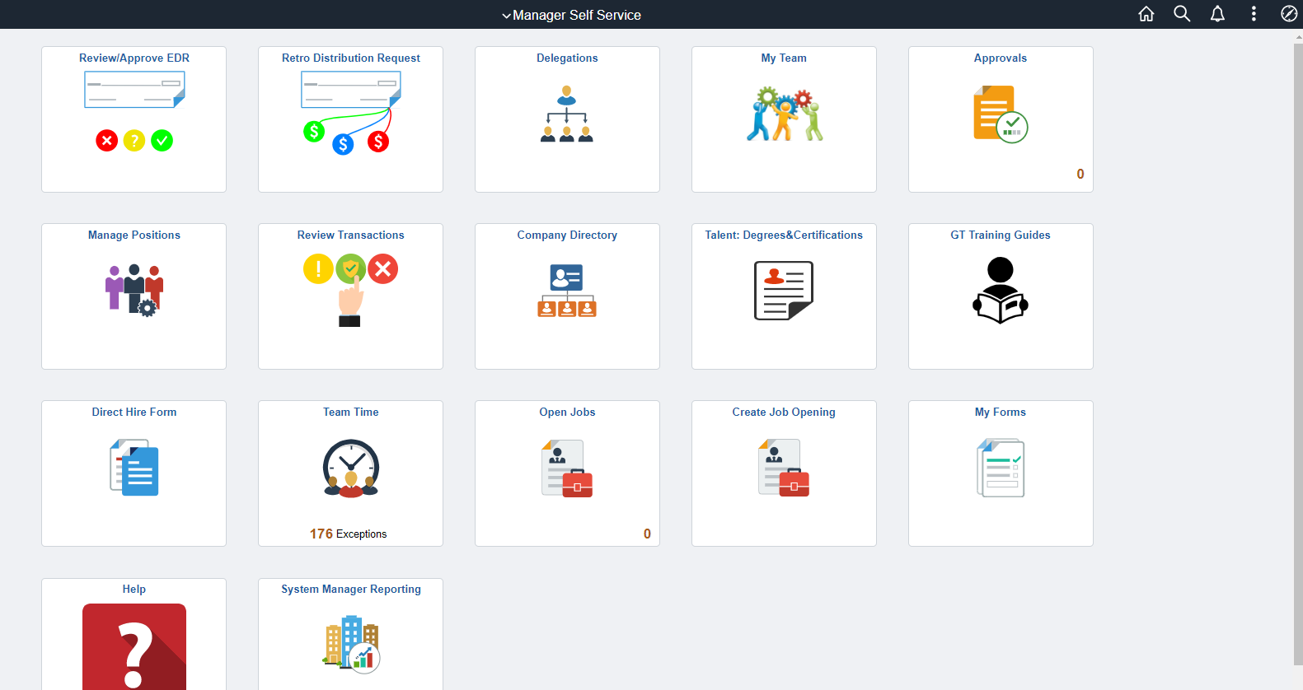
Navigate to Monthly Project Detail
Notes:
Below are scripts from a recorded webinar session
Navigating to the project detail report is very similar to navigating to the invalid funding report. You would click the Employee Self-Service dropdown at the top, select Manager Self-Service, select a System Manager reporting tile.

Slide 49
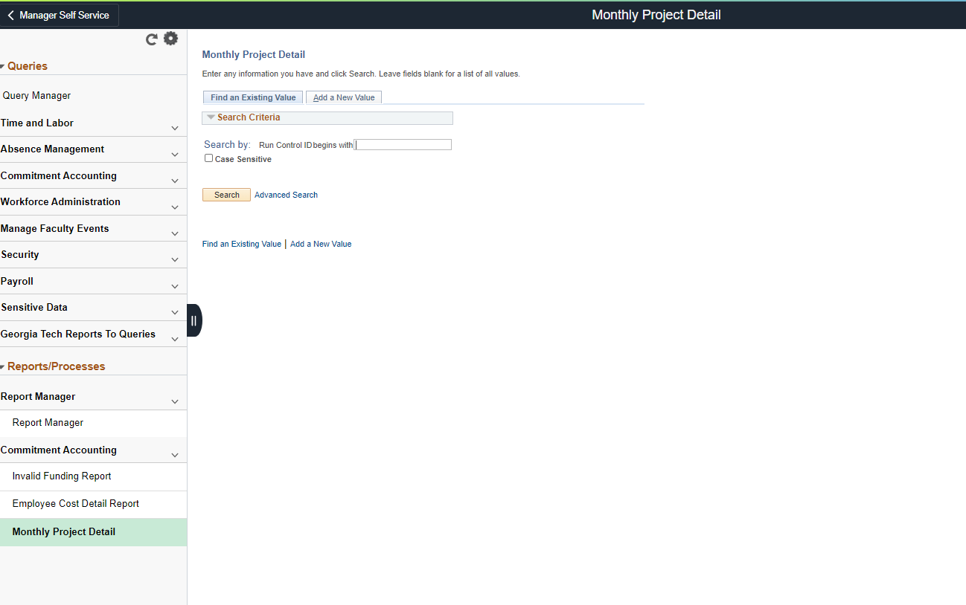
Navigate to Monthly Project Detail
Notes:
Below are scripts from a recorded webinar session
It takes you to the manager reporting work center, you select a monthly project detail link.

Slide 50
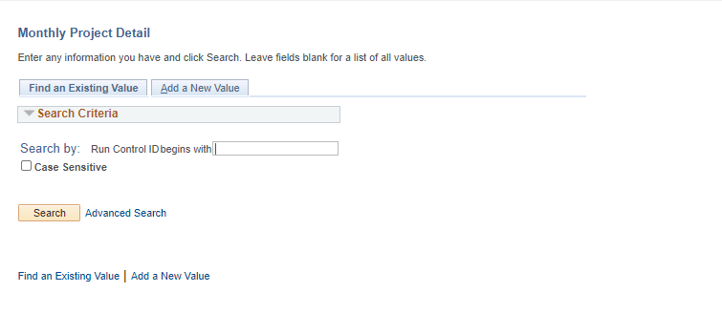
Monthly Project Detail
Select Search or Add a New Value to search for a Run Control ID to run the Monthly Project Detail.
Notes:
Below are scripts from a recorded webinar session
If this is your first time running a new report you would click 'add a new value', it takes you to the run control page once you enter in your run control, I usually use my first initial, last name of my initials, and then I click 'add', it takes you to the monthly project detail report screen for you to enter your parameters.

Slide 51
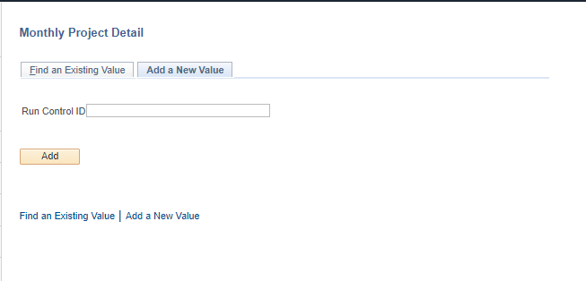
Monthly Project Detail
Populate the Run Control ID field.
To run the monthly project detailed report, use your fist initial and last name as the Run Control ID.
Notes:
Below are scripts from a recorded webinar session
The company again is 030, fiscal year should be 2020, please note that OneUSG will only have current fiscal year data going forward, if you need to run a project detail report for a prior fiscal year that has to be done in the old legacy SPD system.

Slide 52
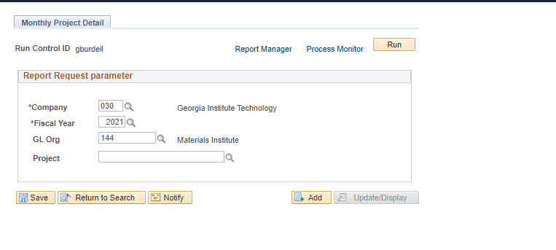
Monthly Project Detail
Populate the details in the Report Request Parameter with the all required fields:
Select Run for a list of available output options
Notes:
Below are scripts from a recorded webinar session
The company again is 030, fiscal year should be 2020, please note that OneUSG will only have current fiscal year data going forward, if you need to run a project detail report for a prior fiscal year that has to be done in the old legacy SPD system. Once you have all your criteria entered, you would click Run, it takes you to the Process Scheduler Requests Screen.

Slide 53
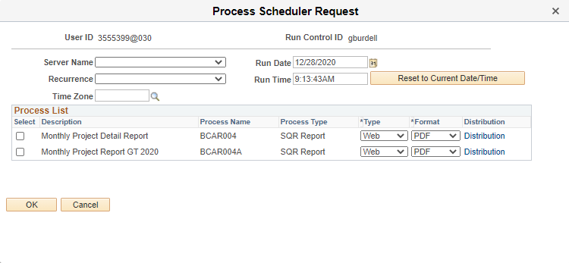
Monthly Project Detail
Notes:
Below are scripts from a recorded webinar session
Check all of your parameters here, if everything is good, you click OK, the report is generated in this processing so in order to view the report you click report manager.

Slide 54
Monthly Project Detail

Slide 55
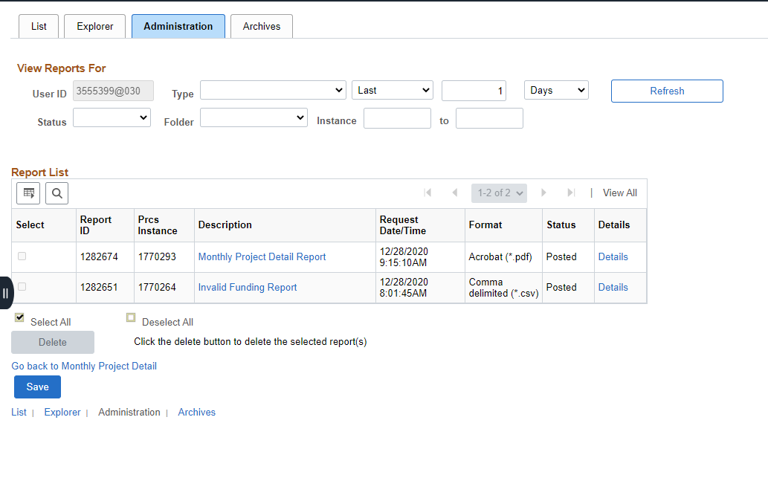
Monthly Project Detail
Notes:
Below are scripts from a recorded webinar session
Click on the administration tab, and then click your monthly project report link and it displays the report based on the format you selected.

Slide 56
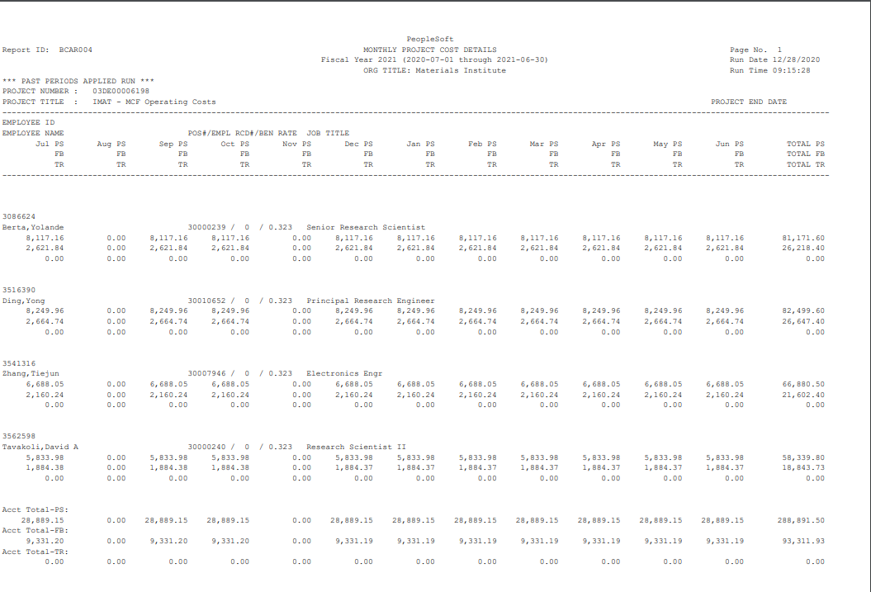
Monthly Project Detail

Slide 57
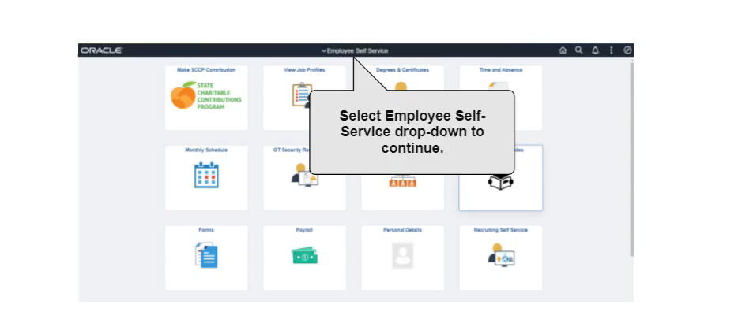

Demonstration-Monthly Project Detail

Slide 58
Employee Cost Detail Report

Slide 59
Employee Cost Detail
The report can be run for one employee by entering the employee ID# or for multiple employees by leaving the employee ID # blank ​
Can be run for all paid employees, specific employees, Undergraduate and Graduate employees​
Report updated with pending EDR transaction.​
EDR denied report reverts back to original distribution ​
A CURRENT Employee Cost Detail report is required to be attached on all EDR transactions (within the same period)
Notes:
Reports should be in the System Manager Reporting; CA on left with drop down. You can also get here through the navigator
Below are scripts from a recorded webinar session
The employee costs detail report: this report can be run by GL ORG or department, in OneUSG, there's only one department which is a home department so the GL ORG or the department will be the same in OneUSG, this report can be run for one employee at a time or multiple employees at a time, it can be run for all paid employees, specific employees, graduate students, undergrad students, staff, just depends on your needs for this report.

Slide 60
Navigate to Employee Cost Detail
Notes:
Below are scripts from a recorded webinar session
The navigation is very similar to the previous two reports, navigate to the Manager Self Service page, click the system manager reporting tile.

Slide 61
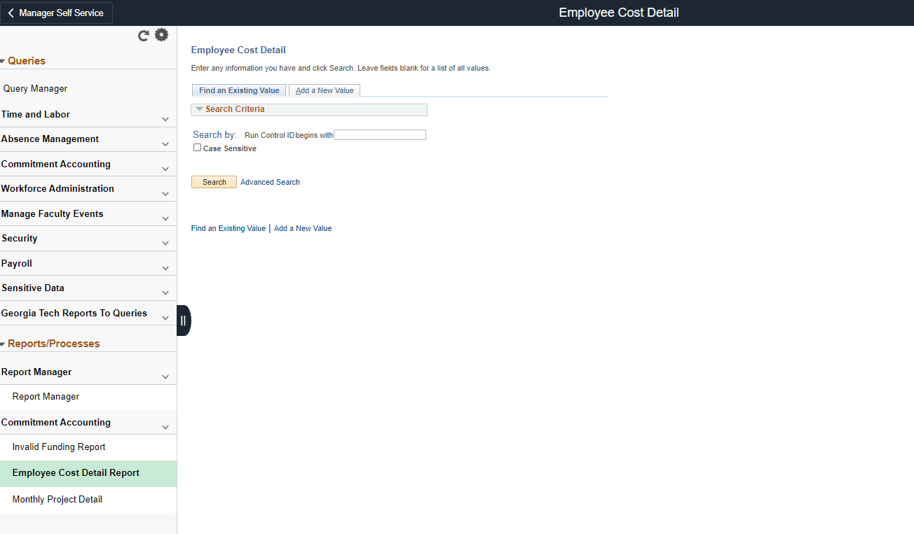
Employee Cost Detail
Notes:
Below are scripts from a recorded webinar session
It takes you to the reporting work center, you select employee cost detail report, by now you should have a run control set up, but if not, you click 'add' to add your run control ID, once you have that, it takes you to the report request parameters page.

Slide 62
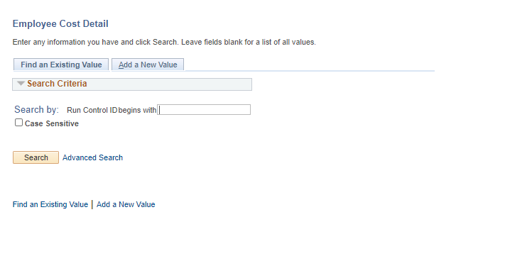
Employee Cost Detail
Select Search or Add a New Value to search for a Run Control ID to run the Employee Cost Detail.

Slide 63
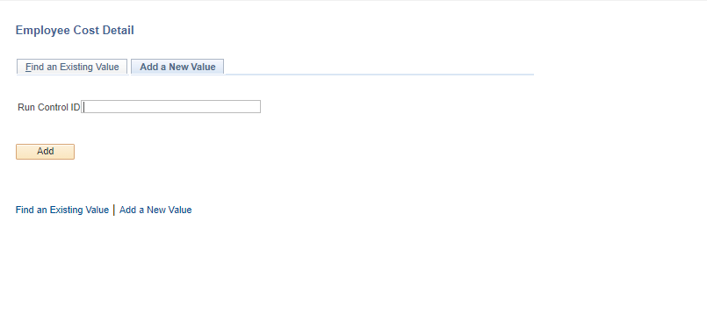
Employee Cost Detail
Populate the Run Control ID field.
To run the monthly project detailed report, use your fist initial and last name as the Run Control ID.

Slide 64
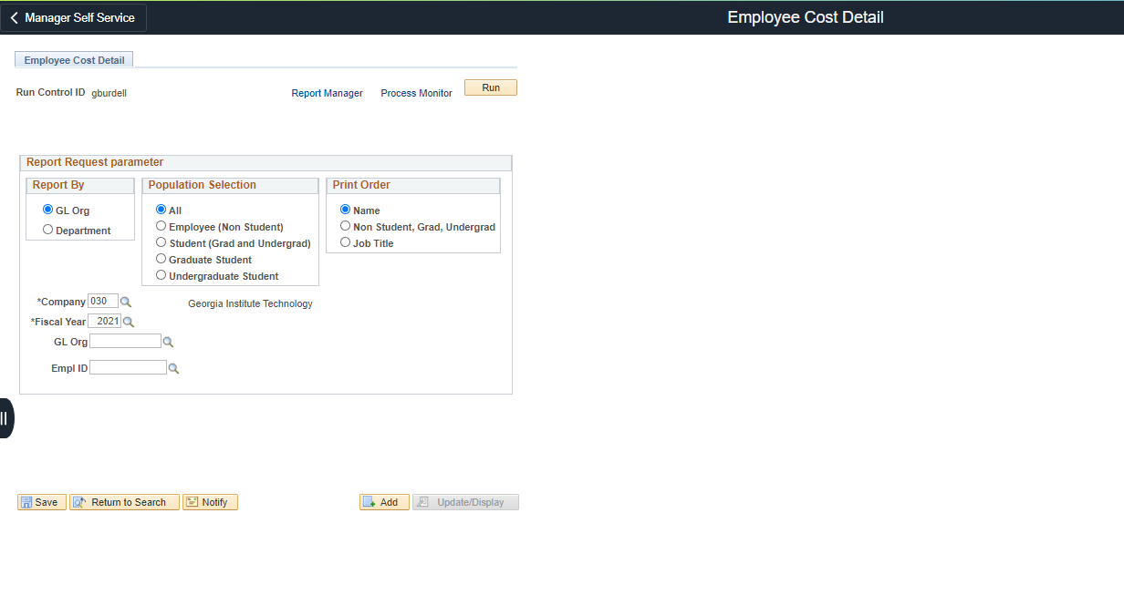
Employee Cost Detail
Notes:
Below are scripts from a recorded webinar session
you can enter your parameters here, where you can select report by GL ORG or department that shouldn't matter, they're both the same. You select your population selection, this is where you would select employees or non-students, grad students, undergrad students, I recommend leaving it set to 'all' and in that way you shouldn't get any errors when trying to run a report, and you could also select the 'print order', I prefer sorting by name but some users prefer sorting by job title, for instance, they want to see all the grad students together and all of their professors together, and then once you have your company, fiscal year, GL Org, employee ID selected, or if you need to run this report for multiple employees you would leave employee ID blank, once you have your parameters selected, you would select 'Run'.

Slide 65
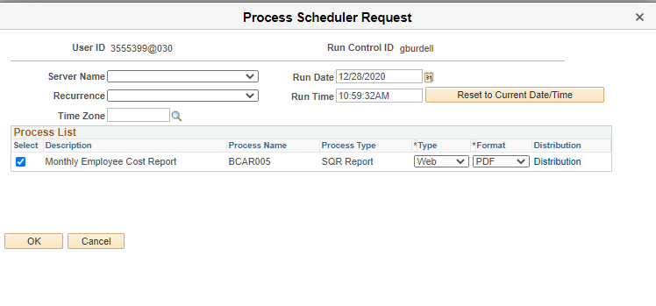
Employee Cost Detail
Notes:
Below are scripts from a recorded webinar session
That brings up the 'process scheduler requests' page, make sure everything is OK here, then you click OK to kick the report off and takes you back to the 'employer cost detail report screen'

Slide 66
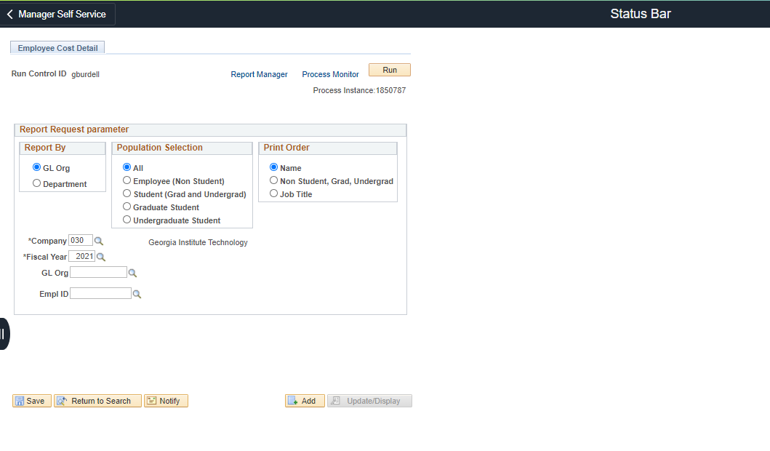
Employee Cost Detail
Notes:
Below are scripts from a recorded webinar session
Select Report manager and it takes you to the status page.

Slide 67
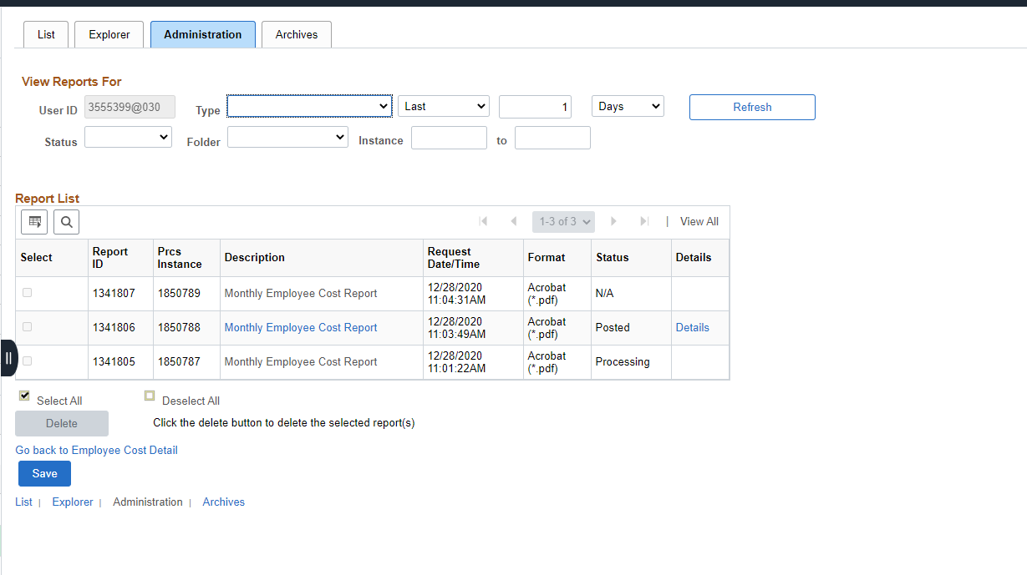
Employee Cost Detail
Notes:
Below are scripts from a recorded webinar session
Select the administration tab.

Slide 68
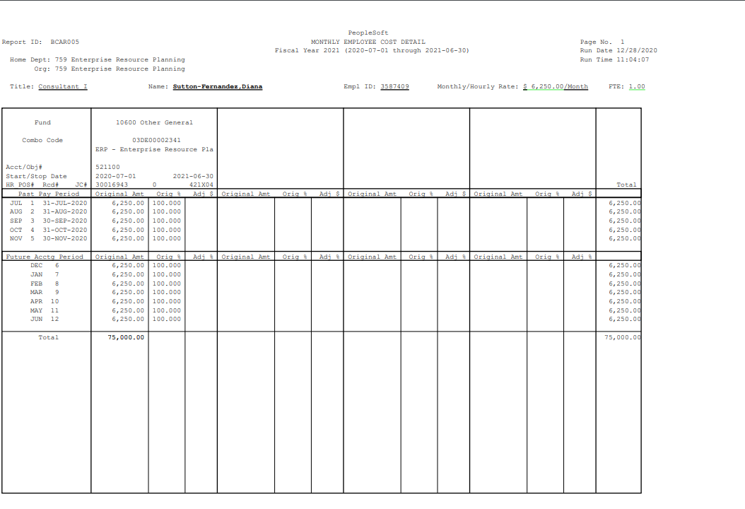
Employee Cost Detail

Slide 69
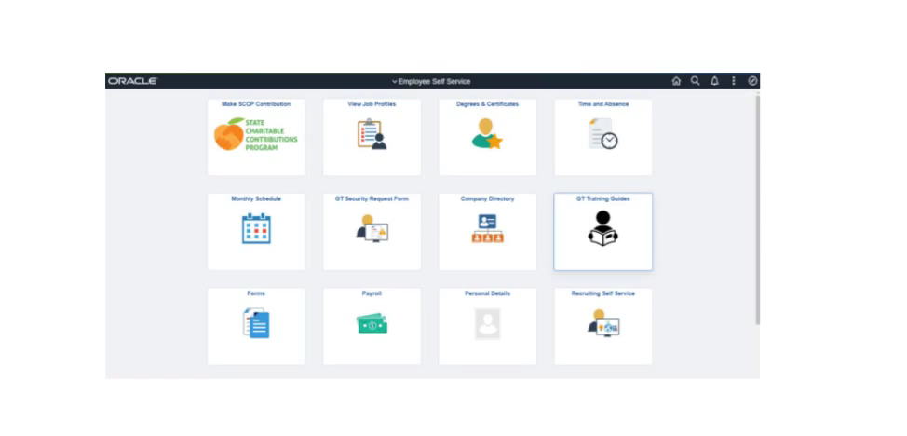
Demo- Employee Cost Detail Report

Slide 70
Other Reports

Slide 71
Undesignated Sponsored Justification Report
Aged report that displays expenditures and encumbrances allocated to undesignated sponsored work tags
Can be run in summary which shows totals
Can also be run in detail which includes employee information
lite.gatech.edu

Slide 72
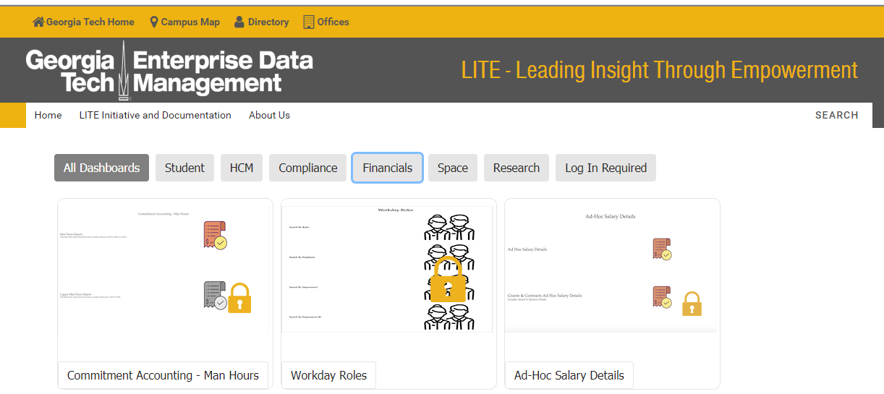
Demo – Undesignated Sponsored Justification

Slide 73
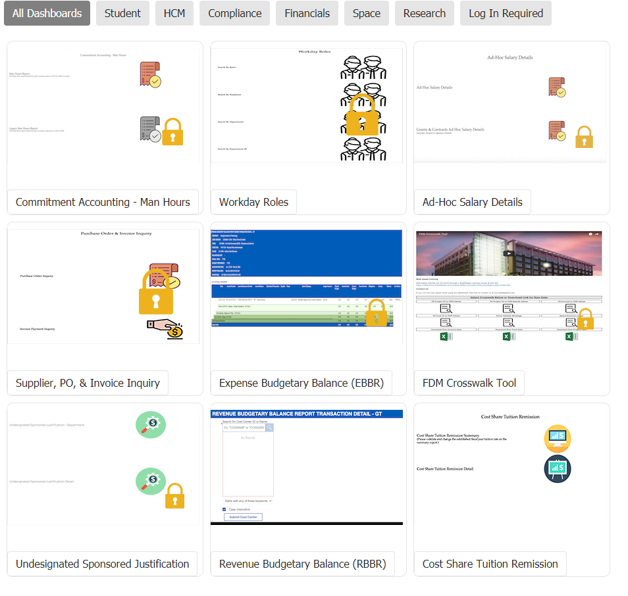
Undesignated Sponsored Justification Report

Slide 74
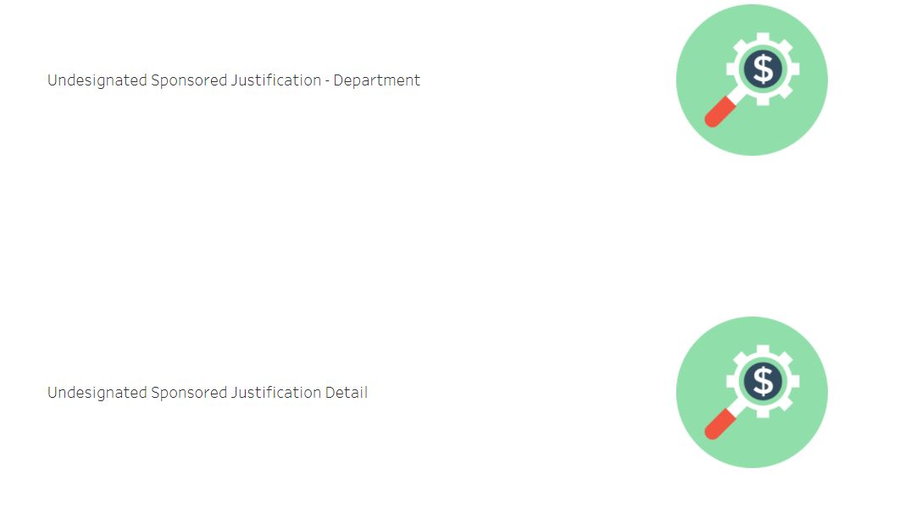
Undesignated Sponsored Justification Report: Department and Detail
Notes:
Kim

Slide 75
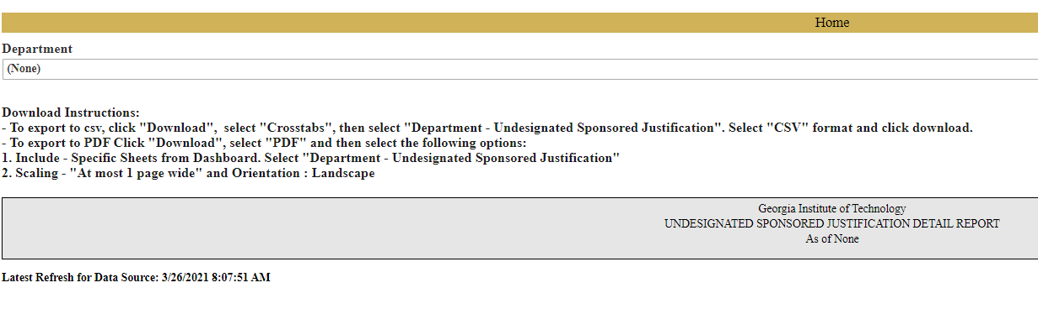
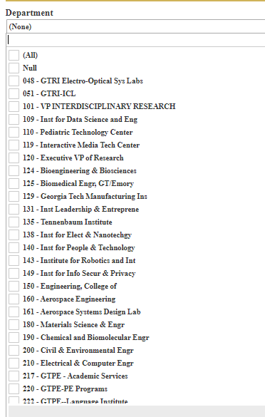
Undesignated Sponsored Justification: Department
Notes:
Kim

Slide 76
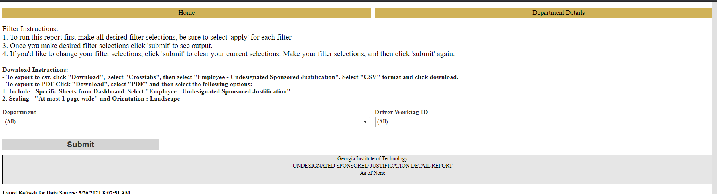
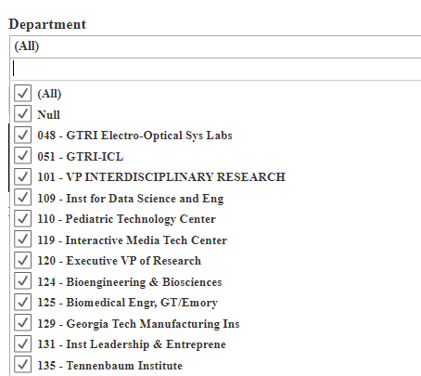
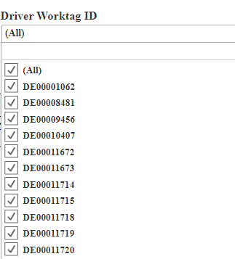
Undesignated Sponsored Justification: Detail
Notes:
Kim

Slide 77
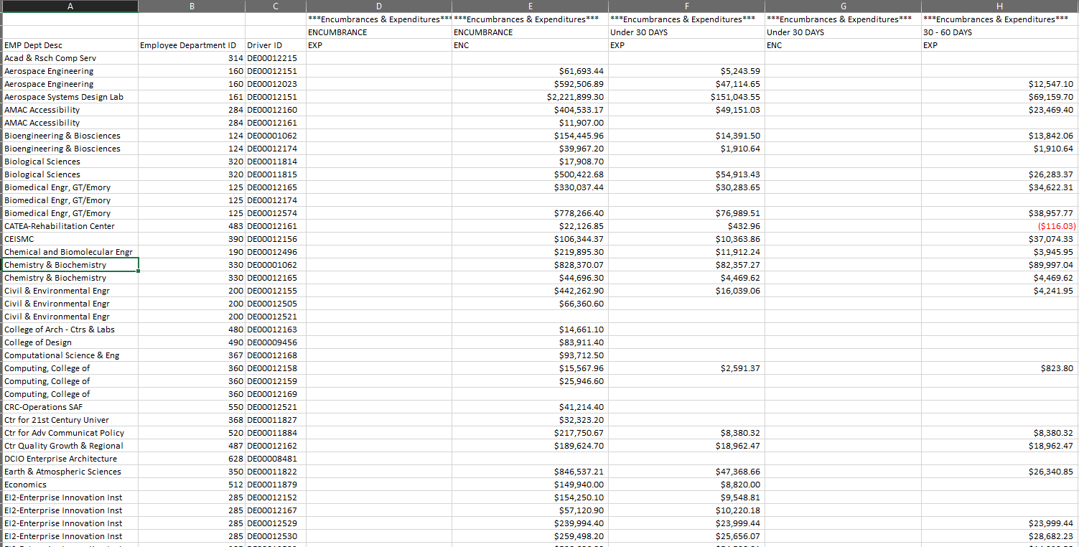
Undesignated Sponsored Justification Report

Slide 78
Ad Hoc Salary Detail Lite Report
Similar to running the USG reports.
Displays salary information by cost center, HR department, worktag, or employee.
Run by journal date or paycheck date.
lite.gatech.edu

Slide 79
Demo – Ad Hoc Salary Details Report

Slide 80
Ad Hoc Salary Details Report

Slide 81
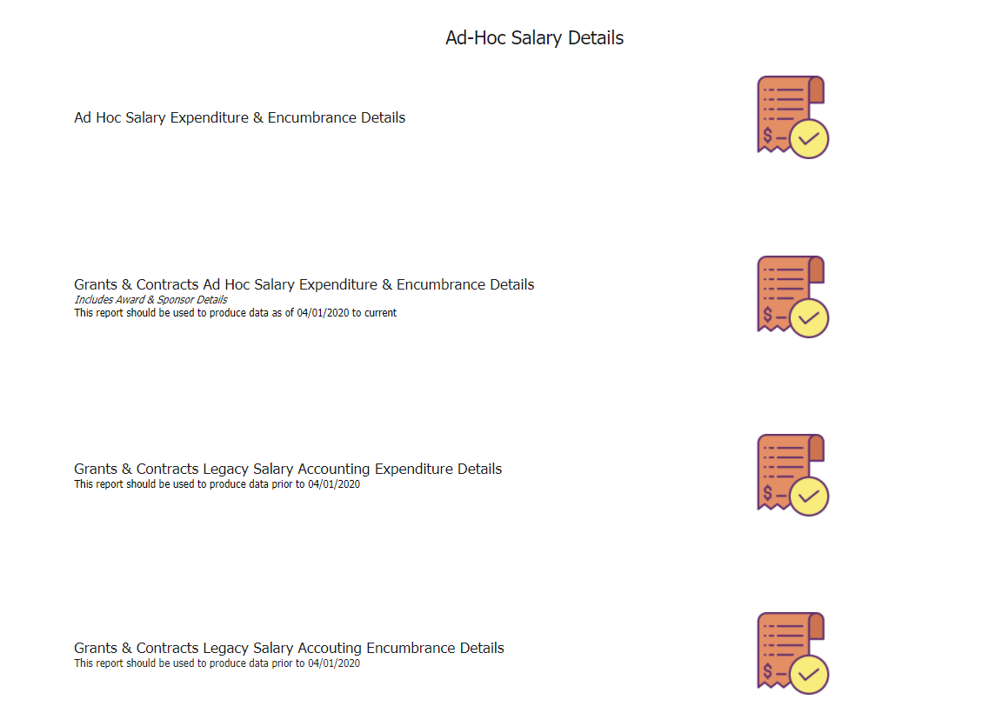
Ad-Hoc Salary Expenditure and Encumbrance Details
Notes:
Kim

Slide 82
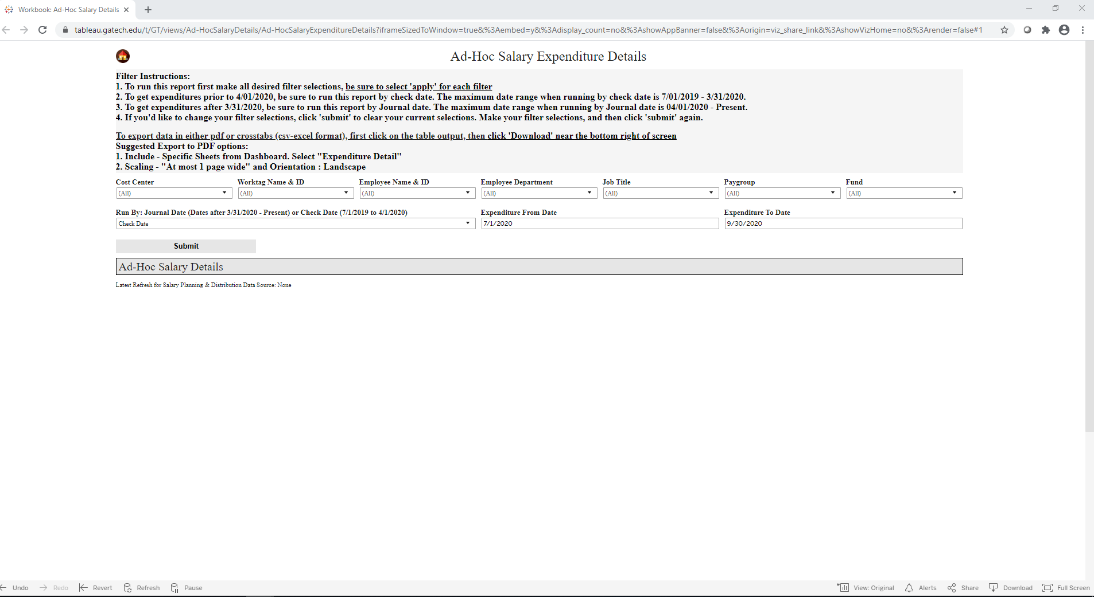
Ad Hoc Salary Detail Lite Report

Slide 83
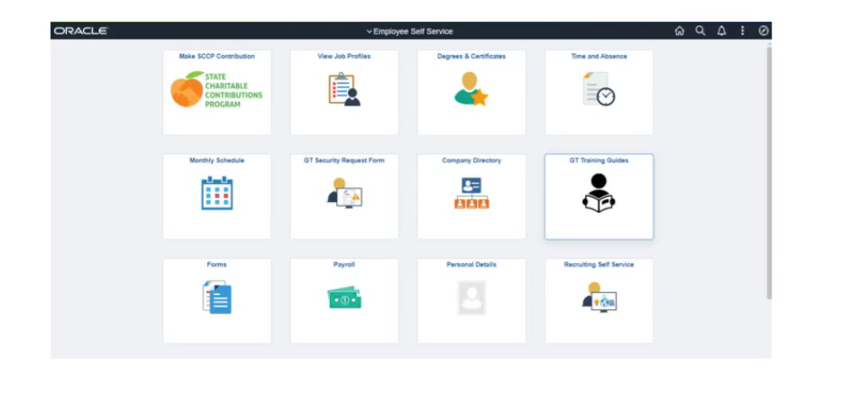
Demo-Change Position Funding
Notes:
Jana

Slide 84
Demo- Employee Cost Detail Report

Slide 85
Workday Grants Reporting
Amy Zhang
ERP Application Support Analyst II

Slide 86
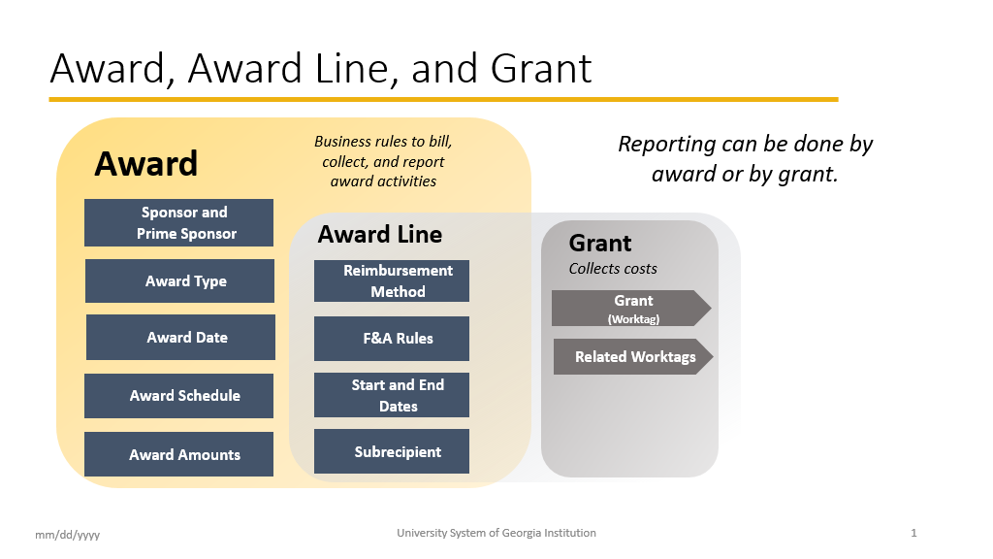

Slide 87
SPONSORED AWARD BUDGET EXPENSE REPORT (SABER)
Type of Reports:
SABER
SABER BY OBJECT CLASS
SABER BY AWARD (NEW)

Slide 88
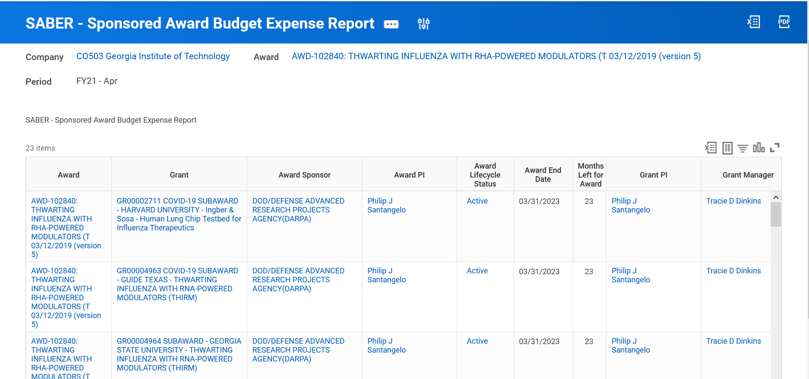
What are the differences
The Sponsored Award Budget Expense Report (SABER) displays award real-time budgets, spend, and remaining balances. You can drill down into transactions originated in Workday including supplier invoices, expense reports, purchase orders, requisitions, and accounting journals, and summarize grant costs by object class (cost category), cost center, and more.

Slide 89
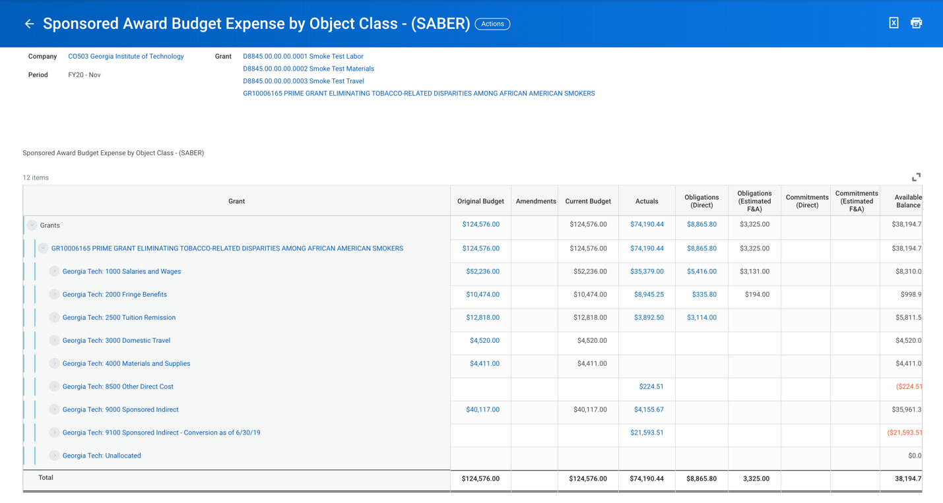
What are the differences
SABER BY OBJECT CLASS is a different presentation of the same report as SABER
Both reports are organized by Grant, but SABER by Object Class allows you to drill down immediately into object classes by Grant.

Slide 90
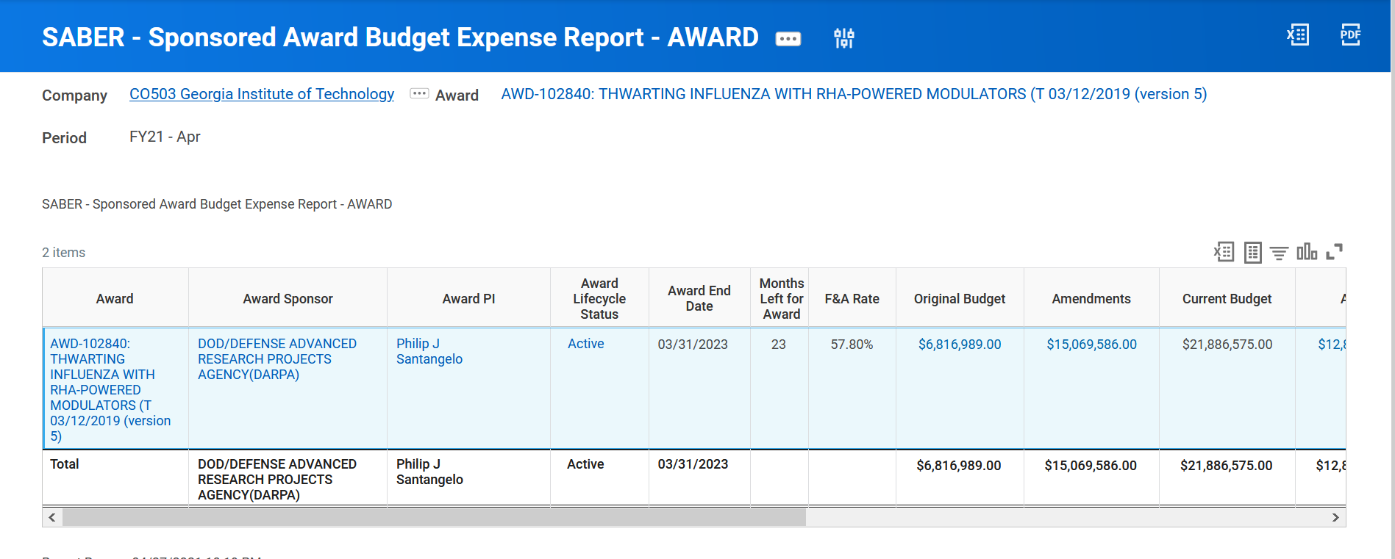
What are the differences
SABER BY AWARD (NEW) provides capability to quickly summarize Award costs by object class (cost category), cost center, and more.

Slide 91
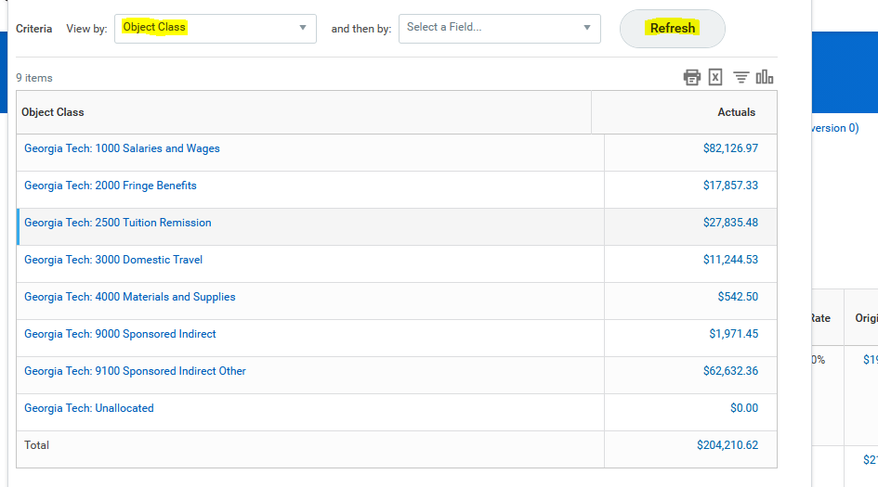
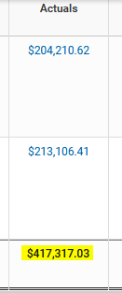
Drill Down for Detail
Drill down on total for Award and/or Grant and view by Object Class and refresh

Slide 92
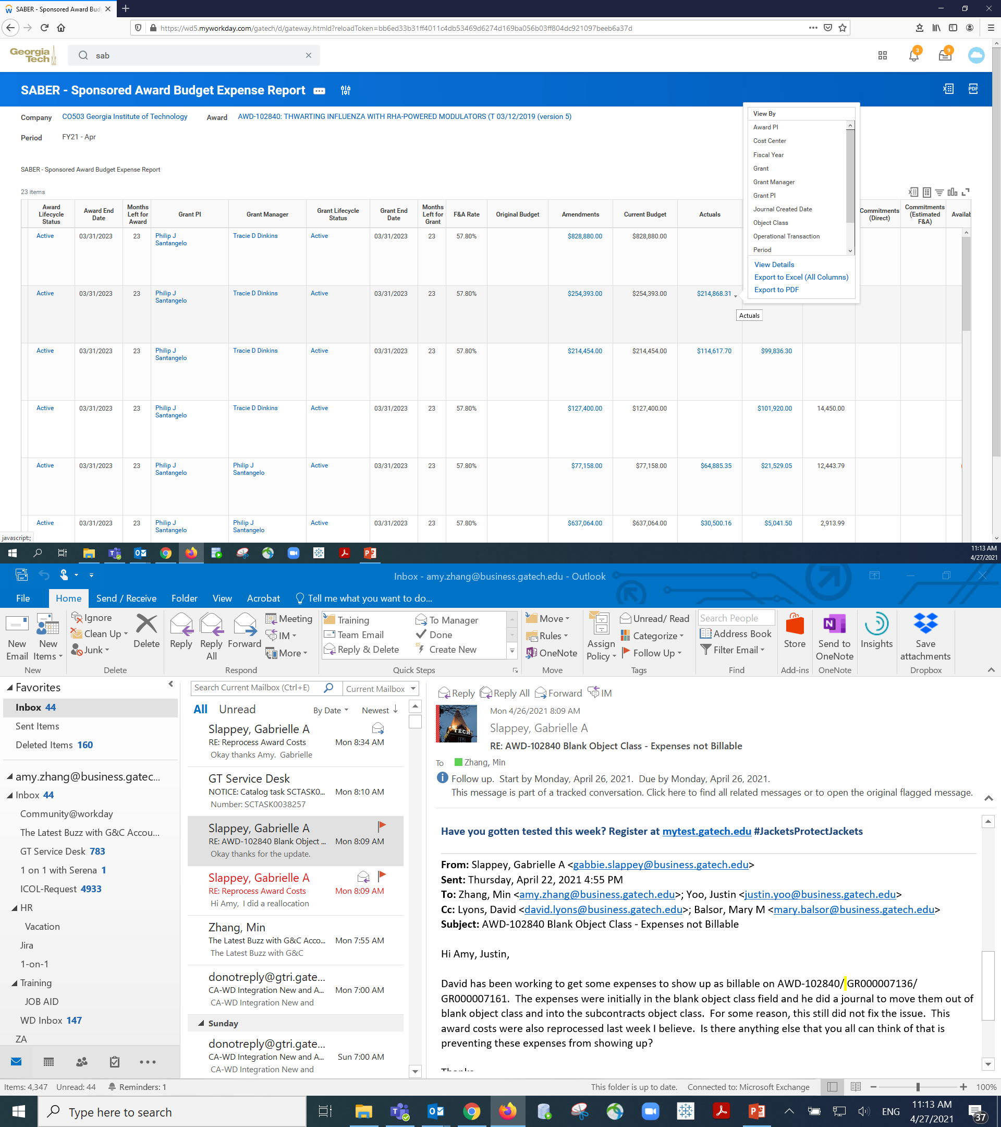
Drill Down for Detail
  Move your cursor next to the number until you see the triangle and left click your mouse. You will see the pop up menu.

Slide 93
TIPS AND TRICKS
  https://www.grants.gatech.edu/sites/default/files/images/the_latest_buzz_mar25.pptx
  Question: How do I view actuals for a specific period of time?
  Answer: Use the Budgets & Actuals On or After and Budgets & Actuals On or Before criteria
Question: How do I view just the Sponsored portion of my Award, not the cost share (vice versa)?
Answer: Use the Grant Hierarchy field to filter.
Question: How do I save a filter if I want to view the same criteria on a regular basis?
Answer: Enter Criteria, Create filter name, and Save filter
Question: How do I modify filters?
Answer: You can select Manage Filters and then edit your filter.
Question: Can I create multiple filters?
Answer: Yes, you must create unique filter name. All filters will
display in the drop down.

Slide 94
Rob Roy, CRA
Director of BOR Sponsored Operations

Slide 95
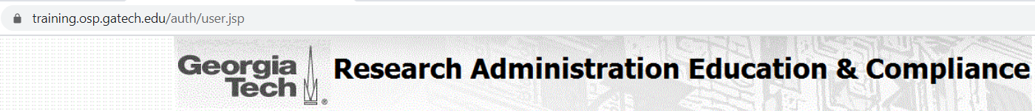
Upcoming Research Administration Trainings
May Training Classes:
5/11 (Tuesday) - Pre-Award Part 2 from 12:30pm - 3:00pm
5/12 (Wednesday) - 2 CFR 200 Workshop from 9:00am - 4:00pm
5/13 (Thursday) - Pre-Award Part 1 from 9:30am - 12:00pm
5/18 (Tuesday) - Post-Award & Compliance Part 2 from 12:30pm - 3:00pm
5/19 (Wednesday) - GT Basic Certification Workshop from 9:30am - 12:30pm
5/19 (Wednesday) - Finding Funding and Submission Process from 7:00pm - 8:00pm
5/20 (Thursday) - Post-Award & Compliance Part 1 from 9:30am - 12:00pm
5/21 (Friday) - NSF CAREER Panel Discussion from 10:00am - 12:00pm
CRA Study Group (10 week session) Friday's between 12:30pm-2pm
Next series starts August 27th (skips Sept 3rd) and ends November 5th

Slide 96

The Latest Buzz with G&C Accounting
GRANTS.GATECH.EDU

Slide 97

GRANTS.GATECH.EDU

