Slide 1

Service Centers for CRA Study Group
Jonathon Jeffries, CPA
Director, Cost Accounting
Office of Grants & Contracts Accounting
Fall 2021

Slide 2
Overview
What is a Service Center?*
Types of Service Center *
What are the Regulations and Requirements to be Considered?*
When Should a Service Center be Established?*
How to get Started?
Determining Charge Rates *
Service Center Operating Procedures
Annual Rate Validation Procedures

Slide 3
What is a Service Center?
Service Centers are separately budgeted, self-supporting operating units established to provide specialized types of services and/or supplies to users (Internal, Federal, External):
  Required for research projects managed by multiple users.
  Charge Rates are established to recover allowable costs from users in order to fund the operations of the service center.
  Service Center Charge rates can include both direct and an allocable share of Facilities & Administrative (F&A or Indirect) costs.
  Each center is responsible for the management of its service activities, including work required to establish user fees.

Slide 4
Types of Service Centers
Specialized service facilities
  (Highly complex or technical)
    Animal Care Facility
    Clean room
University-Wide recharge centers
  (Managed by Central)
    Facilities Management
    Copy/Printing Center
    Partnership for an Advanced Computing Environment
Departmental recharge centers
  (Operated by a department)
    Machine Shop
    High-Throughput
    Organic Molecular Chemistry Lab

Slide 5
Regulations & Requirements
Service Center Policies and Procedures should be established to incorporate :
  Institution policies and procedures
  G&C Notice
  State regulations
  OMB 2 CFR 200
  CAS Best Practices Manual for IHE
  OMB 2 CFR 200.413 Direct Costs
  General. Direct costs are those costs that can be identified specifically with a particular Federal award with a high degree of accuracy.
  Federal Awards. The cost of materials supplied from stock or services rendered by specialized facilities may be included as direct costs of Federal awards.

Slide 6
Regulations & Requirements
Excerpts from: OMB 2 CFR 200.468 Specialized Service Facilities
.468 (a) The cost of services provided by highly complex or specialized facilities operated by the non-Federal entity, such as computing facilities, wind tunnels, and reactors are allowable, provided the charges for the services meet the conditions of either paragraphs (b) or (c) of this section...
.468 (b) The cost of such services, when material, must be charged directly to applicable awards based on actual usage of the services on the basis of a schedule of rates or established methodology that:
    (1) Does not discriminate between activities under Federal awards and other activities of the non-Federal entity, including usage by the non-Federal entity for internal purposes, and
    (2) Is designed to recover only the aggregate costs of the services.

Slide 7
Regulations & Requirements
OMB 2 CFR 200.468 Specialized Service Facilities (cont’d)
.468 (c) Where the costs incurred for a service are not material, they may be allocated as indirect (F&A) costs.
  Document these centers and the circumstances.
.468 (d). Under some extraordinary circumstances, where it is in the best interest of the Federal Government and the non-Federal entity to establish alternative costing arrangements, such arrangements may be worked out with the Federal cognizant agency for indirect costs.
  Review operations and consider this option if appropriate.
Other Federal Requirements
Rates for Service Centers are subject to review and approval by the institutions cognizant agency and audit agency
  i.e. Georgia Tech’s are Office of Naval Research (ONR) and the Defense Contract Audit Agency (DCAA)

Slide 8
When Should a Service Center be Established?
Examples of instances when consideration should be given to the establishment of a Service Center are listed below:
  Your department purchases an expensive piece of equipment with significant operating costs that will be used by representatives of your department and representatives of other departments.
  Your department plans to initiate the operation of a special services laboratory staffed with high-cost technicians and support personnel that will be used by various members of your department for sponsored activities as well as instructional activities.

Slide 9
When Should a Service Center be Established?
Examples of instances when consideration should be given to the establishment of a Service Center are listed below (cont’d):
  If your department has an existing special services laboratory that previously served faculty members in your department for instructional purposes, a change in costing practices is required when:
    The laboratory begins to be used by faculty members to support sponsored research projects, and/or
    The laboratory begins to be used by faculty members from other departments or units to support sponsored research projects.

Slide 10
When Should a Service Center be Established?
Examples of instances when consideration should be given to the establishment of a Service Center are listed below (cont’d):
  A member of your faculty tells you that he wants to charge Professor Smith in another department for use of his laboratory and staff.
    This type of request needs to be studied to determine if a Service Center should be established, and if so, the type of Service Center to be established.

Slide 11
How to get Started?
Service/Recharge Center Questionnaire
  Purpose of Service/Recharge Center _____________________
  Brief description of each service (whether billed for or not) of the Center. _____________________________________________
  What units of measure are used as a billing base (hour, day, procedure, mileage, etc.)?
  How many units of measure (hour, day, procedure, mileage, percent, etc.) will be processed during the current fiscal year?

Slide 12
Determining Charge Rates
Procedure – Service Center Rate Studies and Charge Rates
At Georgia Tech, the Cost Accounting group of the Office of Grants & Contracts Accounting is responsible for the development of Service Center Rate Studies based on information provided by the Service Center managers and financial officers.
General Guidelines
  Service Center Rate studies are scheduled on an annual basis, but rates can be used for multiple years when acceptable.
  Charge rates are based on actual activity and actual costs incurred, or projected costs that are based on the most recently completed fiscal year.
  Charge rates are not based on what others charge for similar services.

Slide 13
Determining Charge Rates
Procedure – Service Center Rate Studies and Billing Rates
General Guidelines (Continued)
  New or expanded services must be approved to operate as part of an existing Service Center
  Rates can be changed at any time during the year provided a revised rate study is prepared and approved for use.
  All rates must be applied consistently to both federal and non-federal users.
  Federal users must get the lowest rate.
  If preferential rates or free services are provided to some users (usually in the home department), rate calculations are to be based on full charge rates, and the resulting under recovery must be subsidized by departmental funds.

Slide 14
Determining Charge Rates
Procedure – Service Center Rate Studies and Billing Rates
B. Determining Service Center Revenues
  Projected revenue for Service Centers should be based on documented utilization of the service center from the prior period, if available, and a justification of the selected new utilization base.
  Charge Rates should be developed for each significant function or type of service provided.
  Service Center records are to document the amount of services provided for each function and type of service. (Track user data)

Slide 15
Determining Charge Rates
Procedure – Service Center Rate Studies and Billing Rates
C. Determining Service Center Operating Costs
  Projected Service Center operating costs should include only those direct and F&A (Indirect) costs which are directly allocable to the activity;
    Allowable under Georgia Tech, State and Federal regulations;
    Reasonable in relation to the service performed; and
    Depreciation of equipment and facilities used directly by the activity
  Only charges for actual cost should be included. No charges for profit are authorized.
  No charges to generate surpluses for future periods are allowed.
  No charges for any item provided by the Federal government are allowed.

Slide 16
Determining Charge Rates
Procedure – Service Center Rate Studies and Billing Rates
C. Determining Service Center Operating Costs (cont’d)
  Direct Costs include all labor, fringe benefits, materials and supplies, and services which can be identified as directly benefiting the Center.
  F&A (Indirect) Costs include equipment depreciation by specific item, facility depreciation for net square footage occupied, facilities maintenance costs based on the prior year, and departmental administrative costs, if appropriate.

Slide 17

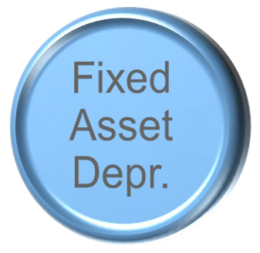



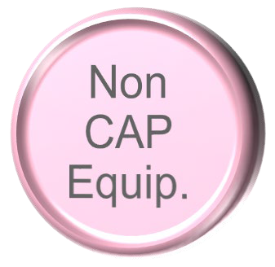


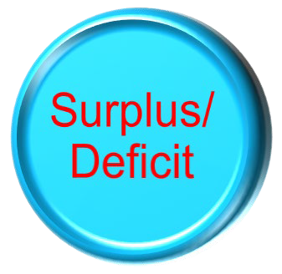

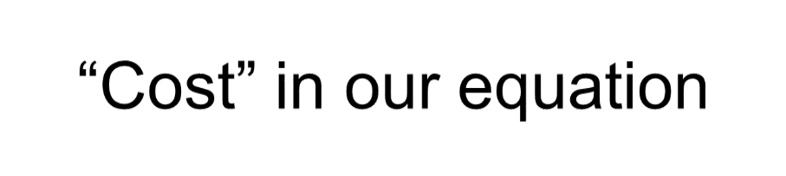
Determining Charge Rates
Procedure – Service Center Rate Studies and Billing Rates
C. Determining Service Center Operating Costs (cont’d)

Slide 18
Determining Charge Rates
Procedure – Service Center Rate Studies and Billing Rates
D. Over/Under Recovery of Costs
  Service Center charge rates can recognize adjustments to costs for any over/under-recovery of costs from prior years.
  A five-year cycle is considered an appropriate time period for a Service Center to operate at no better than break-even.
  Operating cost subsidies - When departments subsidize a portion of the operating costs by charging related personnel and/or expenses to unrestricted funds in the unit, these costs should be recognized in the charge rate calculation.

Slide 19
Determining Charge Rates
Procedure – Service Center Rate Studies and Billing Rates
E. Service Center Charge Rates
  Service Center Charge Rates normally become effective July 1 of the subsequent year.
  Prior to the cognizant agency’s approval, if required, rates utilized will be considered provisional until amended.
  All work sheets and documents supporting rate calculations should be retained for audit.

Slide 20
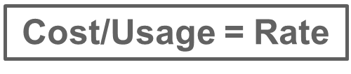

Determining Charge Rates
Procedure – Service Center Rate Studies and Billing Rates
Basic Equation:
Direct Operating Costs:
Labor (Salary + Fringe)
Direct Operating Costs:
Non-Labor Costs (supplies, maintenance contracts, etc. )
F&A (Indirect) Costs:
(equipment & building depreciation + Plant Maintenance)
+/- Prior-year balance
÷ Projected # of Goods or Services Sold
= “Calculated” Rate per Unit
(may not be the same as the Actual Recharge Rate)

Slide 21
Determining Charge Rates
EXAMPLE 1: Machine Shop
Service
Center
-
Rate
Calculation
%
FTE
on
Base
Projected
Projected
Service
Total
Center
Staff Assist
Machine
Salaries
Increase
Salaries
Center
Expenses
Rate
Rate
Personnel
Expenses:
Salaries/Wages:
Manager (at 100% of base salary)
$
60,000
3%
$
61,800
100%
$
61,800
$
54,546
$
7,254
Technician
(at
60%
of
base
salary)
50,000
3%
51,500
60%
30,900
28,804
2,096
Total
Salaries
&
Wages
$
110,000
$
113,300
$
92,700
$
83,350
$
9,350
Fringe
Benefits
(S&W
Center
Expenses
at
34.0%
Rate)
34%
$
31,518
$
28,339
$
3,179
Non
-
Personnel
Expenses:
Materials and
Supplies
1,500
1,500
Maintenance
contract
2,000
2,000
Equipment
(non
-
capitalized)
9,000
9,000
Security
software
-
licensing
and
software
(non
-
capitalized)
30,000
30,000
Equipment
Depreciation
40,000
40,000
(Over)
Under
Recovery
(50,000)
(41,000)
(9,000)
Total
Operating
Expenses
$
156,718
$
70,689
$
86,029
Base:
Billable
Staff
Assist
Hours
2,547
Billable
Machine
Hours
2,934
Internal
Rates
$
27.75
$
29.32

Slide 22
Determining Charge Rates
EXAMPLE 2: Laboratory Copy Machine
Operating statistics from previous year:
Total actual copies made 07/2020 - 06/2021 |  | 287,300
Projected operating cost 07/2020 - 06/2021
Lease purchase of copier |  | 5,300.00
Maintenance Agreement |  | 4,400.00
Paper Legal size 50 reams @ 3.25 |  | 162.50
Paper Letter size 525 reams @ 2.60 |  | 1,365.00
Toner 12 cartridges @ 37.50 |  | 450.00
Developer 1 bottle 55.00 |  | 55.00
Fuser oil 2 bottles @16.50 |  | 33.00
Total Operating Costs |  | 11,765.50
Less over recovery from prior year |  | -1,200.00
Total Cost to be recovered |  | 10,565.50

Slide 23
Determining Charge Rates
EXAMPLE 2: Laboratory Copy Machine
Total Estimated Copies for Fiscal Year 2020 - 2021 = 287,300
Total Costs $10,565.50
--------------- ----------------- = $ 0.0368/copy
Total Copies 287,300

Slide 24
Operating Procedures
Service Center Unit Managers or Financial Officers are Responsible for:
Overall Responsibilities
  Preparation of annual Service Center Budget to assure that center is self-supporting.
  Preparation and maintenance of financial and operating records required to document Service Center activities, revenues and expenses as required for Rate Studies and Reviews.
  Participate in the preparation of Rate Studies that determine charge rates or inventory markup rates including interim rate adjustments, if needed.
  Completion of monthly financial reviews to assure that Service Center operations are operating according to budget.
Notes:
These are discussed in the context of Operating Procedures at Georgia Tech; however, these are also recommended best practices.

Slide 25
Operating Procedures
Service Center Unit Managers or Financial Officers are Responsible for:
Service Center Revenues
  Service Center Revenue are to be recorded to Service Center Revenue accounts established to account for center activities.
  Prepare and maintain records of goods and services requested, provided and invoiced.
  Document all charges by function and type of service provided (Track user data).
  Prepare and submit timely invoices for services rendered, at least monthly, with adequate documentation.
  Internal billings are to be invoiced to an account/project.
  External billings (at Georgia Tech they are handled by the Office of Industry Engagement).

Slide 26
Operating Procedures
Service Center Unit Managers or Financial Officers are Responsible for:
Service Center Operating Costs
  Direct expenses applicable to the service center are to be recorded to projects/accounts established for purposes of reporting and accounting for center activities.
  Expense Projects should be established and maintained to separately identify all Service Center Operating expenses.
  If required, a physical inventory of merchandise for resale should be maintained.
  Records of equipment used in service center activities are to be separately identified and maintained in accordance with the institution’s Capital Asset Accounting requirements.

Slide 27
Operating Procedures
Service Center Unit Managers or Financial Officers are Responsible for:
Service Center Financial Review
  Review of monthly revenue and expenditure financial statements for accuracy and completeness.
  Analyze monthly operating results to determine if revenue obtained using approved charge rates is adequate to recover costs.
  Consider adjustments to charge rates if actual revenue is not covering all allowable operating costs.
  Prepare Annual Rate Validation Form.
  Submit information in a timely manner.

Slide 28
Operating Procedures
OMB 2 CFR 200 Audit Procedures
When material charges are made from internal service, central service, pension, or similar activities or funds, the auditor should verify that the charges from these activities or funds are in accordance with the applicable cost principles.
The auditor should consider procedures, such as:
  Test working capital balances/refunds.
  Test that all users of services are billed in a consistent manner.
  Test that billing rates exclude unallowable costs, in accordance with applicable cost principles.
  Test that billing rates (or charges) are developed based on actual costs and were adjusted to eliminate profits.

Slide 29
Operating Procedures
Types of Problems Identified In Service Center Audits
Accumulation of surplus funds due to the lack of analysis of recoveries and adjustment of billing rates resulting in overcharges.
Not crediting recharge center accounts for earned interest on excess fund balances.
Improperly classified inventory that was not consumed as an operating expense.
Including surplus and deficits of recharge centers as an indirect expense in the calculation of indirect cost rates and overcharging federally sponsored projects.
Use of recharge center surplus funds for unrelated purposes.
Use of inequitable billing practices by charging inconsistent billing rates to users of computer services.

Slide 30
Operating Procedures
DHHS-OIG Audits of Recharge Centers
Suggestions developed from prior audits:
  Complete annual or bi-annual rate studies and adjust subsequent year rates for appropriate prior year over/under recoveries.
  If you have accumulated surplus balances, credit the account for earned interest.
  Use proper business practices related to identification of operating costs, including proper inventory accounting.
  Service/Recharge Center operations should be accounted for as Other Institutional Activities to avoid any recognition of gains or losses in the F&A rate calculation.
  Account for all service center utilization in the rate determination process to avoid inconsistent billing practices.

Slide 31
Annual Rate Validation
Service Center rates are validated periodically to ensure that charge rates were at or below cost during the prior period(s).
Accurate tracking and reporting (including detailed supporting documentation) for expenses and revenue entries is critical to the timely performance of service center rate validations.
Existing (previously approved) Service Center billing rates, where a significant amount of charges were posted to sponsored projects, will be suspended if this validation process is not completed in a timely fashion.
Notes:
At Georgia Tech, this validation work is scheduled and managed by the Office of Grants and Contracts Accounting with significant assistance from the responsible Center or Unit Financial Officer.

Slide 32
Annual Rate Validation
To complete the Annual Validation Procedures, the Service Center files need to be updated related to:
Service Center operations, location, and equipment to confirm that the approved rates determined by the latest Rate Study are still valid for use in charging for services.
Confirm that the Service Center is still operating, and/or if other significant changes have occurred in the Service Center’s operations.
To determine if Service Center revenues and expenditures match the original plans, space on the form is provided to identify the current year Service Center revenues by account and the Service Center operating costs by DSS Worktag.

Slide 33
Annual Rate Validation
Information Required for Annual Validation Forms
  Contact Information
  Revenues and Expenses:
    Enter the amount of actual operating revenue and expense
  Description of Operating Changes:
    Report any significant changes to the Service Center operations since the last Rate Study was performed
  Equipment Changes:
    Report any new equipment purchases and/or any equipment that has been removed from the Service Center operations.
  Location Changes:
    Report any changes to the Service Center location, including the addition or deletion of space in the same building.

Slide 34

QUESTIONS?
For more information regarding service centers please visit our Georgia Tech Policy Library via the following link:
http://policies.gatech.edu/cost-service-centers
If you have any additional questions please feel free to contact us by phone or email:
jonathon.jeffries@business.gatech.edu
Andrew.Chung@business.gatech.edu
servicecenter.ask-request@lists.gatech.edu

